Slide 1
Technical Focus Area 2 Smart Applications

Slide 2
Technical Focus area 2 Smart network-Intensive Applications: Scope and Introduction
An increasing number of scientific applications require extensive use of high-performance networks to access critical resources and expertise that are often geographically distributed. The deployment and execution of current network-intensive applications over today’s networks require heroic effort; network capabilities are often not exposed to developers, and when exposed, they are not used intelligently. Network resources are constantly changing due to the stochastic nature of networks, applications, and attacks; application developers and network operators have to constantly diagnose and repair network/application failures.
Network-Intensive Applications categories:
Science applications
Data movement (bulk and streaming)
Remote instrumentation
Distributed visualization
Operator-initiated applications
Network maintenance
Diagnostic applications
Network management applications
Users network query applications
Network status query
Network performance query
Network search query

Slide 3
Mark Elgan in 2013 on “smart applications”
Learn user context and preferences: By paying attention to our choices and behaviors, software learns to predict what we'll want.
Rely on artificial intelligence to make decisions. Algorithms enable software to discern between relevant and irrelevant incoming information.
Contact users to provide contextually relevant information: Rather than waiting for us to search for something, they can buzz our phones with answers to questions we haven't asked.
Act proactively. Instead of waiting for us to take action, they take action for us.
Automate tasks. Either users or the software can set up if-then commands like programmers do, and they can do so across different applications and services.
Communicate as the user. Software learns to know who you'll communicate with and what you'll say, then does it for you. To the recipient, it appears as though the message comes from you. When both parties are using software agents to communicate, it's just software talking to software.
Facilitate users' actions. Agents figure out what you'll want to do and get it ready for you. By pressing a single button, you can tell the system to do something that would otherwise be a multi-step process.
Act with agency on the user's behalf. Software does something for you without asking permission or informing you in advance.
Notes:
ComputerWorld

Slide 4
Smart network-intensive applications in science
What’s special about network-intensive applications?
Really big flows
What else?
What’s special about science?
Highly distributed and open infrastructure
Diverse and rapidly evolving applications and participation
Complex and often unusual devices
High ambition-to-budget ratio
Other important factors
Rapidly growing data volumes
Exascale computers
Increasing importance of cloud
Increasing importance of mobile
Experiment automation
Ever-more-challenging security environment

Slide 5
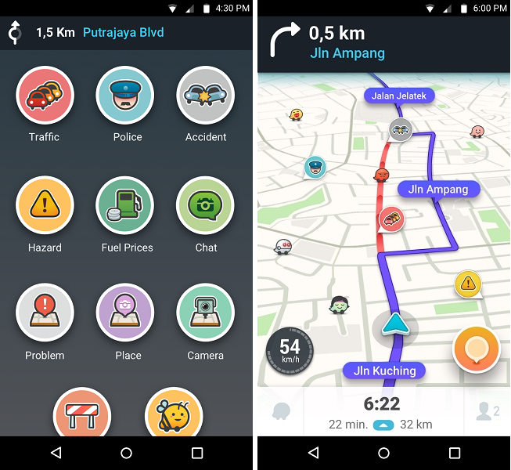
Analogies from vehicular transport: Google/Waze
Delivers higher-level services
Optimize for time or tolls
Choose car or train or bus
Route around accidents
Predict travel time for future trips
Supported by:
Sensors in roads
Location, speed, destination information from other users
User-inputted warnings
Notes:
An analogous data transfer application: Determine an ideal network path, provide transfer time estimates, and respond intelligently to failures?

Slide 6
Analogies from vehicular transport: Autonomous vehicle management
Optimize for various metrics:
Optimize aggregate throughput
Avoid accidents
Reduce pollution
Respond to events: e.g., congestion, accidents
Provide planning functions: e.g., evacuation
Secure
Supported by “smart roads”:
Sensors that deliver information required for effective autonomous management
Inter-vehicle signalling
Smart road-to-vehicle signalling
Support controls of e.g. traffic lights
Allow for incremental deployment and graceful degradation in capability
Notes:
An analogous smart science network management application would optimize network configurations and allocations to optimize aggregate performance, and proactively detect and respond to problems as or even before they arise.

Slide 7
Some examples of smart network-intensive applications in science
Flow-oriented applications:
Transfer this data from X to Y by time T
Ensure this flow has QoS Q
Tell me when this flow will complete
Distributed science intent:
Enable scientists A, B, and C to collaborate “securely, efficiently, and reliably” on data D [placement, network, perimeter configuration, ...]
Automated experiment system can meet goal of 1000 experiments per day across five institutions
For system operators:
Diagnose and correct performance and security problems
Explain current state of system and possible risk factors
Other:
Scientist S can engage effectively and securely with experiment as she transits work->car->home->hotel

Slide 8
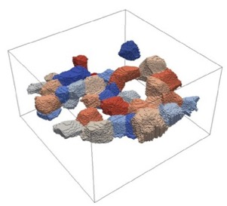
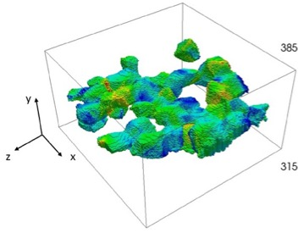
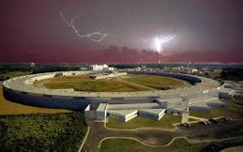
Light source beamline
Initialization
High fidelity
nf & ff HEDM,
μ-CT
Prior info on material’s mechanical behavior
Material properties experimental data
Param set
Param set
Calibration
Param set
Processing
Compression
μ-CT & HEDM data
Reconstruction
Initial FE mesh
Dynamic loading
Initial structure
Online μ-CT
μ-CT
data
Registration
Reconstruction
Object
Param set
Update
FE mesh
Param set
Preprocessing
Param set
Online ff-HEDM
Ensemble simulation
Diff. data
Preprocessing
Predicted state
Region of interest for zooming
Analysis
Validation
New scientific understanding
Sensitivity analysis
Validation of simulation
Full reconstruction of experiment
New experiments

Slide 9
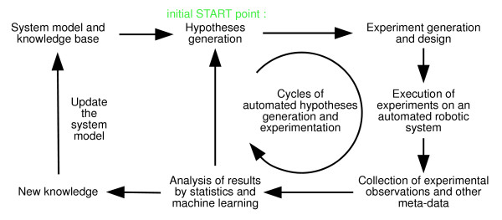
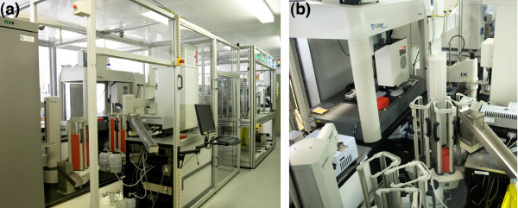
Smart applications: Automated distributed experiments

Slide 10
Smart network-intensive application architecture
Hard:
What we want:
Smart application
Smart application
Smart services
Dumb network
Smart-enabled network
We want smart services and a smart-enabled network to simplify application development.
What are smart services? What is a smart-enabled network?

Slide 11
Technical Focus Area 2 Smart network-intensive applications: Breakout questions
Can we create a taxonomy of smart network-intensive applications?
What are compelling examples of smart network-intensive applications that, if available within 10 years, would have transformative impact?
What are the major obstacles to realizing the various classes of smart applications?
What smart network capabilities do you believe can simplify the development of smart applications? Can we identify desirable smart services?

Slide 12
Reading materials provided by attendees

