Slide 1
Safety Awareness in Foreign Locations
Weiwei Zhang, Nathaniel Butler, Michael Lewis, and Brigitte Collins

Slide 2
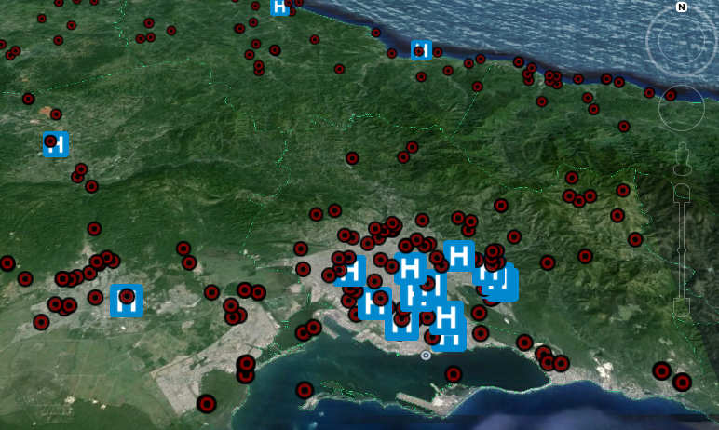

Slide 3
