Slide 1
Team Chromos
Alex Moreno
Keval Shah
Yuan Zhao

Slide 2
Problem Statement
Data sets from disparate sources often employ different formatting styles for the same variables. We propose the development of a tool for automatic detection of shared parameters and conversion into a common, compatible
format. This tool will support a large number of commonly measured variables, including timestamps and geographical location.

Slide 3
Solution
Two main capabilities:
data format parsing and conversion
(2) shared parameter extraction from multiple datasets.

Slide 4
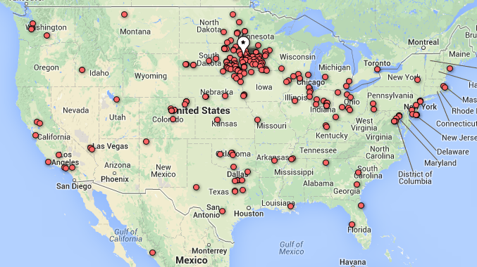
#Tornado Warning Tweet’s location

Slide 5
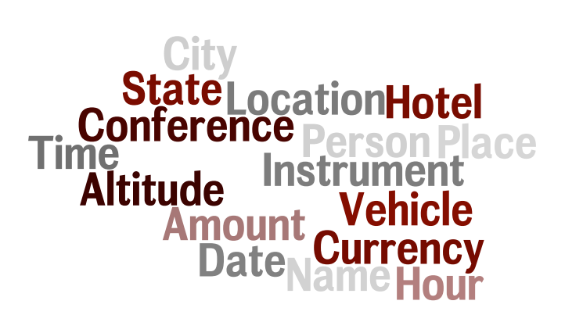
List of likely column names

