Slide 1
Organizing the Global Historical Climatology Network
Jill Hardy
Race Clark
Chris Natoli
William Matthews

Slide 2
Temperatures: averages, records, and everything in between
What is “normal”?
What is a “record”?
“Strong” and “weak” records
Climate change

Slide 3
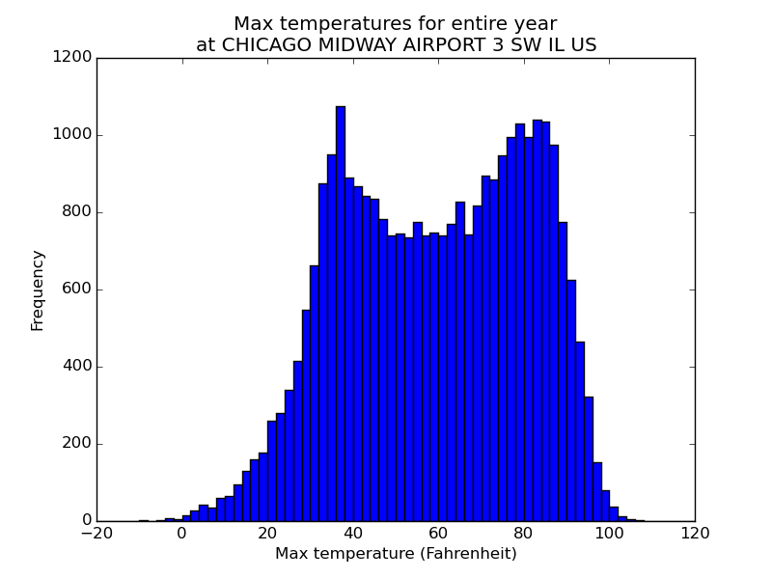
86 years of maximum temperatures
Over 31,000 total measurements
Bimodal
Wide range – continental climate
Can tell us rarity of all-time highs or all-time lows

Slide 4
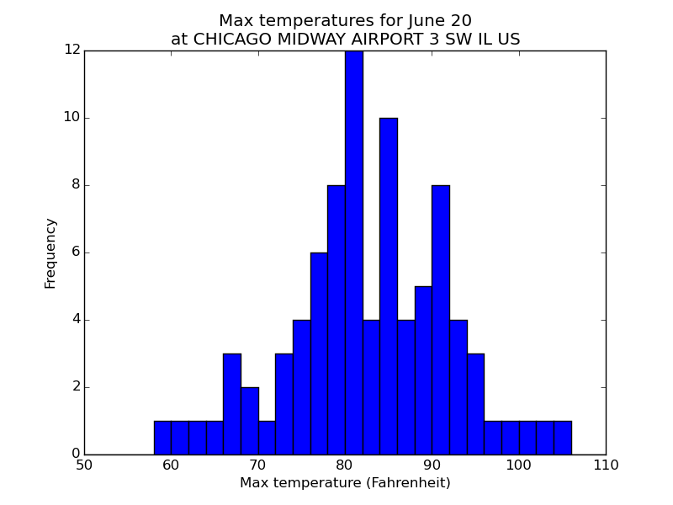
Now only 86 data points
Normal distribution
Wide variation still
No outliers
What if we could plot the temperature ranges as an animation through the year?

Slide 5
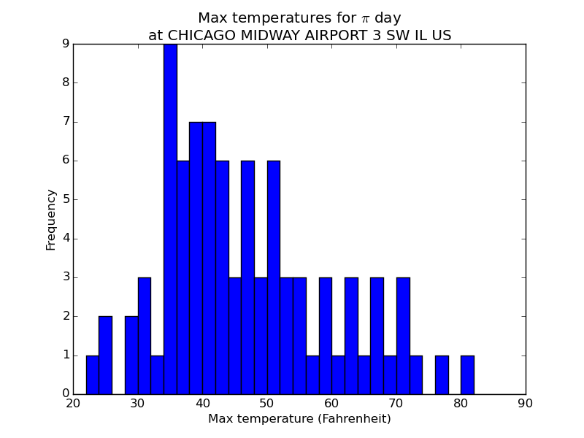
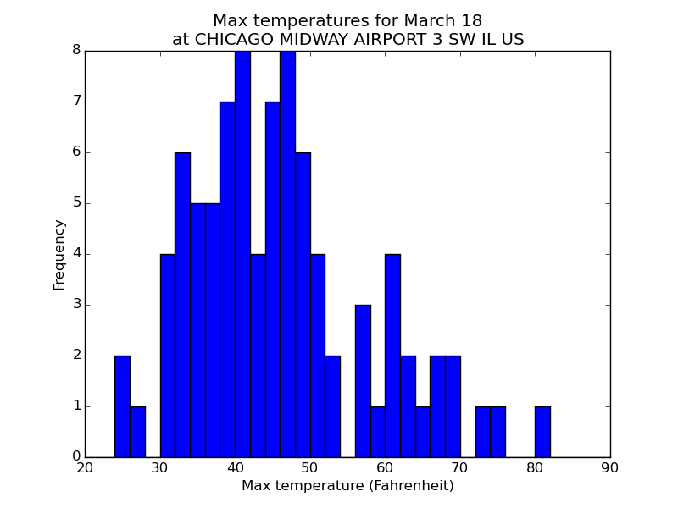
Outliers! (20s on Pi Day and Spring Break …. Or 80s)
Wide variation
Long warm tail

Slide 6
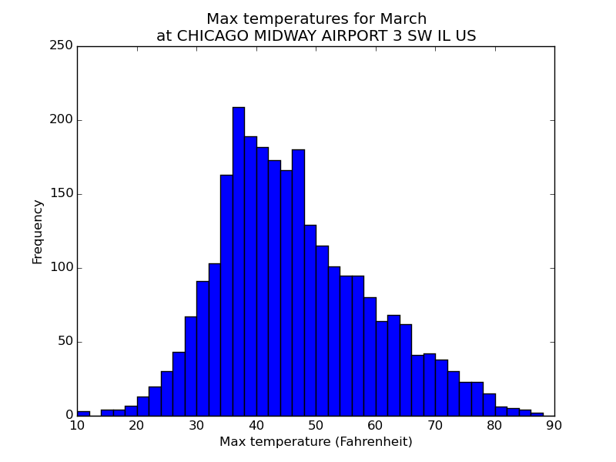
Nearly 2,700 points
All those above 80 recorded in one week in 2012
Extremely unlikely!
Note 10 to 90F range….

Slide 7
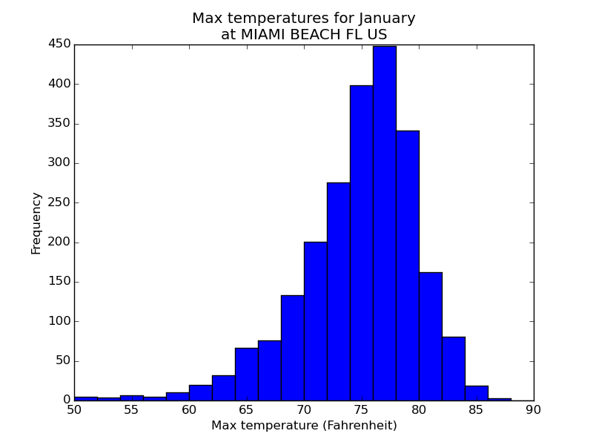
Tighter distribution
Subtropical climate
Now you see a cold tail

Slide 8
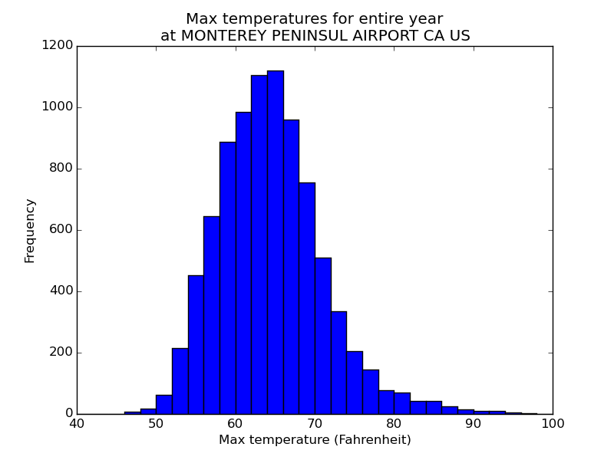
Tighter distribution
Mediterranean climate
When people in California say 80 or 90 is hot, you know they mean it….

Slide 9
