Slide 1

Organ Procurement and Transplantation Network (OPTN) Database on the OSDC
Christine Harvey
ceharvey@mitre.org
Rafael Suarez
rsuarez@uchicago.edu

Slide 2
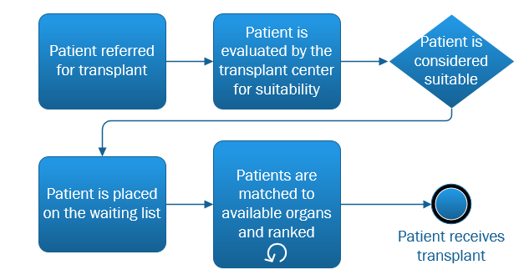
OPTN
Collects and manages scientific data related to organ donations and transplants in the U.S.
118,000 people on the organ waiting list in the America
  Comprehensive data on every registrant
    Age
    Sex
    Ethnicity
    Citizenship
    Blood Type
    Location
    Reason for transplant

Slide 3
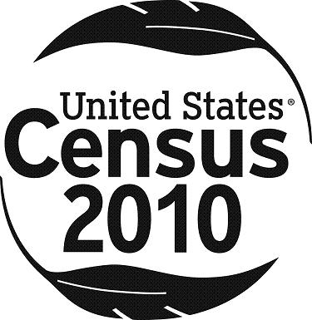


Current Work
Addition of two databases to the OSDC
  2010 U.S. Census Data
  Official Hospital Compare Database
Contact with UNOS regarding accessing the database
  Short research proposal in progress

Slide 4
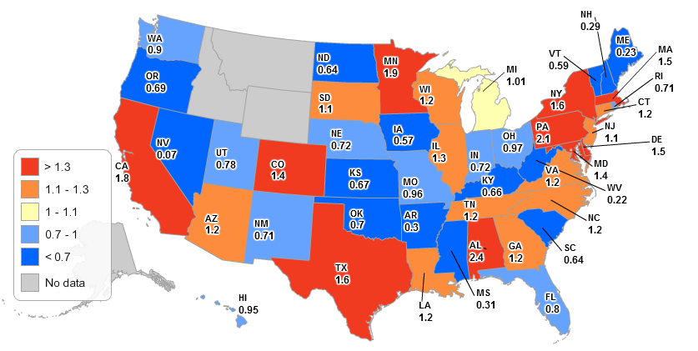
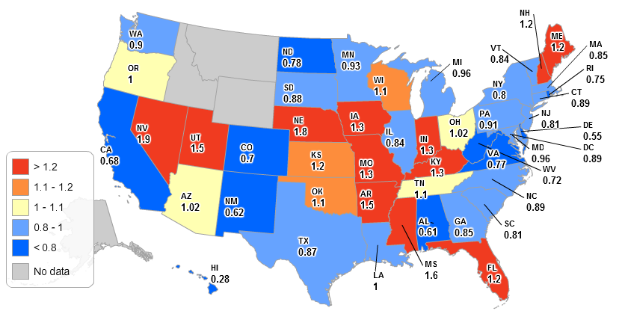
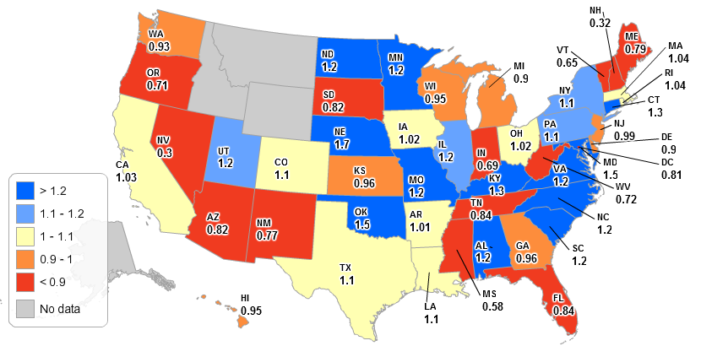
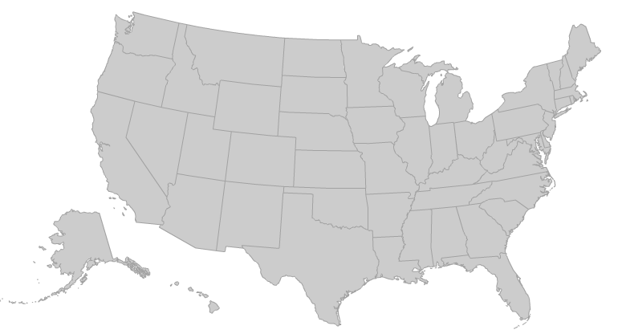
Future Work
Continue efforts to make the OPTN data on the OSDC
Determine needs to make the databases of interest collaborative
Normalized waiting list removals
Normalized waiting list additions
Normalized waiting list size

Slide 5
Research Questions
Locations vs. quality of transplant process
  Geographic factors: Wealth, overall area health, hospital rankings, household size, local industries…
  Transplant factors: Length of waiting list, time waiting, transplants performed, transplant survival…
Where do differences exist? Can we determine why? Can an improved awareness help the situation?
Could improvements be made to the current transplant process to increase the number of transplants performed and/or improve the survival rates of transplanted patients?

