Slide 1
Retroviral Links to Cancer
Gilbert W Cole University of North Carolina At Charlotte
Sandra Gesing Ph.D. University of Edinburgh

Slide 2
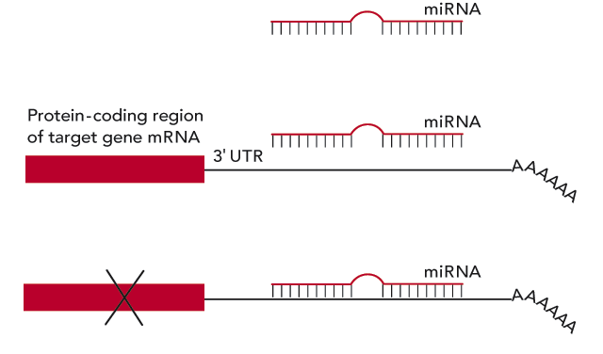
Regulatory Networks & miRNA
Gene Regulator Networks control the functions of the cell
Molecular Signals are used for intracellular communication
Micro RNA (miRNA) is used as a molecular signal typically to inhibit transcription or translation of other molecular signals or genes.
Alien miRNA introduced into the cell could disrupt the regulatory networks within the cell resulting in a cancerous cell.
miRNA is typically between 18 – 25 base pairs in length

Slide 3
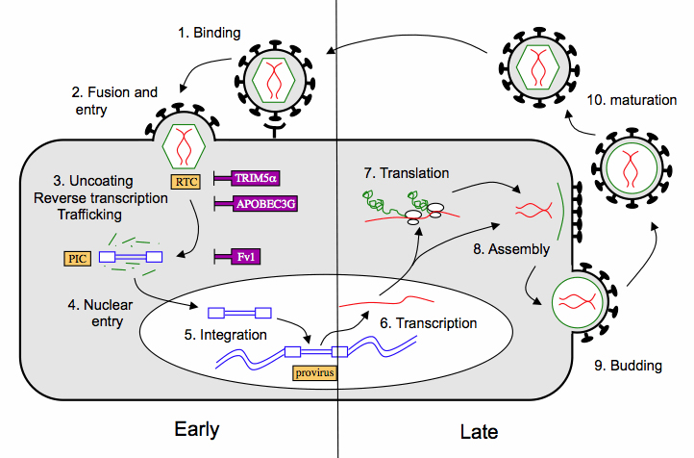
Retroviruses
Retroviruses enter and infect cells as RNA the convert themselves into double stranded DNA and insert themselves into the host genome.
Once the retrovirus has inserted itself into the host genome, the host will make new copies of the virus that can infect other cells.

Slide 4
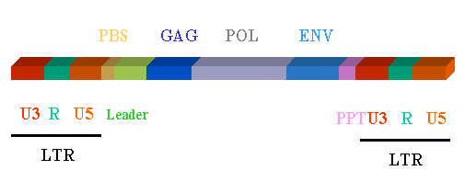
Retroviral & miRNA
Retroviruses can pick up regions of their host during the replication process.
These regions may contain gene segments that can act as miRNA
4 Essential genes of a retrovirus (GAG, PPT, POL and ENV)
Unspecific gene regions (U3 and U5)
Repetitive sequence regions (R)
The U3 and U5 regions are locations
where miRNAs could be located

Slide 5
GPU Search tool
Development of a GPU based search tool.
The search tool will be written in both CUDA and OpenCL to determine the most efficient GPU method for the search tool.
The algorithm will use the 4 genes, gag, ppt, pol and env to locate the retroviruses.
Once these regions are found we will search the regions beteween the 4 genes against the miRNA database for matches with high confidence.
The tool will search for both the miRNA and its reverse compliment to also find potential interfering RNAs (RNAi). When a match is found the tool will report the match location and miRNA sequence.
It is hoped that this information will help in the development of cancer treatments.

