Slide 1



Examining Vegetation Recovery Time After a Small Scale Disaster using MODIS Data and the OSDC
Zac Flamig (University of Oklahoma)
Gilbert “Warren” Cole (University of North Carolina Charlotte)
Rafael Suarez (University of Chicago)

Slide 2
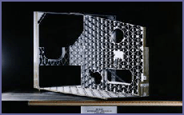
MODIS Normalized Difference Vegetation Index (NDVI)
Moderate-resolution Imaging Spectroradiometer (MODIS) sensor package on two satellites Terra (1999) and Aqua (2002) providing nearly full Earth coverage every 1-2 days
NDVI = (Band2 – Band1) / (Band1 + Band2)
  -1.0 to 1.0 which represents level of healthiness in vegetation
32 Day MODIS Bands 1-7 composites from Global Land Cover Facility (UMD)
  Composites to reduce/remove impact of cloudiness
  2001 to 2006 from UMD site, 500m resolution
MODIS 32 day Band 1-7 Composites loaded into OSDC public data
  Can be used for monitoring a variety of changes from fire, floods, severe weather, ice storms, snow, drought, crop production
  Data is mosaics instead of swaths, much easier for scientists to work with
NDVI dips and recoveries could be useful metric for evaluating post-disaster recovery process around the world
  “Develops tools and metrics for evaluating progress against set goals, objectives and milestones.” – US FEMA Post-Disaster Recovery Guidelines
MODIS Sensor Mainframe

Slide 3
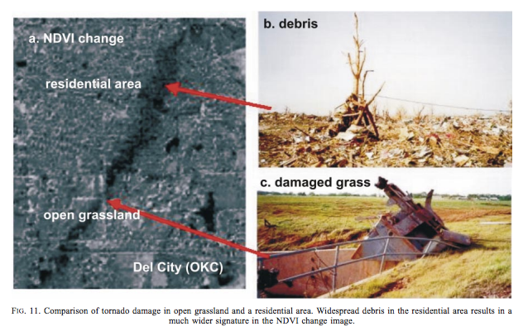
Disaster Case Study Information
  Use tornado data as “small scale” event.
    Tornado related impact on NDVI already observed and documented as utility in immediate aftermath of the disaster
    Tornado start/end locations well documented and can range in scales from a few tens of meters to kilometers
    Tornado path defines bounding box for region to examine in MODIS data
    Avoids need for classification, hopefully
  April 28th, 2002 La Plata, Maryland tornado examined for case study
  >30 mile path length, 880 yards wide at times
  Hypothesis: Changes in standard deviation of NDVI extracted for bounding box around path can quantify damage
Yuan et al. (2002) shows remotely sensed tornado path
“Although NDVI difference imagery identified vegetation changes in the damage path regions, these signatures were often masked by or confused with natural vegetation changes during the observation period. An unsupervised classification approach identified only portions of the damage track regions subjectively discernable in the imagery, and also included some undisturbed features in the same classification as the storm damage.” – Jedlovec et al. (2006)
Tornado Path
Bounding Box

Slide 4

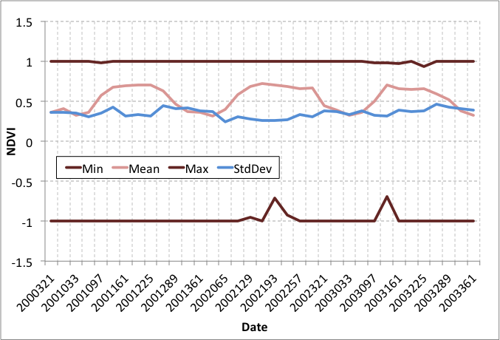



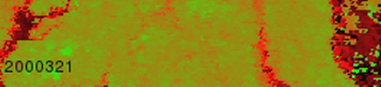
Results
Tornado Occurred
April 2001
(Pre-Tornado)
April 2002 (Tornado)
July 2002 (Post-Tornado)
April 2003 (Post-Tornado)
NDVI
0
1
Loop of NDVI from November 2000 to January 2004

Slide 5
Conclusions & Future Work
500m 32-day composite MODIS NDVI can detect large tornado damage paths and monitor vegetation regrowth
Find minimum detectable tornado length & width. May consider processing 250m MODIS data for OSDC
  Maybe NDVI isn’t best best, classification on other band combinations better?
Simple statistics from tornado damage region aren’t useful for monitoring changes
Develop a “smarter” data-driven method for detecting tornado path & control area, which may refine results
  K-means clustering? Some other method?
MODIS NDVI monitoring done for forest fires, may be possible to compare methods & later recovery times
  Maybe expect different recovery times?
May be possible to segregate tornado data based on rating and compare recovery time.
  Possible to infer severity/rating from recovery time?
Data and processing power available to examine all small-scale vegetation loss events (including non-tornado) as soon as a workable method is identified
MODIS data and OSDC resources utilized to examine a cross-disciple question during OSDC-PIRE Workshop in Edinburgh.

