Slide 1
Networks of the Future & Next-Generation Production
Rooms 203-204 (Level 2)
Sunday March 30, 2025 (13:00 - 15:30)
Organizers
Scotty Strachan (Lead), Nevada System of Higher Education, United States
Sana Bellamine (Lead), CENIC MMBI, United States
Akbar Kara, Ciena, United States
James Stewart, Utah Education and Telehealth Network, United States
Chris Tracy, ESnet, United States

Slide 2
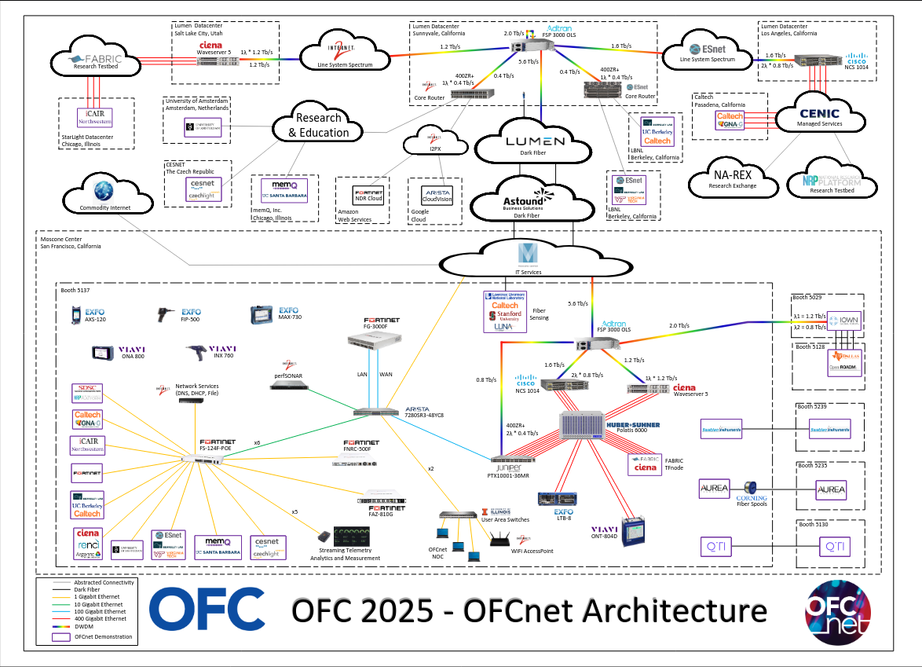

Slide 3
Welcome to OFCnet 2025!
Bridging Today’s Innovations to Tomorrow’s Networks
Thank you for joining us for a dynamic 2.5-hour panel-format workshop that connects the latest advancements from the OFC conference to the networks of the future.
Focus Areas
Automation & Orchestration
Evolving network ops teams for smarter, faster decision-making
Trend Analysis & Failure Prediction
Leveraging standardized data for machine learning-driven insights
Quantum Networking Early Wins
Real-world implementation updates and lessons learned
Networks of the Future
Bleeding-edge tech: What’s coming next—and when?

Slide 4
Welcome Speakers!
James Deaton, Internet2, United States
Danial Ebling, Utah Education & Telehealth Network, United States
Lidia Galdino, Corning Optical Communications, United Kingdom
Mariam Kiran, Oak Ridge National Laboratory, United States
Hideki Nishizawa, NTT, Japan
Reza Rokui, Ciena, Canada
Dirk van den Borne, Juniper Networks, Germany
Wenji Wu, Energy Sciences Network, United States
John Wu, Energy Sciences Network, United States

Slide 5





Thank you to our facilitators!
(as well as their sponsoring organizations)
Sana Bellamine (Lead), CENIC MMBI, United States
Scotty Strachan (Lead), Nevada System of Higher Ed, United States
Akbar Kara, Ciena, United States
James Stewart, Utah Education and Telehealth Network, United States
Chris Tracy, Energy Sciences Network, United States

Slide 6
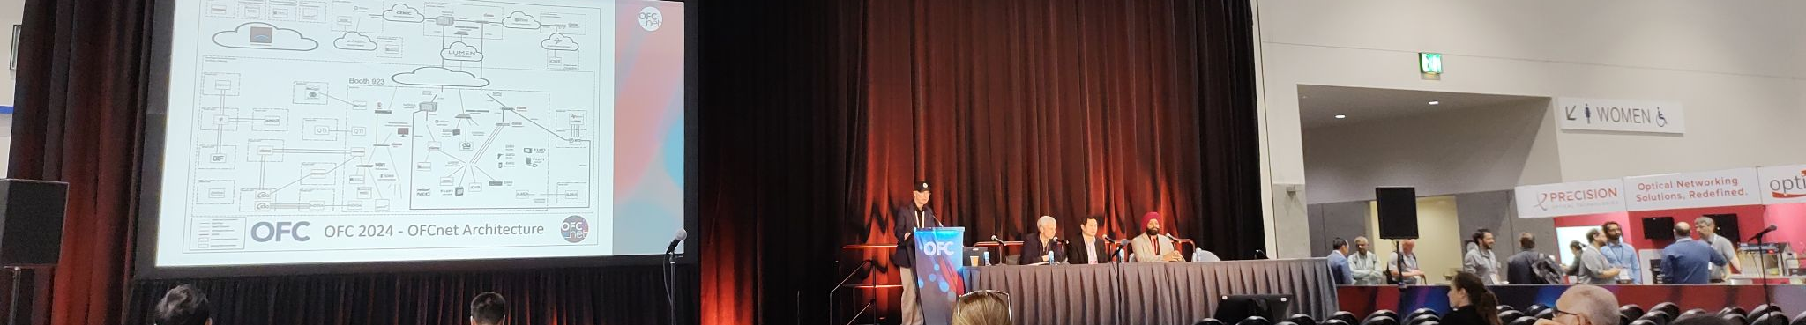
Workshop Structure
2.5 hour workshop divided into 4 sessions
    30 min: Automation and Orchestration
    30 min: Trend Analysis and Failure Prediction
    15 min break
    30 min: Quantum Networking Early Wins
    30 min: Networks of the Future
Moderated Panel + Audience Q&A:
  Dive into challenges, opportunities, & real-world applications
  Interactive!

Slide 7
Automation and Orchestration:
Evolving the network operations team
Akbar Kara, Ciena, United States (Facilitator)
James Deaton, Internet2, United States
Hideki Nishizawa, NTT Japan

Slide 8
Questions:
What is your vision for the path from CLI to an orchestrated network? How far are you in this journey?
Are you developing network automation tools/workflows in-house, or are you deploying commercial solutions? How should organizations approach this decision?
How are automation/orchestration tools changing your team’s makeup or subject-matter expertise?
What tools/software have you tried or are currently working with for multi-vendor automation & orchestration? What are your likes and dislikes?

Slide 9

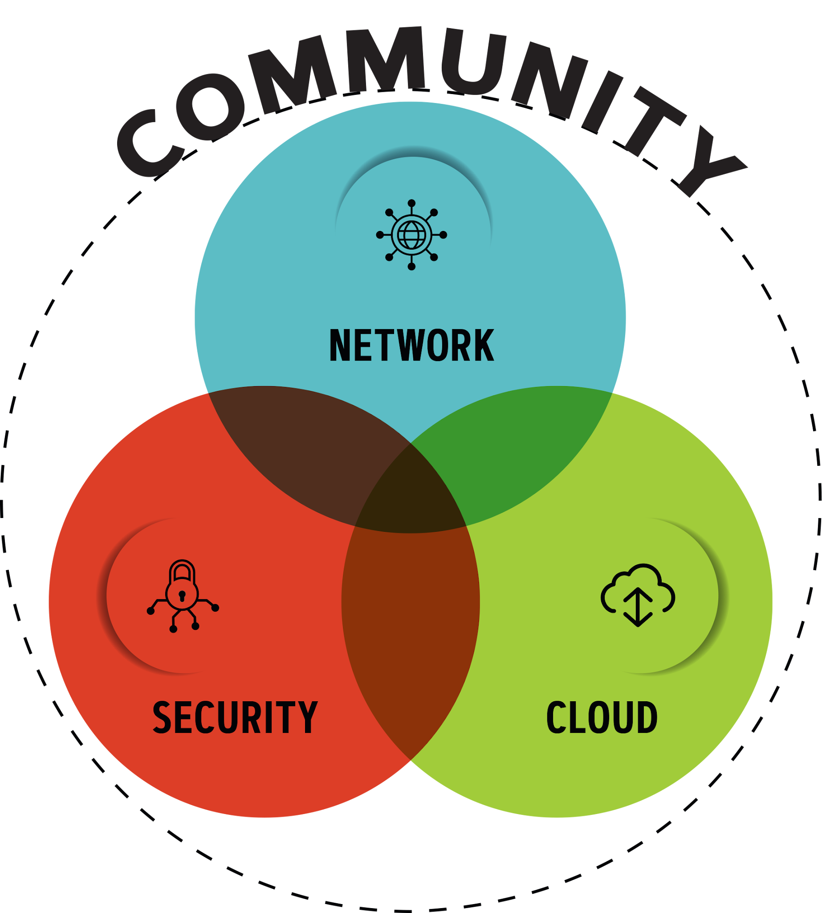
Internet2: A Member Consortium
Internet2 is a non-profit consortium providing research support, cloud solutions and custom services tailored for Research & Education.
A trusted, adaptable, secure network that empowers higher education, research institutions, government entities and cultural organizations.

Slide 10
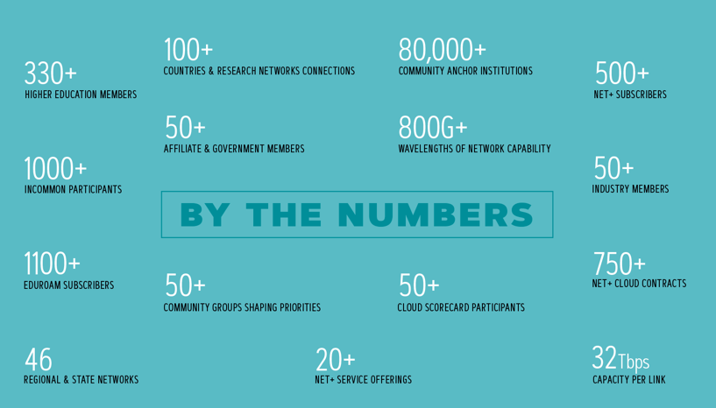
Internet2 by Community

Slide 11
Internet2 Network Services
PEER EXCHANGE
RAPID PRIVATE INTERCONNECT
LAYER 1 SERVICE
Provides institutions with
access to commercial peers across the
national footprint.
Allows Internet2 connectors to present themselves for private peering at selected national peering locations.
Point-to-point 10, 100 & 400G links and flexible grid spectrum to support private network needs.
R&E
LAYER 2 SERVICE
Provides institutions with
access to each other across the
national footprint.
Effective and efficient wide area 100 gigabit Ethernet technology.
CLOUD CONNECT
GLOBAL DDoS PROTECTION
LAYER 3 SERVICE
Uses regional’s infrastructure in conjunction with the Internet2 Network to reach cloud resources.
Our cloud-based, volumetric DDoS mitigation service was procured on behalf of the community.
For IP network and peer exchange needs.

Slide 12
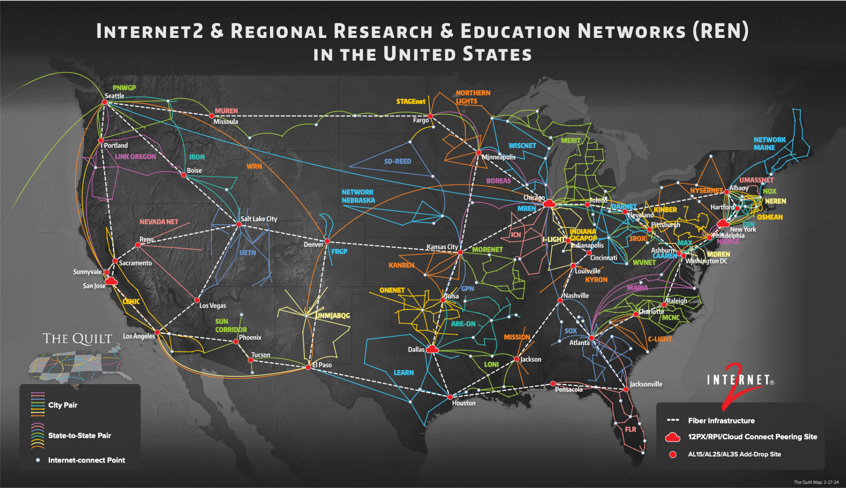

Slide 13
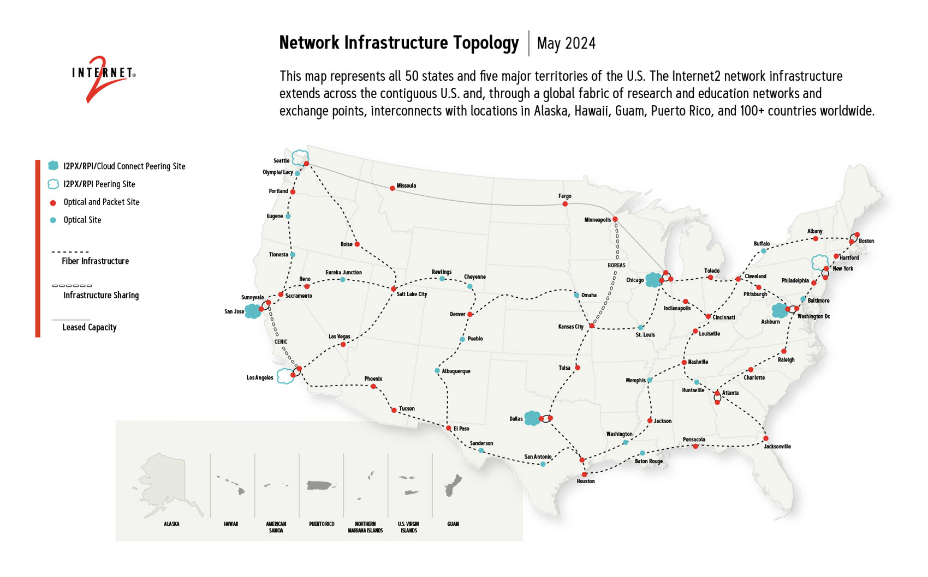

Slide 14
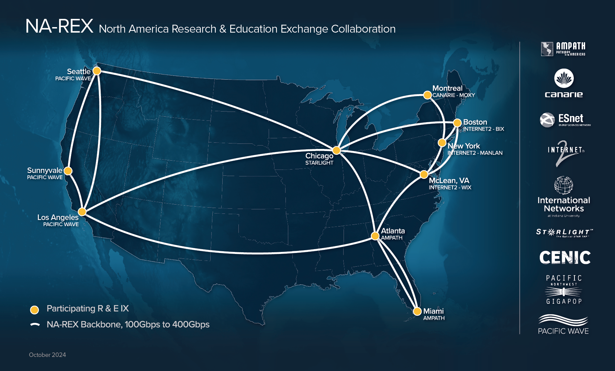

Slide 15
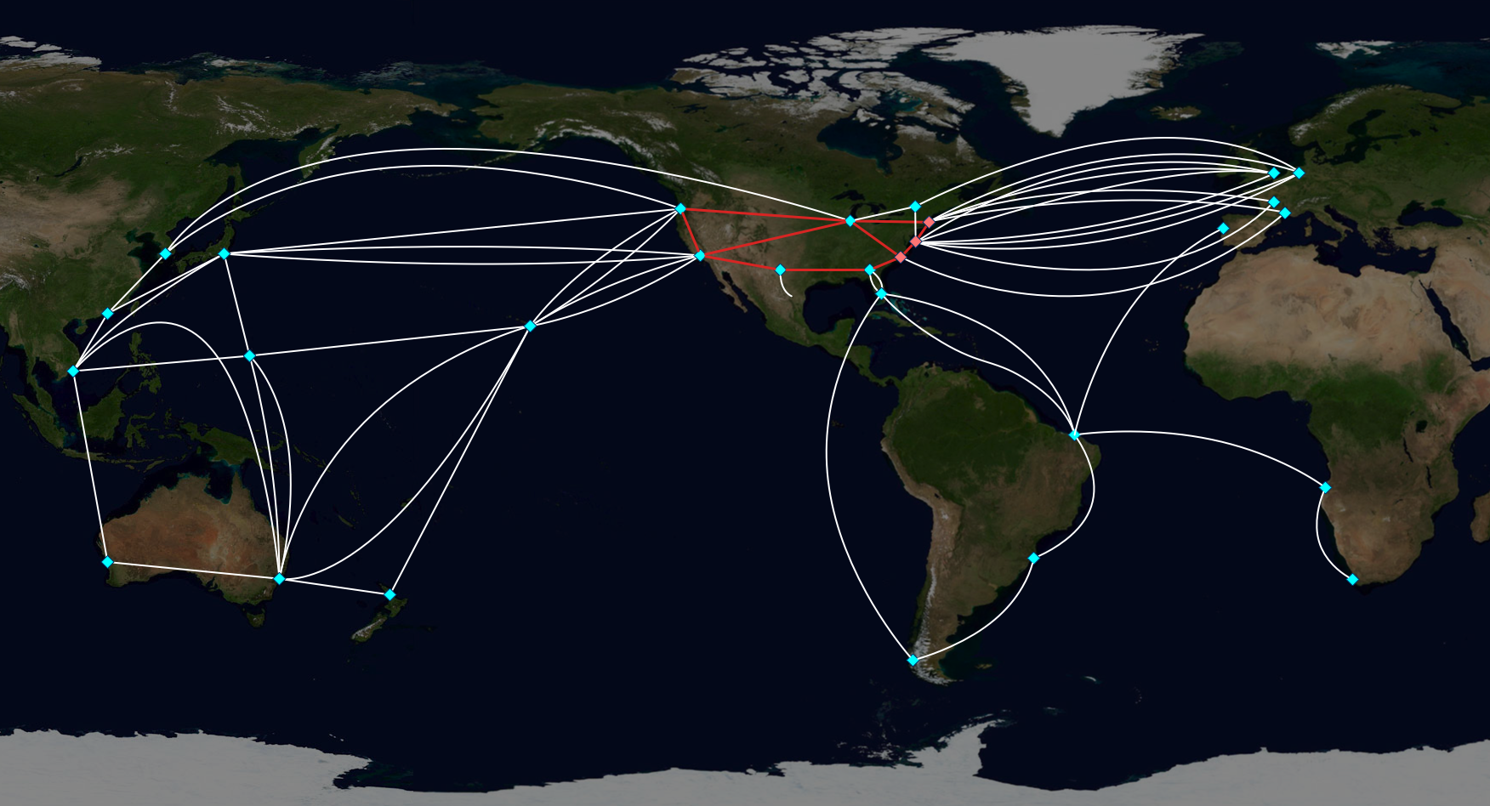
International Connectivity (NREN to NREN)
via multiple partnerships and consortiums

Slide 16
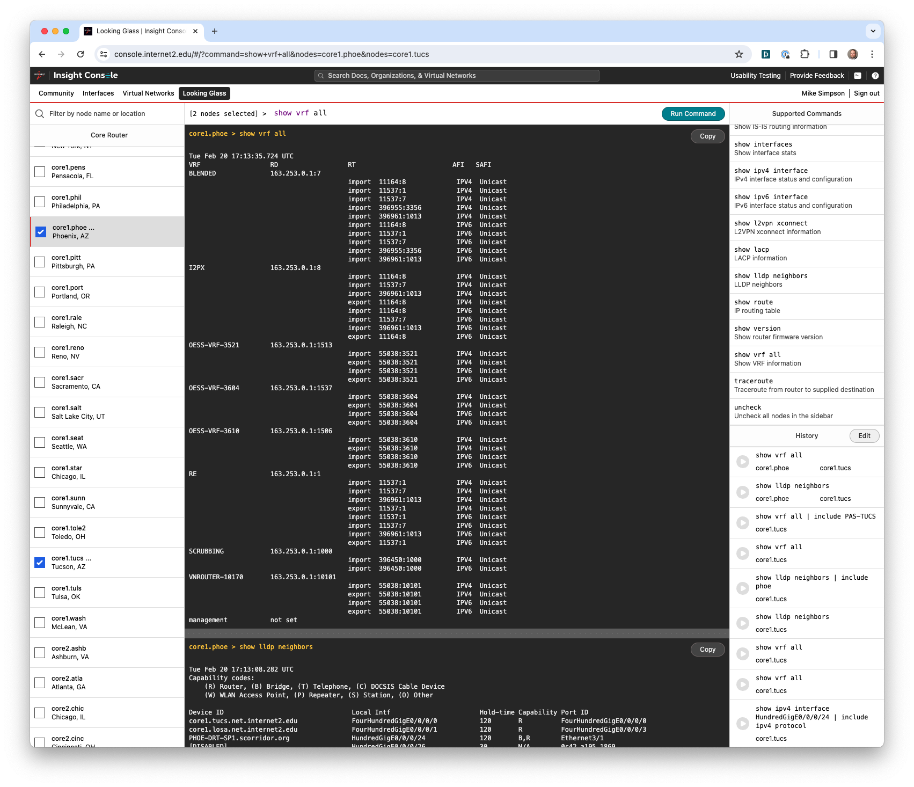
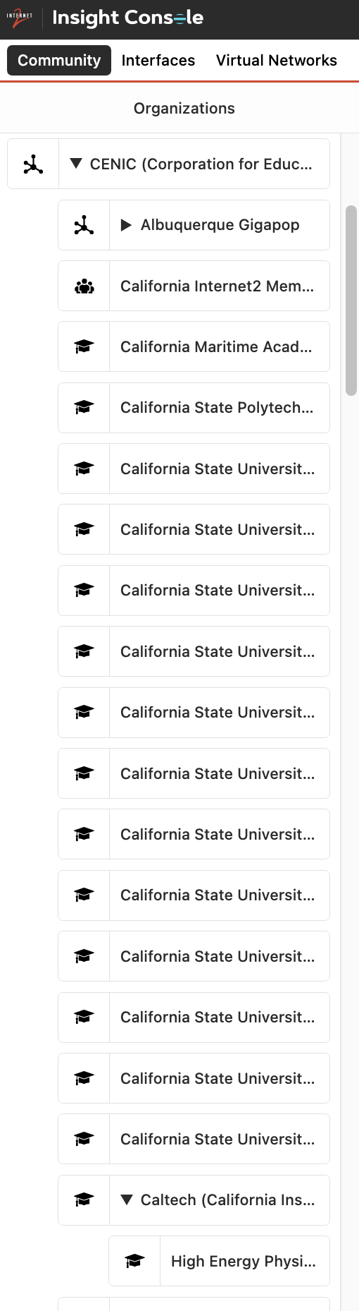
Insight Console
A web-based tool for visualizing, managing, and troubleshooting all Internet2 network services.
The most visible part of the Insight architecture.
Authentication and authorization integrated with Internet2 Identity Services (a.k.a. “InCommon SSO”).
Functions available:
  Looking Glass: Run commands (in a safe and secure environment) against our production devices and get live results.
  Community: Self-management of organizations, people, and roles.
  Interfaces: Visualization of network ports and services.
  Virtual Networks: Creation and management of L2 and L3 overlay networks, including CloudConnect.
  Routing Intentions: Visualization and management of I2RE and I2PX routes and routing policy.

Slide 17
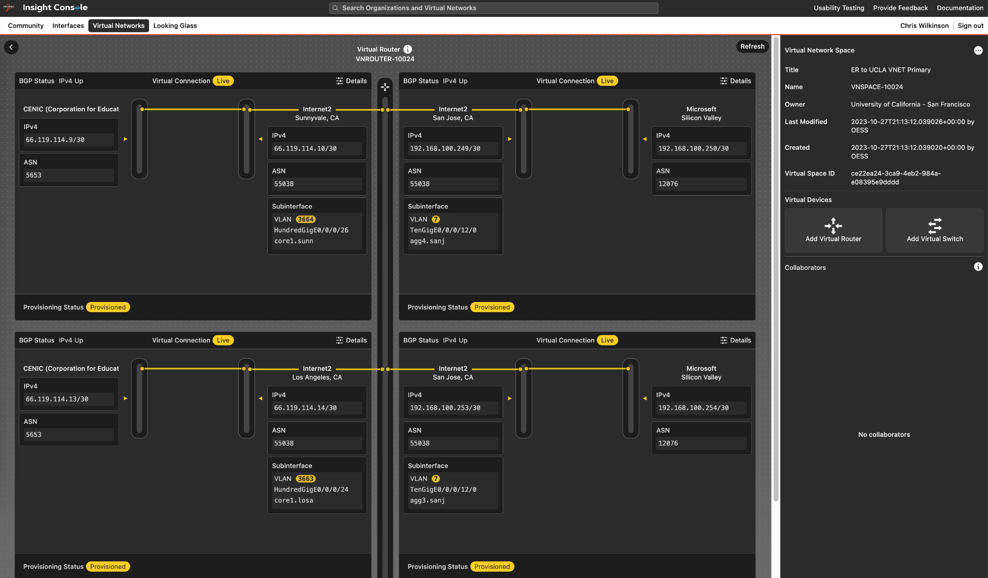
Virtual Networks
Visualization, management, and troubleshooting for L2 and L3 overlay networks
Virtual spaces provide a canvas within which different organizations can collaborate on building overlays.
Virtual devices (switches and routers) can be added to spaces to establish L2 and L3 overlays.
Virtual connections can be added to devices to connect the overlays to interesting places: other Internet2 members or downstream sponsored parties, government and industry partners, cloud partners (AWS, Azure, GCP, OCI), etc.
Provisioning of the overlay networks on Internet2’s production network is handled via Insight API calls, with backend automation provided through NTC Nautobot, Cisco NSO, and other supporting tools.

Slide 18
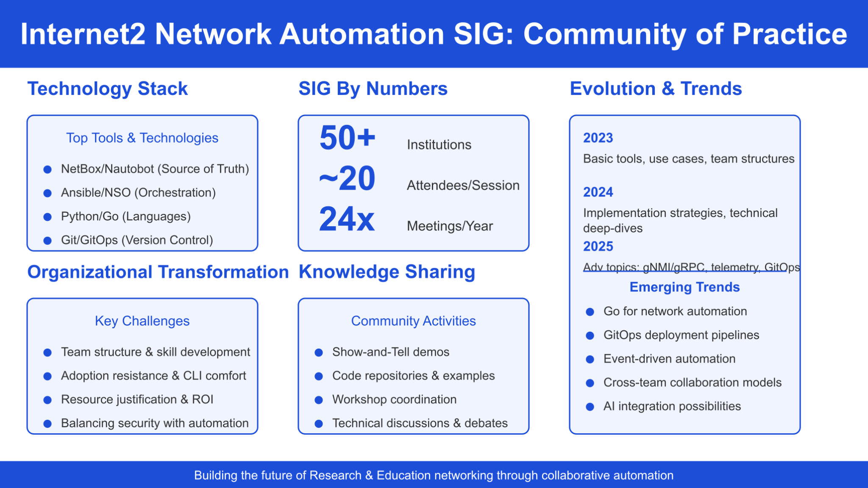

Slide 19
Cloud-native platform and digital twin technology to accelerate open innovation
OFC Workshop: Networks of the Future and Next-Generation Production
Hideki Nishizawa
NTT Network Innovation Laboratories
Co-lead of TIP OOPT Disaggregated Optical Systems
Coordinator of IOWN GF Open APN Task Force

Slide 20
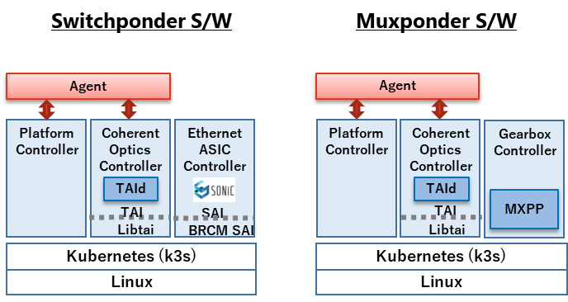
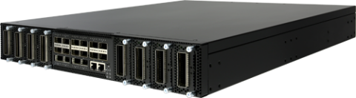



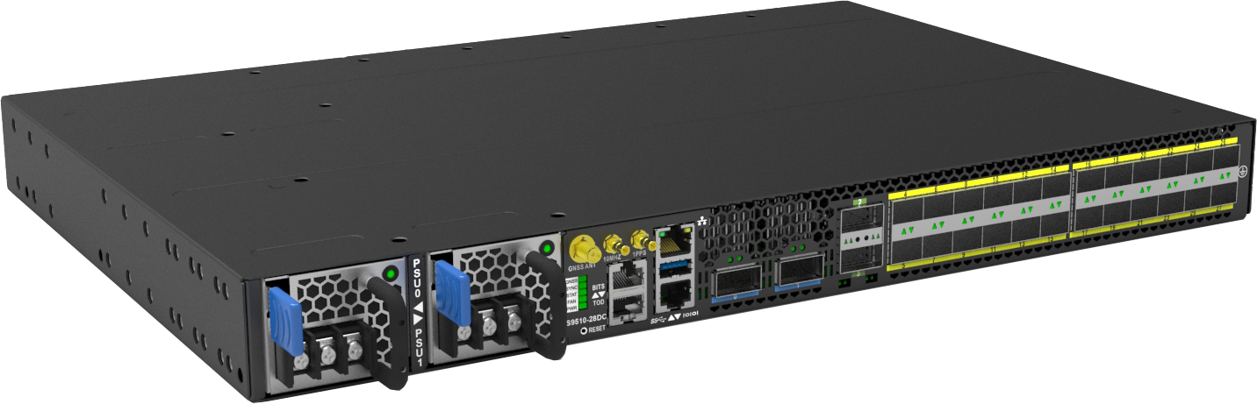
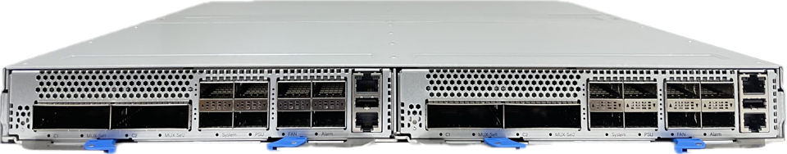
Cloud-Native Platform (Commercial Solutions)
Enabled lower price solution with open hardware from server/switch industries.
The market has been cultivated, and commercial implementation is progressing.
Switchponder H/W
Muxponder H/W
Management IF
Management IF
CPU
Memory
CPU
Memory
Storage
Storage
Switch ASIC
Gearbox
Gearbox
: control
: data
Client TRx
Line TRx
Client
TRx
Line
TRx
Client
TRx
Line
TRx
NOS function split with container
-> Reducing S/W deploy time dramatically
Cassini
(Edgecore)
Galileo Flex T
(Wistron)
400G DCSG
(Ufispace)
Endeavor
(Pegatron)

Slide 21
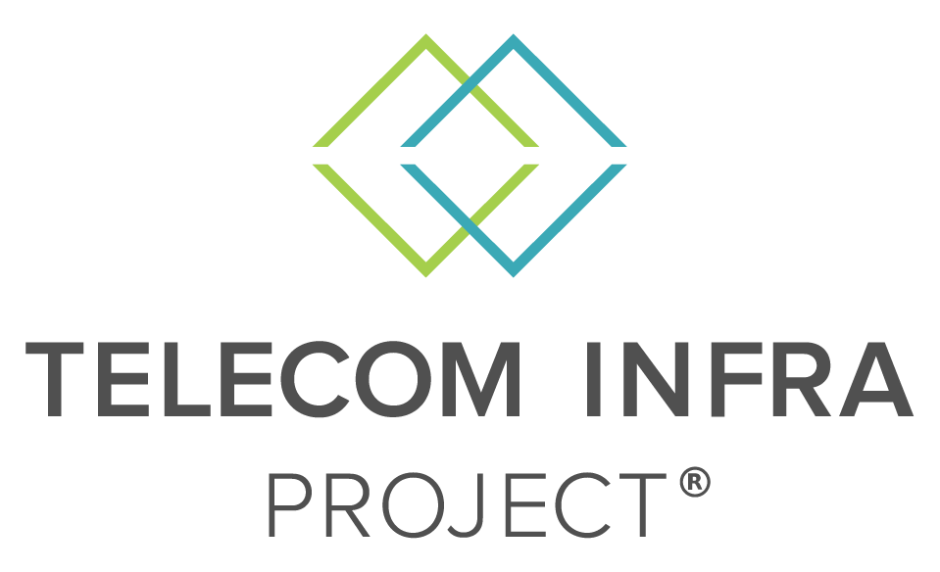


Collaboration Across Open Forums
Although the targets, approaches and strengths of each organization differ, all three share a common goal.
Work together to achieve their common goals by combining individual strengths.
Collaboration with GNPy
2016～
Optical + IP, Vertical disaggregation
Agile, implementation-driven community approach such as GNPy
Multi-vendor
Disaggregation
Open Interface
SDN architecture
2016～
Horizontal disaggregation
Detailed optical interoperability standards such as Open ROADM mode
TRx model + GNPy
Liaison in 2024
Liaison in 2021
2020～
Optical + Computing
Visionary APN architecture such as
Remote transponder, Data Center eXchange
Notes:
Equally important is the collaboration across open forums. TIP’s alignment with IOWN GF and Open ROADM MSA ensures that complementary specifications and technologies can come together to form a cohesive, interoperable solution. Each organization brings its strengths—IOWN GF with its visionary APN architecture, Open ROADM MSA with its detailed optical interoperability standards, and TIP with its agile, implementation-driven community approach. Together, they form a powerful force pushing the boundaries of what’s possible in open optical networking.
The demonstration at OFC 2025 is more than a technology showcase—it’s a proof point for how cross-industry collaboration and open innovation are laying the foundation for scalable, sustainable, and future-ready optical transport networks. TIP is excited to continue driving this journey with our partners and community members around the world.

Slide 22

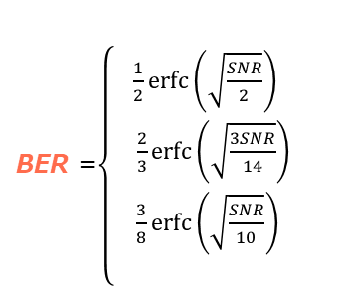
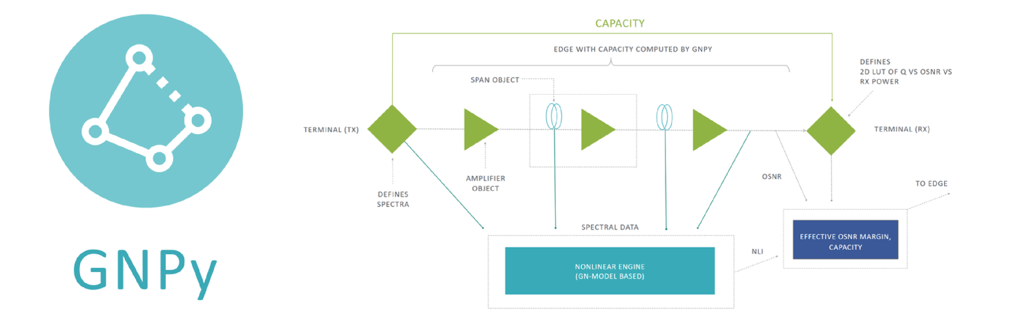

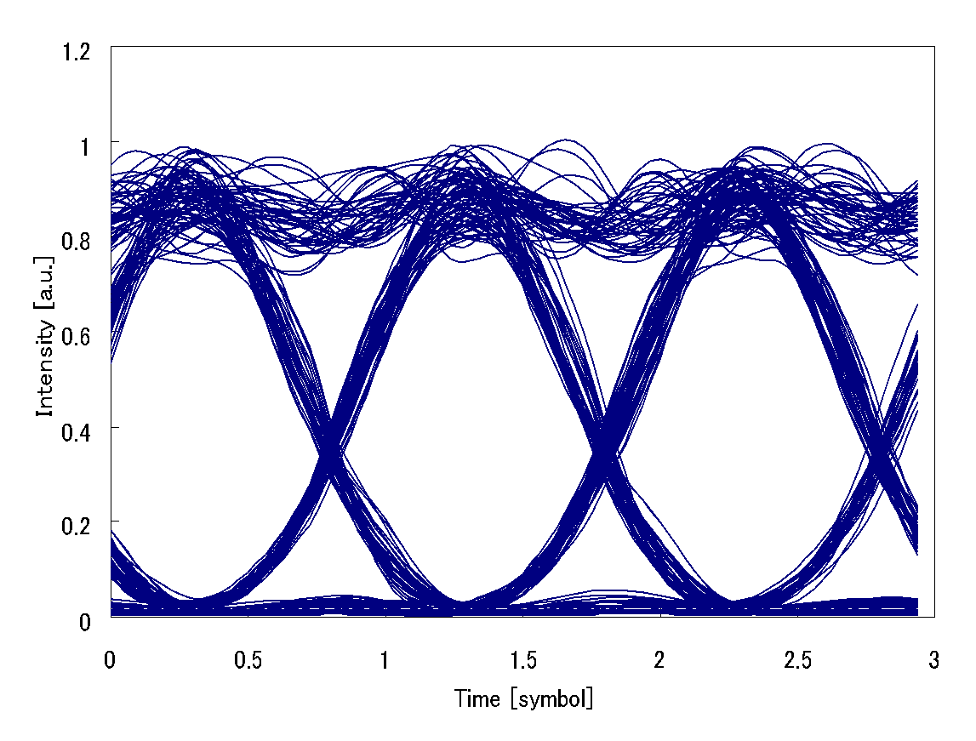
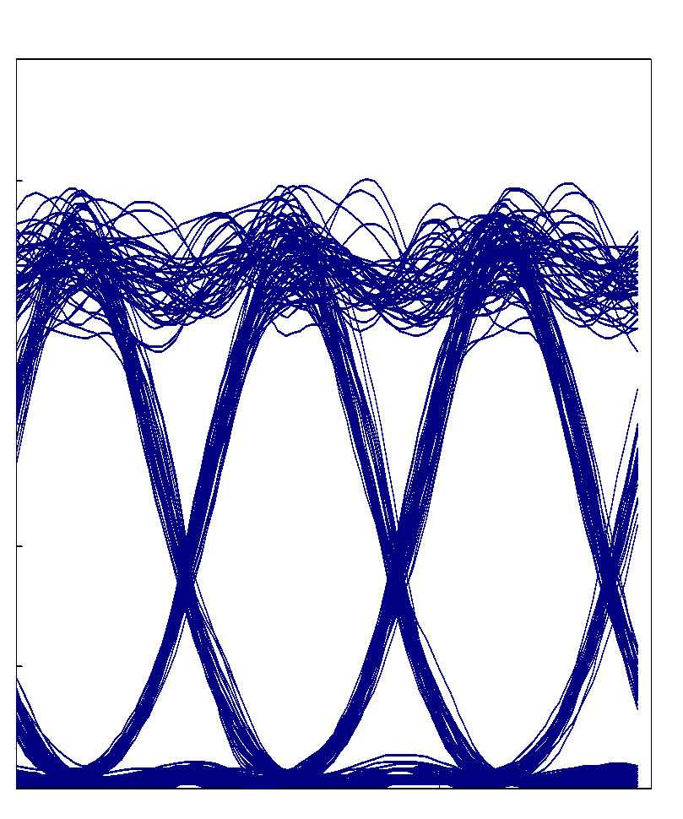
Fast Provisioning with Gaussian Noise Model
To design an end-to-end (E2E) optical wavelength path, it is essential to identify the following basic characteristics.
①Digital signal processing
③Line system characteristic
Baudrate
ASE
Optical fiber nonlinearity
Level diagram/Receiver sensitivity
Optical Power
S
S/N
S1
Receiver sensitivity
N
S2
Modulation
Coherent Module
Optical
DSP
FEC
QSFP28
②Substrate characteristic
BER
Collaboration with PoliTo and NEC
OSNR

Slide 23




Demonstration at IOWN Networking Hub (#5029)
  End-to-End optical path establishment between remote-transponders at user sites (e.g., DC premise).
Multi-vender remote-transponder (Switchponder/Muxponder) configurations.
  TransportPCE/Orchestrator manage L1 (APN-T) and ROADM networks.
  TeraflowSDN controller manages L2/L3 functions on Switchponder.
Control/monitor L1(APN-T).
Manage L2/L3 functions.
Each component is realized by container.
Transport PCE / Orch.
(Open DWDM-NW Controller)
Teraflow
L2/L3 Controller
Teraflow
L2/L3 Controller
TIP-OOPT
MANTRA
Switchponder
Access domain
Open ROADM
Open ROADM
Access domain
TIP-OOPT
MANTRA
Switchponder
Feasibility of remote-transponder
Multi-vendor multi-type equipment configurations.
L1 management by APN-C.
L2/L3 management by L2/L3 controller.
QSFP-DD
QSFP-DD
ROADM NW
TIP Phoenix
WX-T
Open ROADM
Open ROADM
TIP Phoenix
WX-T
CFP2-DCO
Access domain
Access domain
CFP2-DCO
OpenROADM
Transponder
Access domain
Open
ROADM
Open
ROADM
Access domain
OpenROADM
Transponder
CFP2-DCO
CFP2-DCO
DC Premise
Carrier Premise
DC Premise

Slide 24
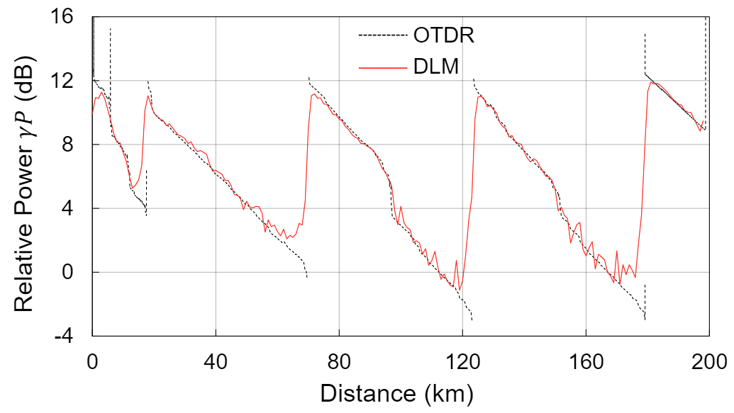

Digital Twin Technology (Under Development)
Methods and an architecture to conduct measurements and optimize newly installed optical fiber line systems semi-automatically.
Integrated physical-aware methods
OLS Calibration
Estimate noise figure, connector loss, effective area, loss coefficient profile, etc.
Digital Longitudinal Monitoring (DLM)
Estimate power profile, chromatic dispersion, gamma x power, etc.
DLM
DEMUX
TRx
WDM source
OSA
DLM
TRx
Physical parameters visualization
Power Profile
Q-factor vs Fiber Pin
ASE noise
limit
Nonlinear limit
H. Nishizawa, G. Borraccini, T. Sasai, Y. K. Huang, T. Mano, K. Anazawa, M. Namiki, S. Usui, T. Matsumura, Y. Sone, Z. Wang, S. Okamoto, T. Inoue, E. Ip, A. D’Amico, T. Chen, V. Curri, T. Wang, K. Asahi, and K. Takasugi, “Semi-automatic line-system provisioning with an integrated physical-parameter-aware methodology: field verification and operational feasibility,” Journal of Optical Communications and Networking, vol. 16, no. 9, pp. 894–904, Aug. 2024.
Q-factor
Fiber Pin
OLS: Open Line System
OSA: Optical Spectrum Analyzer
GN: Gaussian Noise
ASE: Amplified Spontaneous Emission
Collaboration with Duke, PoliTo and NEC

Slide 25



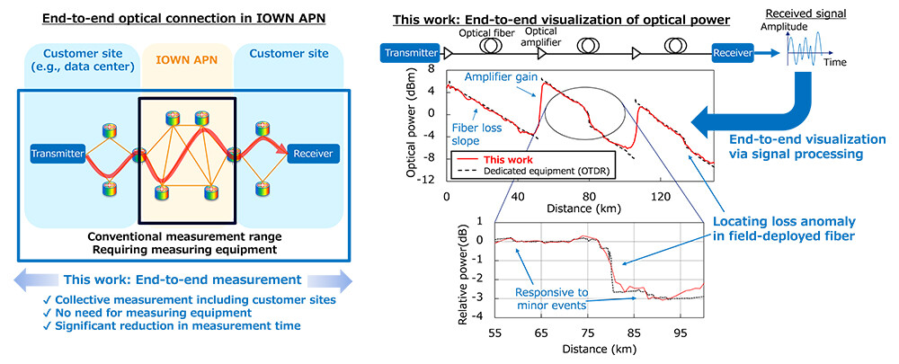

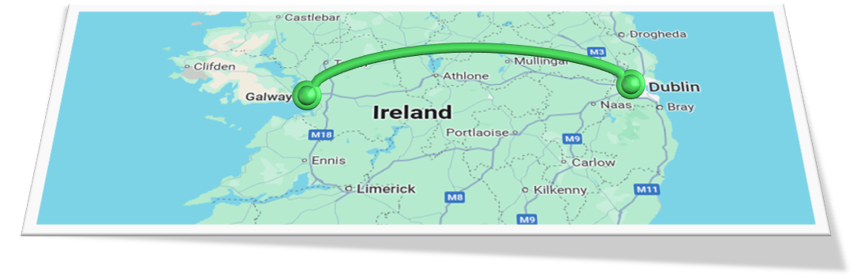
Field Trials at Duke Univ. and CONNECT testbed
We have validated end-to-end visualization of fiber-optic link at Duke Univ.
Last year, we began large-scale experiments with TCD at CONNECT testbed.
Testbed
World's first and most accurate field demonstration of end-to-end visualization of fiber-optic link without measuring equipment (NTT PR, OFC2024 PDP)
Funding
National Institute of Information and Communications Technology (50201); National Science Foundation (CNS-2211944, CNS-2330333); Twilights (22/FFP-A/10598); Open Ireland (18/RI/5721); CONNECT (13/RC/2077 P2).

Slide 26
Questions:
What is your vision for the path from CLI to an orchestrated network? How far are you in this journey?
Are you developing network automation tools/workflows in-house, or are you deploying commercial solutions? How should organizations approach this decision?
How are automation/orchestration tools changing your team’s makeup or subject-matter expertise?
What tools/software have you tried or are currently working with for multi-vendor automation & orchestration? What are your likes and dislikes?

Slide 27
Trend Analysis and Failure Prediction:
Standardized data collection for Machine Learning
Chris Tracy, ESnet, United States (Facilitator)
Danial Ebling, UETN, United States
Reza Rokui, Ciena, Canada
John Wu, ESnet, United States

Slide 28
Questions
How do you see AI impacting network analytics in the next 5 years?
How should network operations teams approach AI?
What are some of the immediate challenges in implementing network assurance/troubleshooting, performance monitoring, failure prediction, and automation? How do you see AI/Gen-AI helping with these challenges?
For extracting actionable insights from the performance metrics, which tools (commercial and/or open-source) would you suggest to network operators to evaluate?

Slide 29



Let’s talk Data Collection
Danial Ebling
Utah Education Network

Slide 30
Why?
Standardization!
Reliability

Slide 31
Options for network metrics
SNMP
OpenConfig
Your favorite vendor flavor

Slide 32
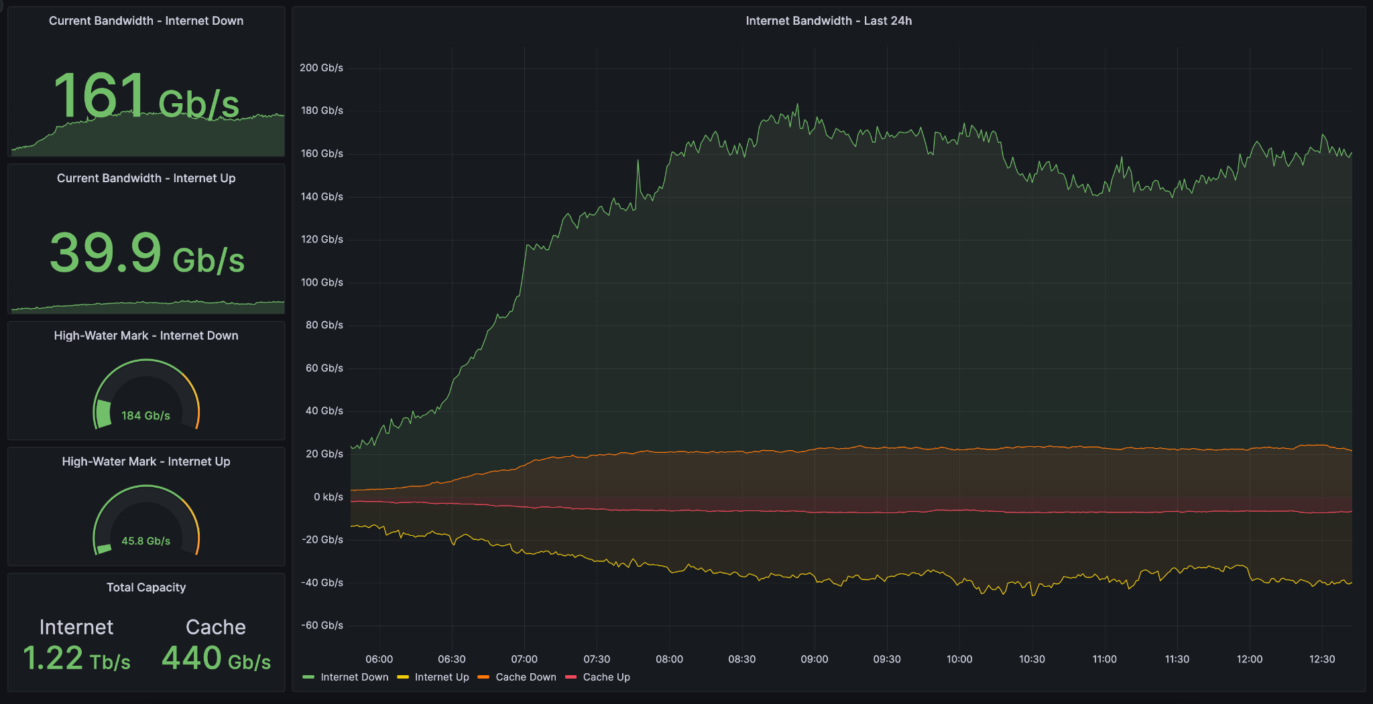
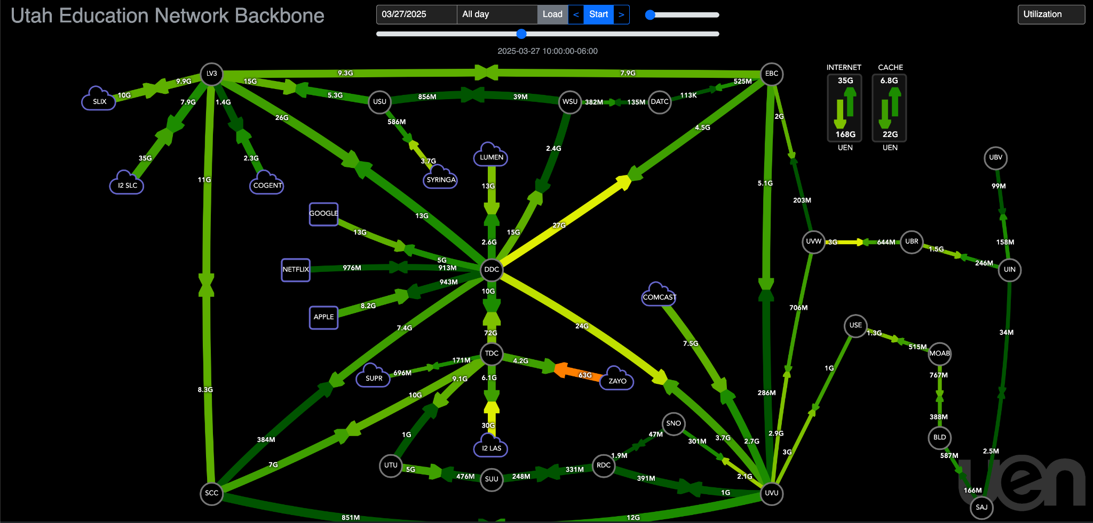
Metrics collection at UEN
Streaming telemetry
  Vendor paths + OpenConfig
220 devices
  5 sec-1 min. intervals
TIG stack
  100% open source

Slide 33
A few slides for Reza’s position statement

Slide 34
Ciena AIOps
Empower Network Operations and Automation Using AI/ML/Gen-AI
Reza Rokui Senior Director, SDN Application Architect
March 30, 2025
OFC 2025
Networks of the Future and Next-Generation Production
See Details HERE

Slide 35
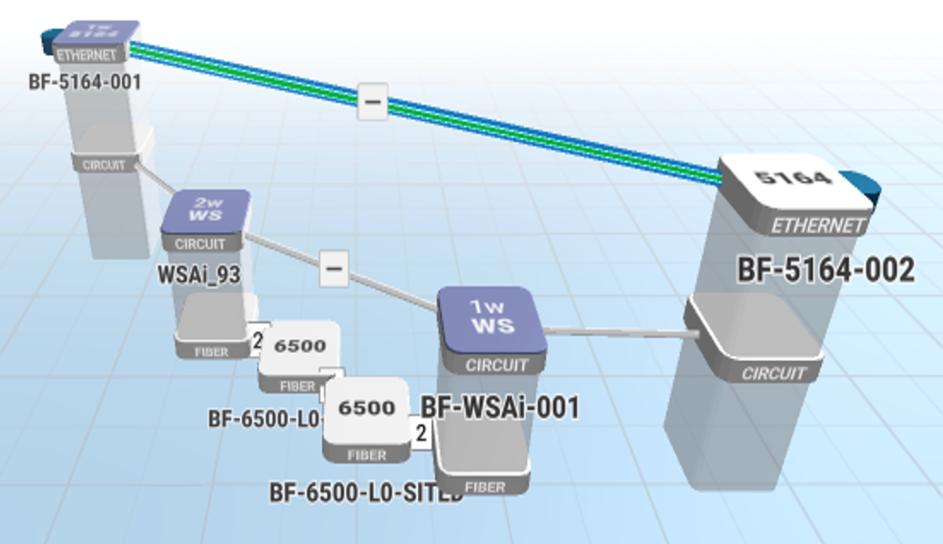

What problem are we solving?
How does AIOps relate to Operators?
  For multi-layer IP/Optical network, main objective of AIOps for operators
  Operational Efficiency
  CAPEX savings
  Multi-layer IP/Optical Network
Various aspects of Operational Efficiency:
Assurance & Troubleshooting
Optimization
Automation
AIOps will have positive impact in your network Operation & CAPEX

Slide 36
Why is AI/ML Gaining Renewed Interest in IP and Optical Networks?
AI/ML has been in networking for the past 10–15 years... What is new?
Key factors driving renewed interest
  Proliferation of Generative AI:
    Advanced AI models improving decision-making, predictive analytics, and automation.
    Enhanced data-driven insights leading to better network performance.
  Willingness of IP and Optical operators:
    Operators increasingly adopting AI/ML for enhanced network efficiency.
    Demand for automated network management and self-healing capabilities.
  Lower cost of software and hardware:
    Declining costs of GPUs, TPUs, and AI-specific hardware.
    Availability of open-source AI/ML frameworks reducing software expenses.

Slide 37
Impact of AI for Operators
3 Areas to Consider
AI Ops
Network for AI
AI for Network
AI for Engineering
Addresses how network operation benefits from AI/ML/Gen-AI
Addresses the use
of AI/ML/Gen-AI
for Network Engineers
Addresses network architectures & network configurations

Slide 38
AIOps: Artificial Intelligence for Operations
AIOps
(term coined by Gartner)
Application of AI / ML / Gen-AI
Improve network operations
AIOps
Various Operational Benefits in areas of:
Network Assurance
Network Optimization
Network Automation
Big Data Driven
Historical Data
Real-time Streaming data
(Time-series PM, alarm, topology & logs
+
AI / ML /
Gen-AI /
Rule-Based
Automation
🡺
AIOps
(AI/ML + Gen-AI +
Big Data)
Simplified Operation
Operational Insight
Decision
Action (Automation)

Slide 39

Ciena AIOps Multifaceted Operational Scenarios
Ciena AIOps
Using AI / ML / GenAI
Assurance
Optimization
Automation
1
2
3
Trend Analysis, Forecasting, Pro-active Monitoring and PM collection used in some of these Scenarios

Slide 40

Network Automation
using GenAI Multi-Agent
Dynamic Workflow
An Enabler for IP/Optical Automation

Slide 41
GenAI based Multi-layer IP/Optical Automation
Note:
To demonstrate the idea, example is provided for Reactive Network Assurance
However, this idea can be extended to all other AIOps scenarios
Problem Statement At-a-glance
Operator has an issue in their network and asks "Network Engineer" to find the issue and to fix it
Network Engineer investigates,
and goes through loops of
“Reasoning & Acting”
Network Engineer provides both the result of their investigation and remedial actions
1
2
3
Input
Output
Loop
Network Engineer
Problem Statement
Mimic the Network Engineer's behaviour and create Virtual Network Engineer
To achieve this, create dynamic workflow using Gen-AI Multi-Agent Capability

Slide 42
Thank You

Slide 43
ESnet Preparing for Predictive Operations
John Wu
JohnWu@ES.net
ESnet is taking a system approach, the following is my own personal observations.
Notes:
Trend analysis and failure prediction: standardized data collection for Machine Learning
Facilitator: Chris Tracy, ESnet, United States
Speakers:
Danial Ebling, UETN, United States
Reza Rokui, Ciena, Canada
John Wu, ESnet, United States
Questions:
How do you see AI impacting network analytics in the next 5 years?
How should network operations teams approach AI?
What are some of the immediate challenges in implementing optical network assurance/troubleshooting, failure prediction and automation? How do you see AI/Gen-AI helping with these challenges?
For extracting actionable insights from the performance metrics, which tools (commercial and/or open-source) would you suggest to network operators to evaluate?
What are some of the immediate challenges in implementing network performance monitoring, troubleshooting, and failure prediction?

Slide 44
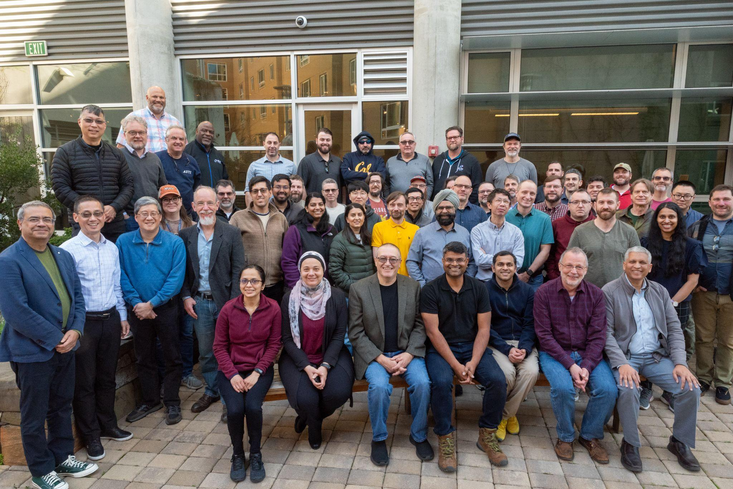
Gathering Input with ESnet Data and AI Workshop
February 25 - 27, 2025, Berkeley:
Organizing committee: Chin, Ed, John M., Chris T., John Wu
48 ESnet staff, plus special guests (center front in photo)
A working group will write reports
More to come by the end of May

Slide 45
Workshop Agenda and Overall Object
The objective of the Data and AI workshop was to identify challenges within ESnet that can be addressed through data-driven methods. This will help define ESnet’s data analysis requirements and shape our AI strategy, guiding data stewardship efforts, and the direction of AI research and AIOps exploration for ESnet7.
The workshop had 5 sessions, each building on the output of the previous session.
Session 1:
Understanding the questions / problems
Session 2:
Understand
our data
Session 3:
Understanding
AI
Session 4:
Bringing it together, building work packages
Session 5:
Where do we go from here, a cross-cut analysis.

Slide 46
Workshop Outcomes - 29 Work-packages
WP1
Alerting
WP2
Rule Correlation
WP3
Data Quality
WP4
Lifecycle
WP5
Data Catalog
WP6
Service Usage
WP7
Business Ops
WP8
Outage Notification Parsing
WP9
Ticket Resolution
WP10
Alarm Correlation
WP11
Hardware Failure Prediction
WP12
External Configuration Anomaly Detection
WP13
Capturing Configuration Intent
WP14
Fast Contract Lookup
WP15
Consistent Data Management
WP16
All Data Query
WP17
Automating Site Deployment
WP18
Automating Configuration
WP19
AI Sandbox
WP20
Generating RFP / Contracts
WP21
Unified Document Search
WP22
Ticket Summarization
WP23
Federated Authentication
WP24
Rewriting Legacy Perl Software
WP25
NLP Interface to Systems
WP26
Information Architecture
WP27
Requirement Management
WP28
Mission Support Management
WP29
Dataset Unified Query

Slide 47
Clustering Work-packages Based on AI/ML Tasks
I: Data Integration
WP3
Data Quality
All Data Query
WP16
WP6
Service Usage
Lifecycle
WP27
Requirement Management
WP4
WP21
Unified Document Search
WP7
Business Ops
Mission Support Management
WP5
Data Catalog
WP28
WP26
Information Architecture
WP14
Fast Contract Lookup
WP29
Dataset Unified Query
WP15
Consistent Data Management
V: AI Core
IV: Knowledge Management
Ticket Summarization
WP25
NLP Interface to Systems
WP22
WP23
Federated Authentication
WP8
Outage Notification Parsing
WP19
AI Sandbox
WP9
Ticket Resolution
III: Predictive Maintenance
II: Process Automation
Rule Correlation
Automating Configuration
WP10
Alarm Correlation
WP2
WP18
Capturing Configuration Intent
Generating RFP / Contracts
WP13
WP20
WP1
Alerting
External Configuration Anomaly Detection
WP12
Automating Site Deployment
Rewriting Legacy Perl Software
WP17
WP24
WP11
Hardware Failure Prediction
Notes:
As is, I am putting WP6, WP7, WP27, and WP28 as loosely related to data management. Looking from the angle of AI/ML, having an NLP interface could benefit these packages as well. In fact, WP19 and WP25 are put in the middle of this page because I take them to be common tasks (enablers) for all other tasks.
WP23 is an important task in the category of Enabler as well, but not necessarily an AI topic.

Slide 48
Introducing AI into ESnet Operations
Establish a Robust Data Foundation:
  Invest in high-quality, data and ontology unification.
  Ensure cross-system integration to enable AI-powered analytics.
Leverage AI for Automation & Efficiency Gains:
  Prioritize anomaly detection and automated configuration to minimize manual interventions.
  Develop AI-driven workflows for ticket summarization and document retrieval.
Monitor Progress with Clear KPIs:
  Track false positive reduction rates for anomaly detection.
  Measure efficiency gains in ticket handling and configuration automation.
  Assess hardware failure prediction accuracy over time.
Enable a Scalable AI/ML Ecosystem:
  Set up an AI sandbox (WP19) for experimentation and controlled testing.
  Partner with industry and academic collaborators for AI innovation.
Address Organizational Challenges & Skills Development:
  Provide training on AI/ML tools and methodologies to operational teams.
  Ensure human oversight in all AI-driven decision-making.

Slide 49
Questions
How do you see AI impacting network analytics in the next 5 years?
How should network operations teams approach AI?
What are some of the immediate challenges in implementing network assurance/troubleshooting, performance monitoring, failure prediction, and automation? How do you see AI/Gen-AI helping with these challenges?
For extracting actionable insights from the performance metrics, which tools (commercial and/or open-source) would you suggest to network operators to evaluate?

Slide 50
15-minute break
Return at 14:20

Slide 51
Quantum Networking Early Wins:
Report-out on the state of implementation
Scotty Strachan, NevadaNet, United States (Facilitator)
Mariam Kiran, Oak Ridge National Laboratory, United States
Wenji Wu, ESnet, United States

Slide 52
Questions
What do you see as crucial R&D projects in the quantum technology space today, and how do you see the results impacting production networks in the immediate (3-5 year) future?
Could you unpack for us the extent to which current production network design drives or influences R&D progress in quantum technologies?
What do you think the next step is in quantum R&D, i.e., what will we be talking about or see demonstrated at OFC2026?

Slide 53
Networks of the Future and Next Generation Production
March 2025, OFC
Mariam Kiran
Group Leader
Quantum Communications and Networking
ORNL

Slide 54
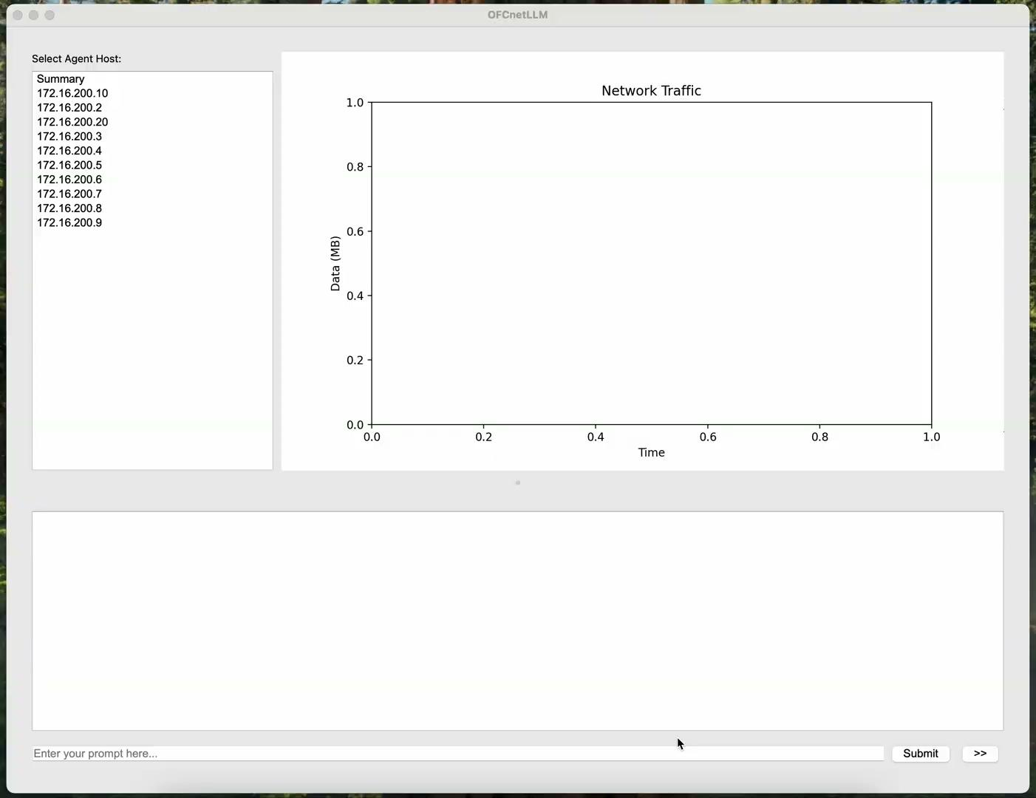
Use of AI in Networks
Deep Learning for studying traffic patterns - anomaly detection, optimizing infrastructure
Deep reinforcement learning for traffic engineering
LLMs for Networks – Learn over large datasets for unknown situations
OFCnetLLM
LLM designed for OFC Network Monitoring

Slide 55
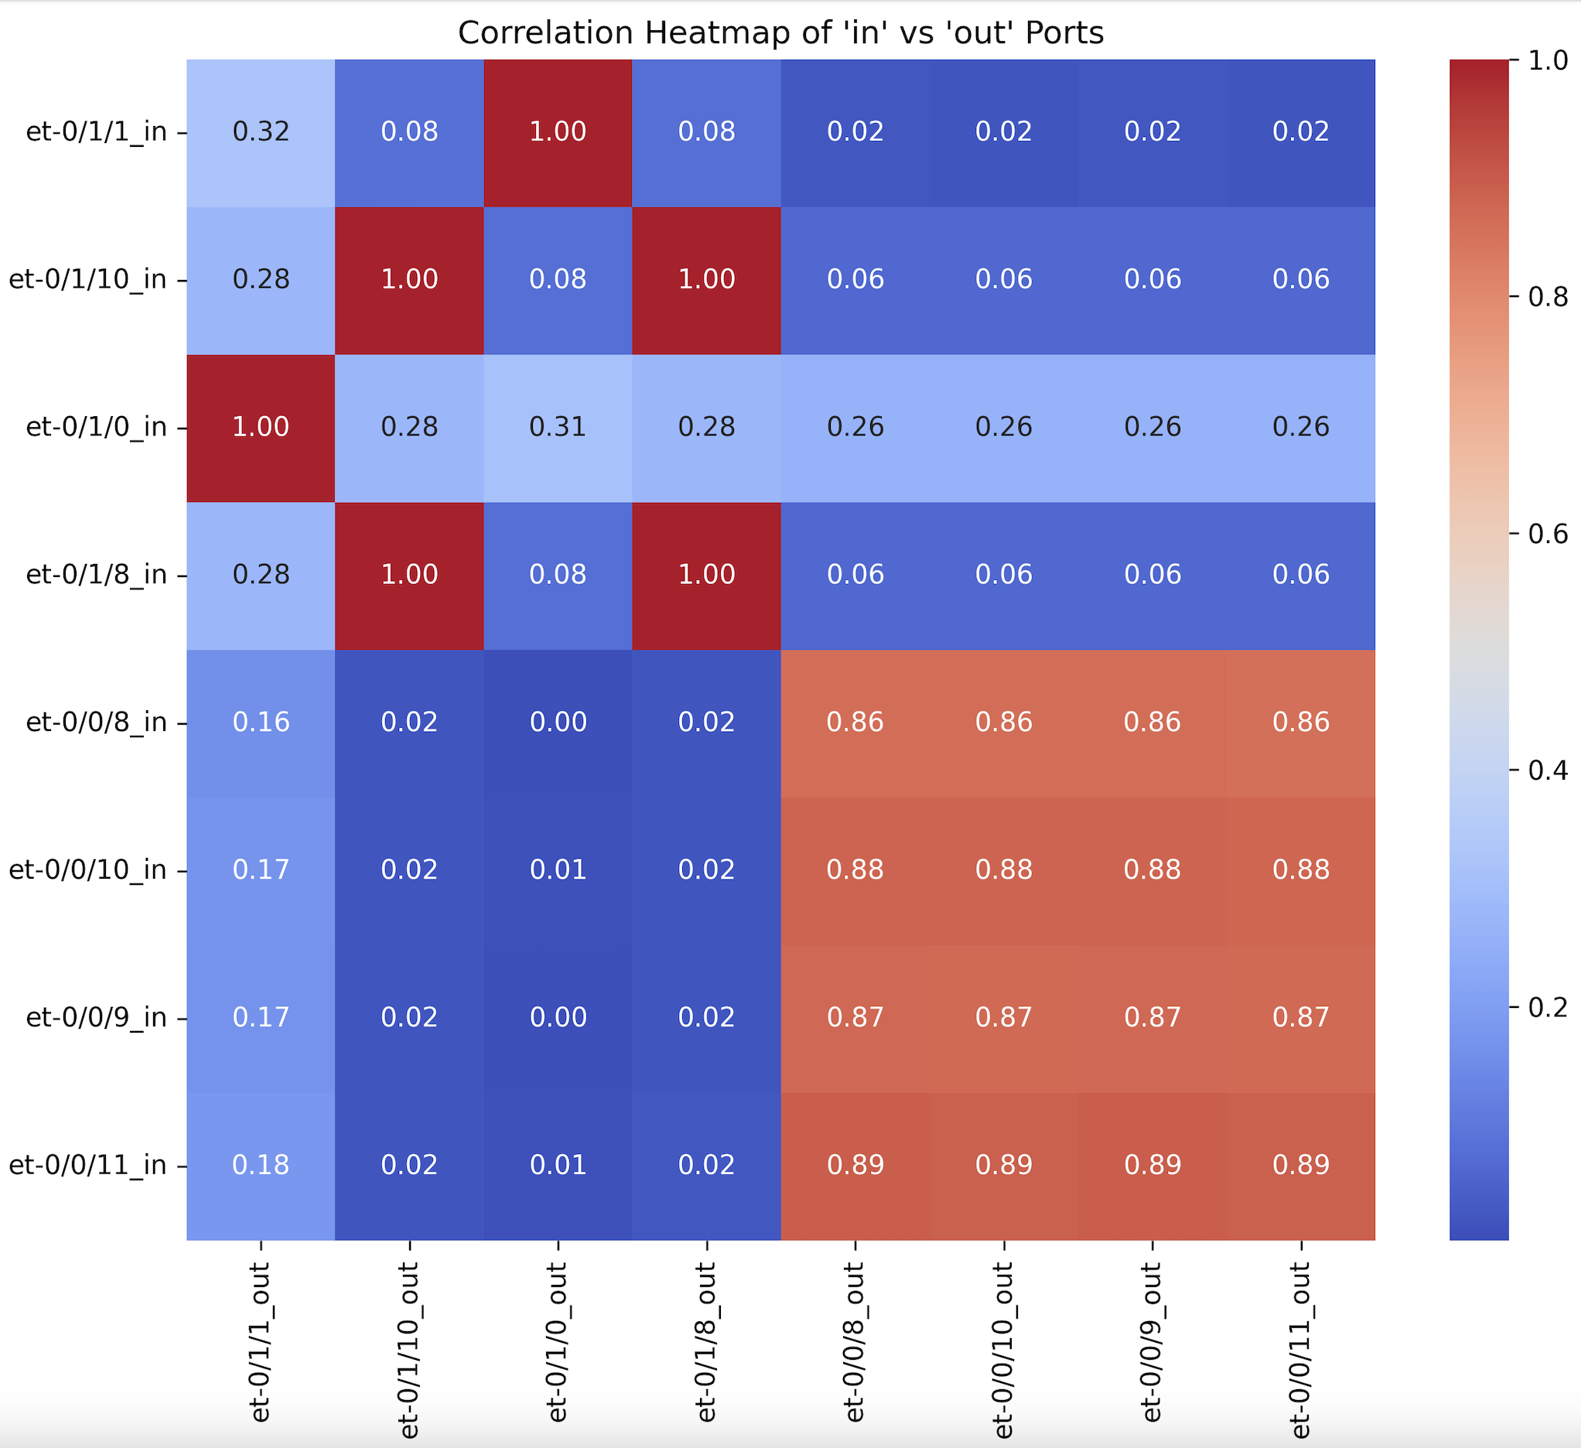
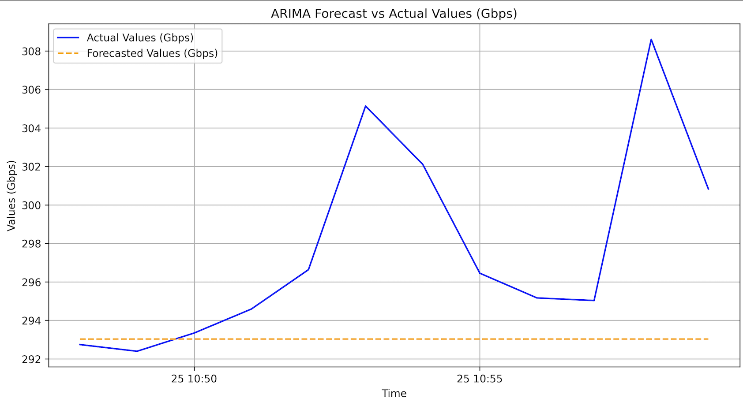
Key Considerations and Application of a DataLake:
Data Aggregation: Must be able to aggregate and ingest data from various sources. PMs, logs, SNMP, gRPC, sFlow etc.
Data Types: raw CLI, JSON, XML, log files etc.
Scalability: Must be able to scale horizontally as more devices and platforms are added.
Analytics Integration: Processed data must be made available and easy to integrate to BYO Analytics applications. This is valuable for future Data Analytics Challenges etc.
Security and Privacy: Data must be accessed in a secure way
Effective Data Storage and Movement: DAQ can turn into an expensive process if not processed correctly.
Statistical Topology Weaver
Network Parameter Forecasting

Slide 56
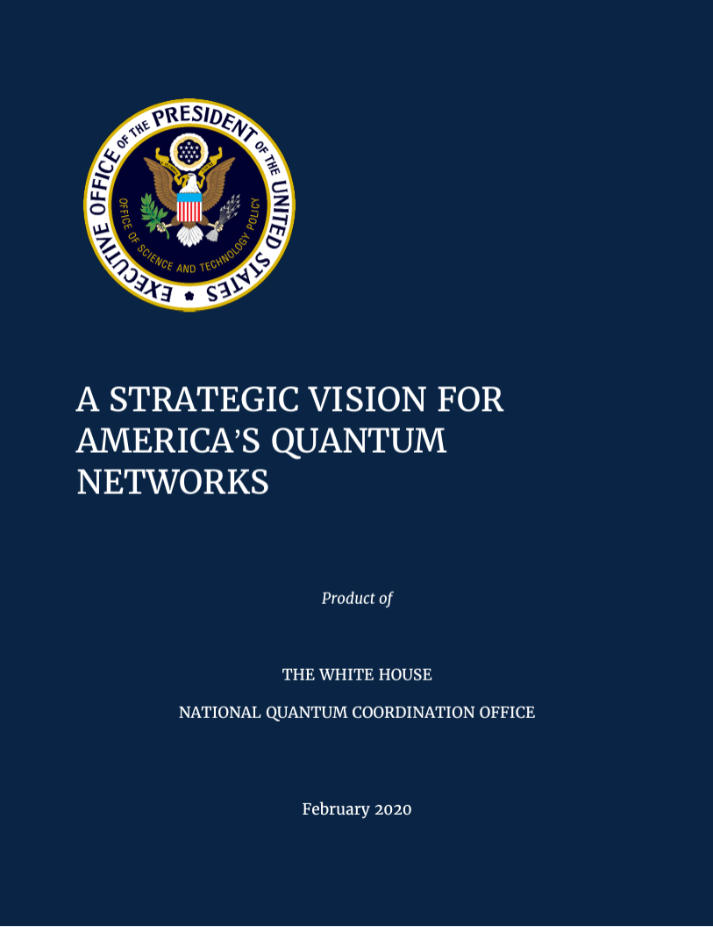



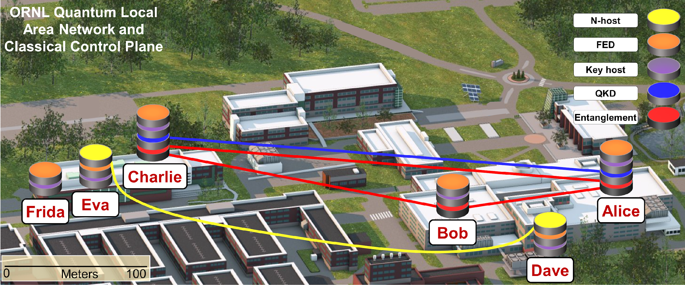
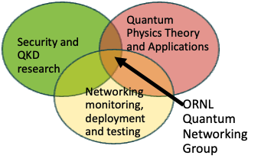
Quantum Networking at ORNL
DOE and Quantum
  Upgraded Detectors with Quantum capabilities
  Quantum Sensing: More precision measurements
  Distributing quantum states through entanglement: Q Computers will need Q Networks to scale
quantum/optic infrastructure (coexistence signals)
M. Alshowkan, et al., PRX Quantum 2 (4), 040304 (2021)

Slide 57
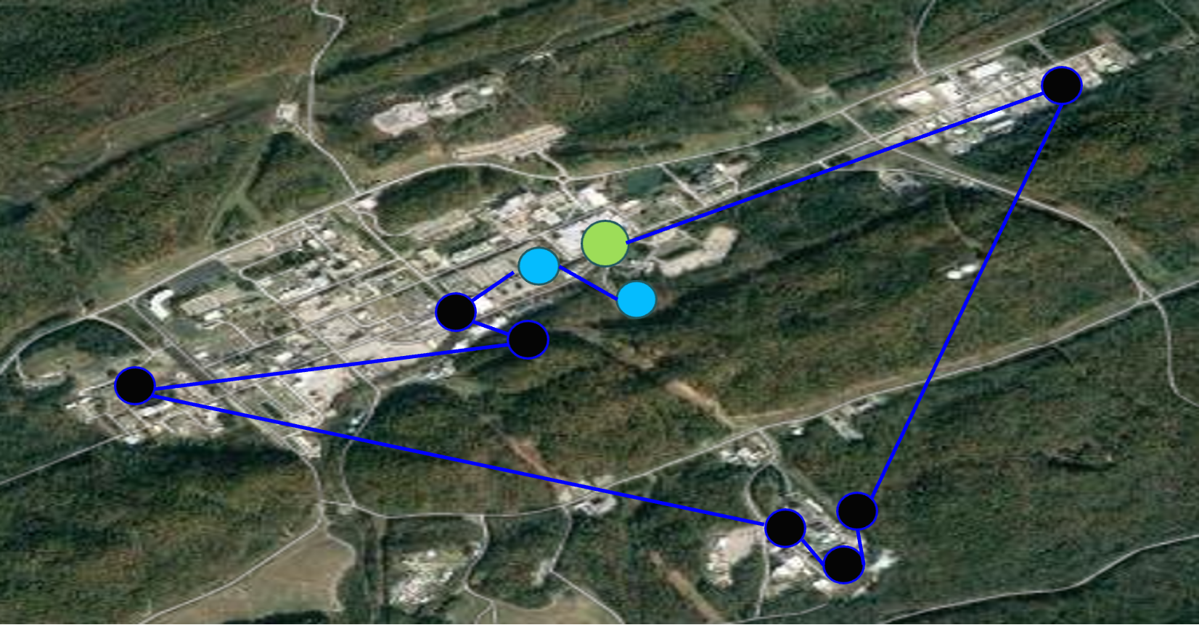
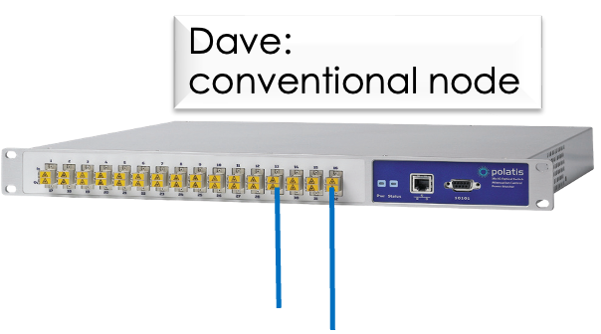
ORNL QLAN: the longest (300km) deployed dark fiber testbed in Lab Complex

Slide 58
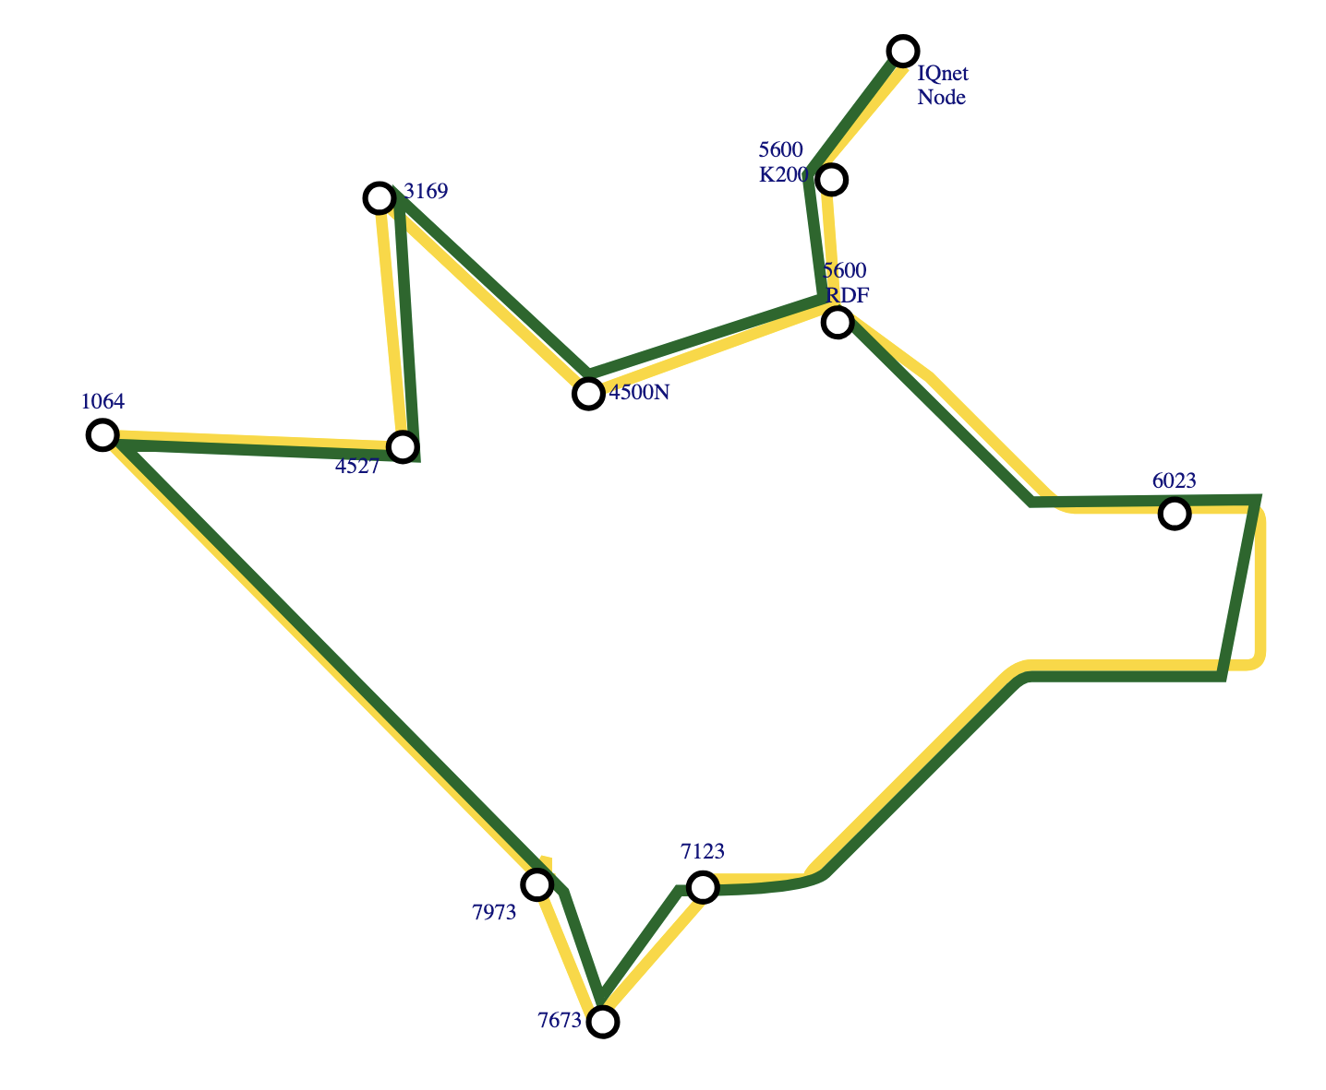
Developing a Quantum Network Testbed for Research
Deployed 400Gb fiber
Demonstrating Quantum Key Distribution (QKD) in smart grids, over fiber and free space
In-house development for Alice/Bob pairs for secure exchange (e.g. FPGA engineers)
Squeezing: showing coexistence of quantum and optic signals
Advancing state of art for networking, control plane, frequency modulation, splicing over channels, network standards (e.g. Internet Research Task Force)
300Km (20 loops of 15 km)

Slide 59
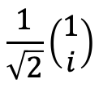
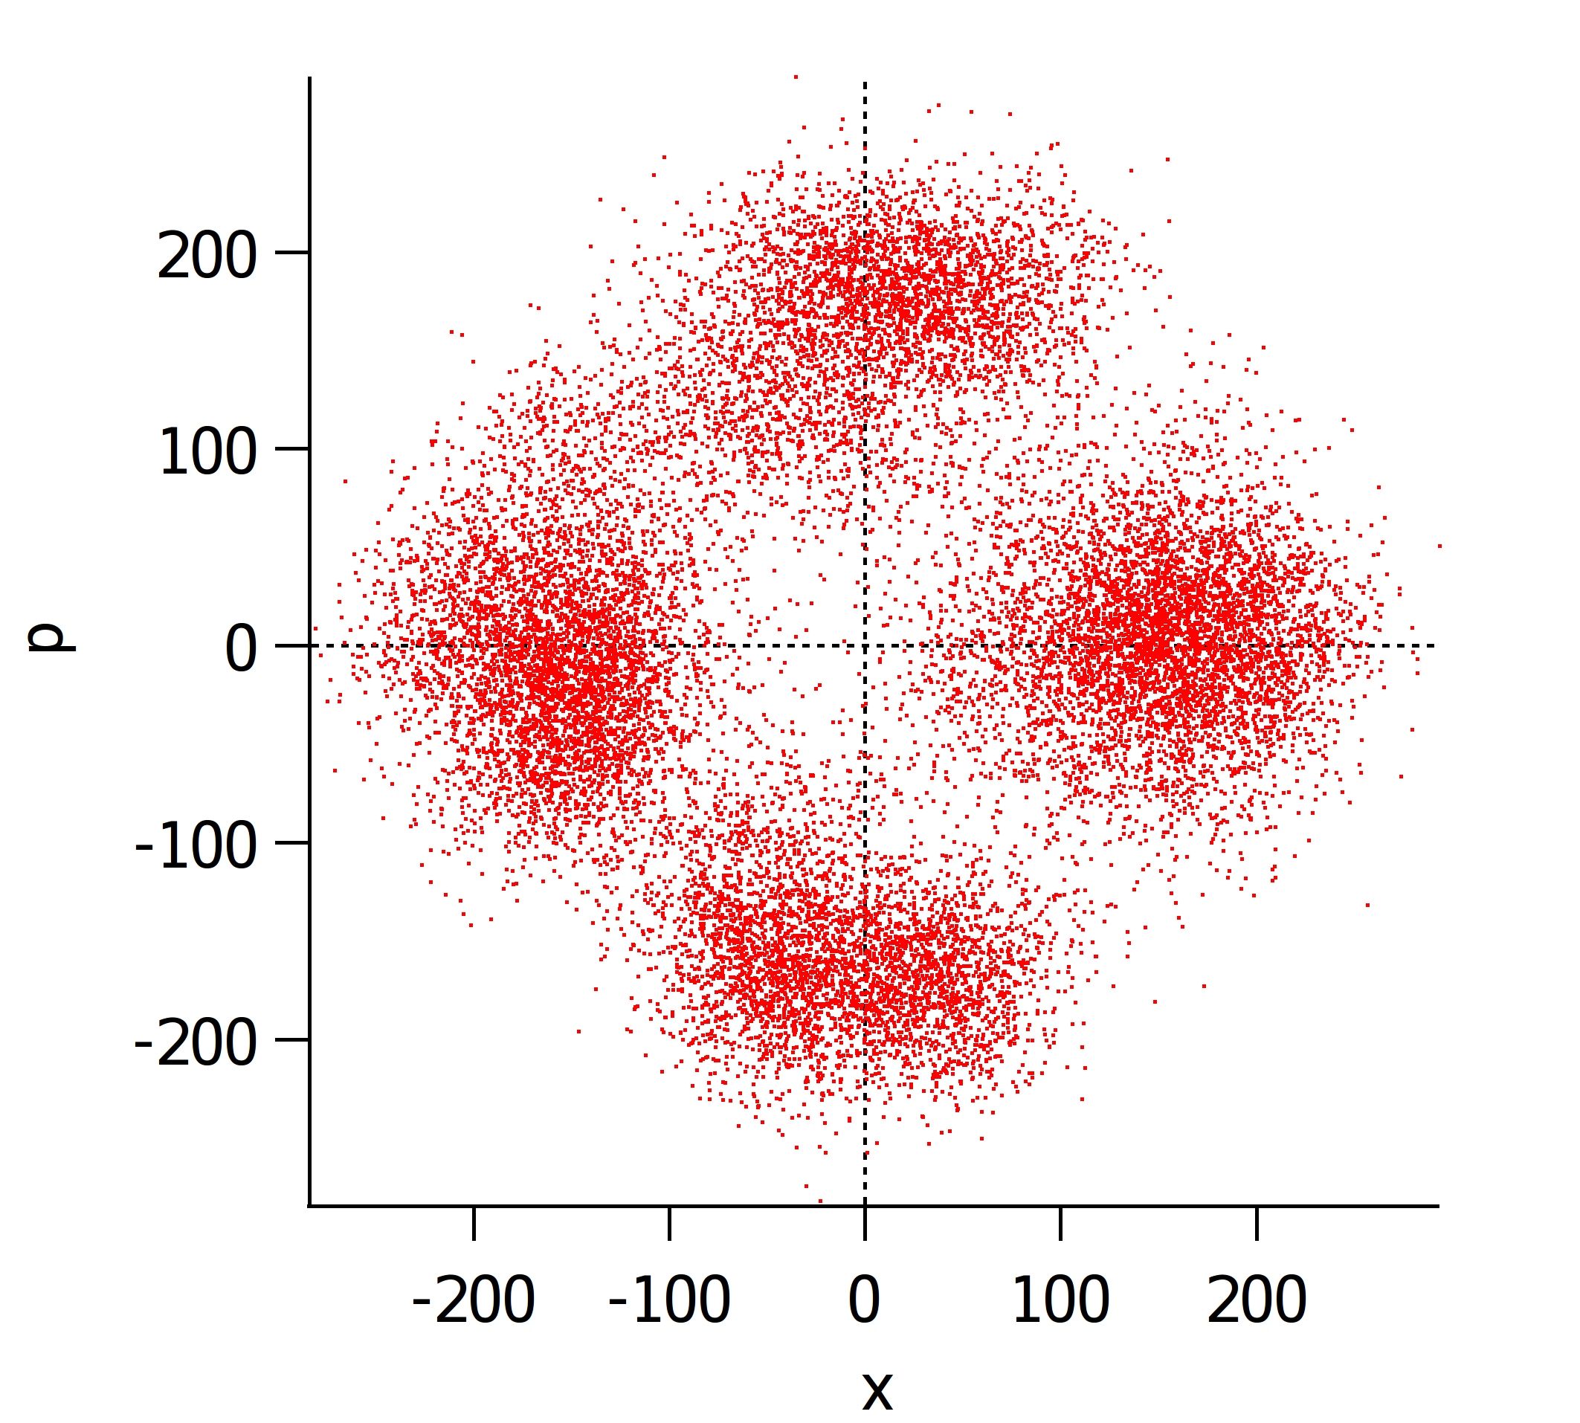

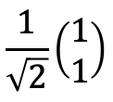


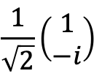
Discrete and Continuous Variables
From N. Peters
Poincare Sphere (qubit)
Continuous Variable (CV)
Examples: position-momentum, energy-time, amplitude-phase
Discrete Variable (DV): qubit
Examples: polarization,
orbital angular momentum, time-bin
Experiments with DV and CV for various applications

Slide 60
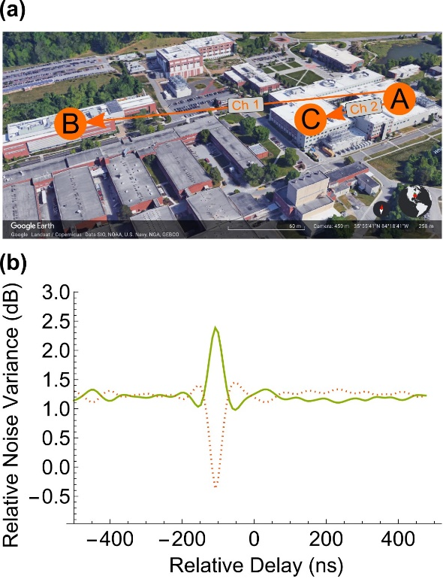
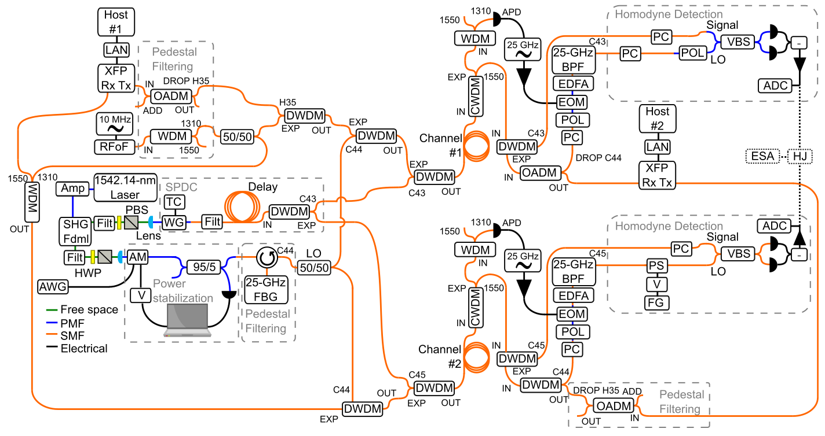
Squeezing and Entanglement
From N. Peters
Squeezed light is a useful quantum resource with applications across QIS
Squeezed light can coexist with classical networking signals without being corrupted by noise beyond some added insertion loss
Distributed joint homodyne detection to enable measurements of two-mode squeezing across our campus network
Chapman et al., “Two-Mode Squeezing Over Optical Fiber Coexisting with Conventional Communications .” Optics Express, (2023)

Slide 61
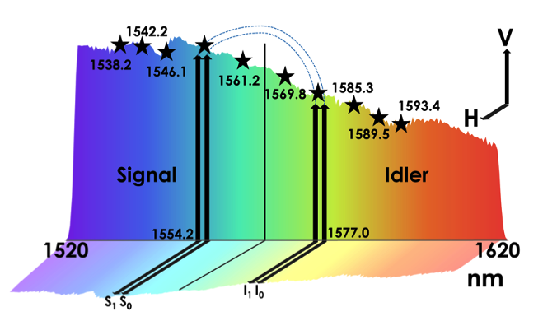
Distributing Entanglement across Distance
C-band
L-band
Select frequency channels to select rooms
Alice entangled with Charlie or Dave
Bob entangled with Charlie or Dave
C-band
Alice
Bob
A
B
Laser pump
Polarized entangled source
Frequency Demux
C
D
Photon pairs
L-band
Charlie
Dave
H Lu et al. Optics Letters (2023)

Slide 62
How Far can Entanglement Travel?
Examples | Distance
Entanglement using trapped ion (Hajdusek et al. ) (2023) | 50 km
LANL/NIST (2007) QKD | 148.7 km
Teleportation Free space (Zeilenger et al.) (2012) | 144 km
China (Wei Pan et al.) (2021) space | 4600 km
Over long distance, photon loss increases
Quantum repeaters use entanglement swapping for reliable transport over short distances
A
B
Entanglement swapping

Slide 63
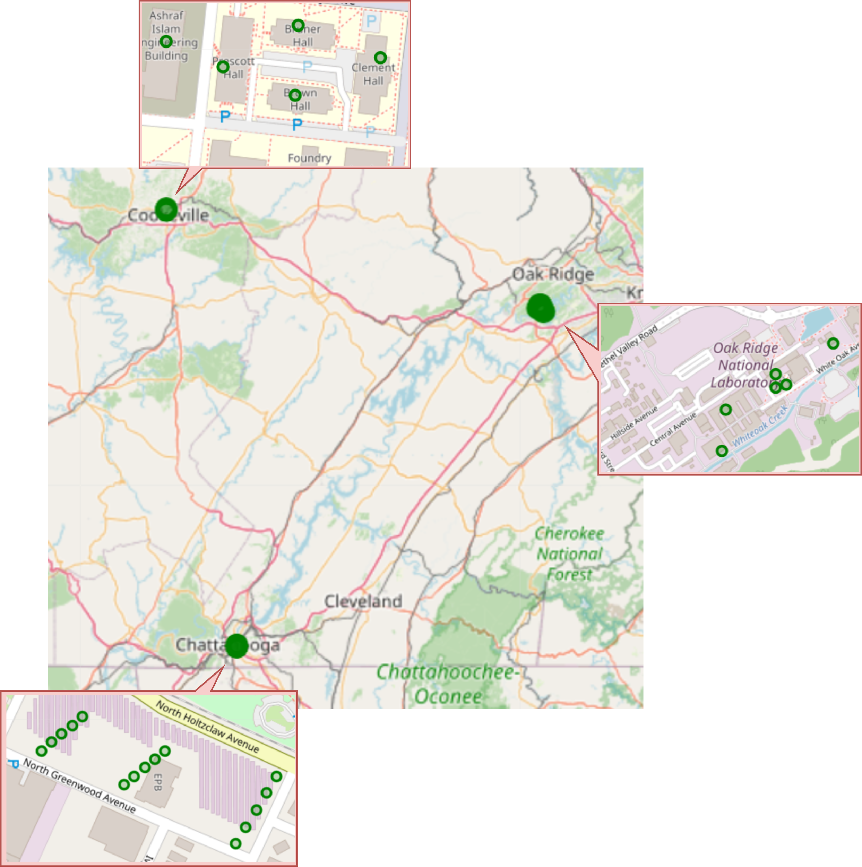
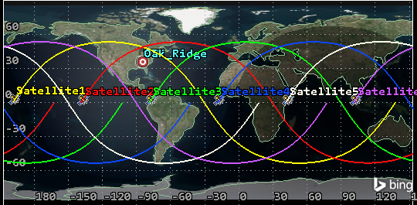
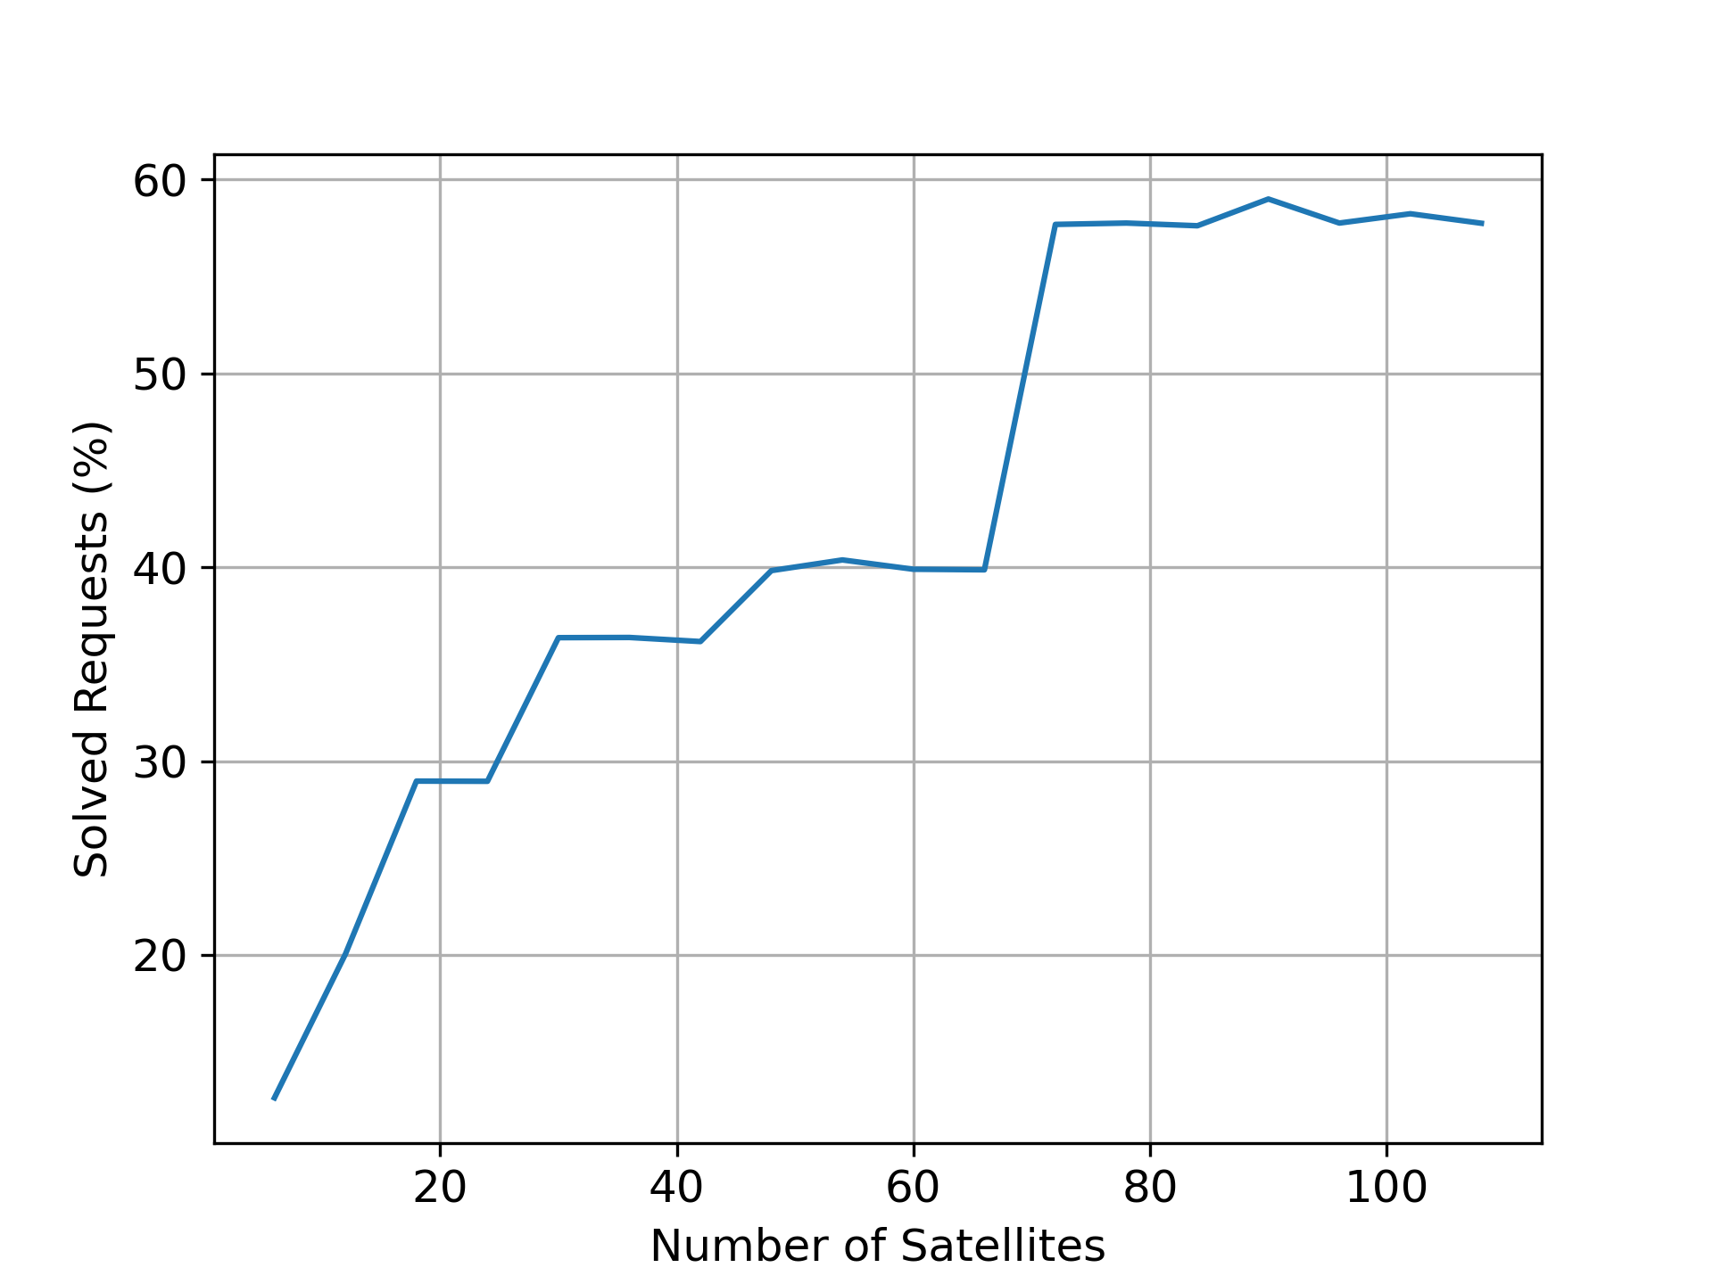
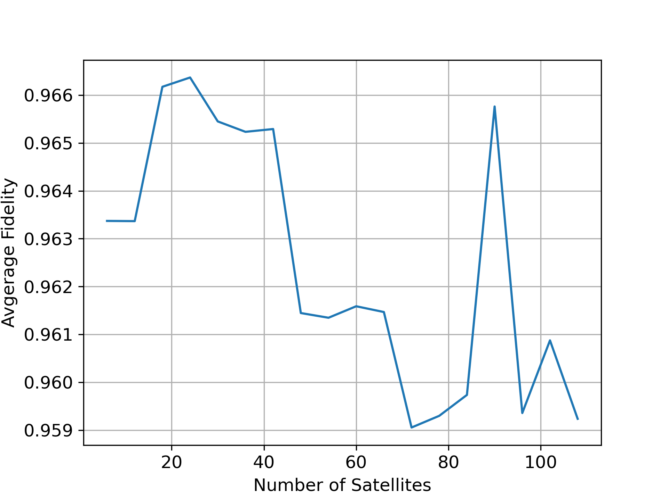
Investigating Satellite Communications
New optimization algorithms in simulation; until we get satellite access
Connecting (100 miles apart)
  EPB Chattanooga
  ORNL
  Tennessee Tech
Optimum number of satellites
  108 satellites provides 55.17% day coverage
  57.75% of entanglement distribution
  Average fidelity of 0.96
M. Mohammed, et al., INDIS SC (2024)

Slide 64

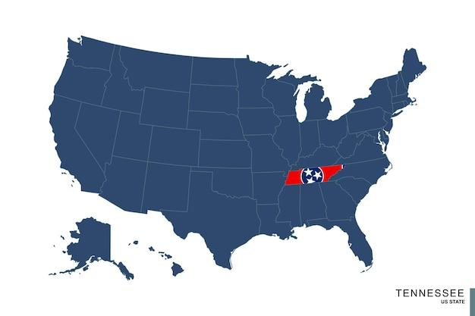



Repeaters, Infrastructure, Protocols and more
Impact of fiber quality, working with providers – Loss, fidelity
Research needed:
  Quantum memory
  Splicing
  Reducing loss (fiber)
  New routing algorithms (graph problem)
Key:
Quantum Router
Quantum Repeaters

Slide 65
Quantum networking early wins: report-out on the state of implementation
Wenji Wu
ESnet
OFCnet 2025 Workshop
San Francisco CA, USA
March 30, 2025
Notes:
Good afternoon, everybody! Welcome to the workshop! I am Wenji Wu, a network researcher from ESnet. Thanks the organizer for inviting me to this workshop. The title of this session is: Quantum network early wins: report-out on the state of implementation.

Slide 66
Agenda
World-wide quantum network efforts
Status for quantum network architecture and control
Status for scalable quantum repeaters and networks
System area, Local area, Wide area quantum networks

Slide 67
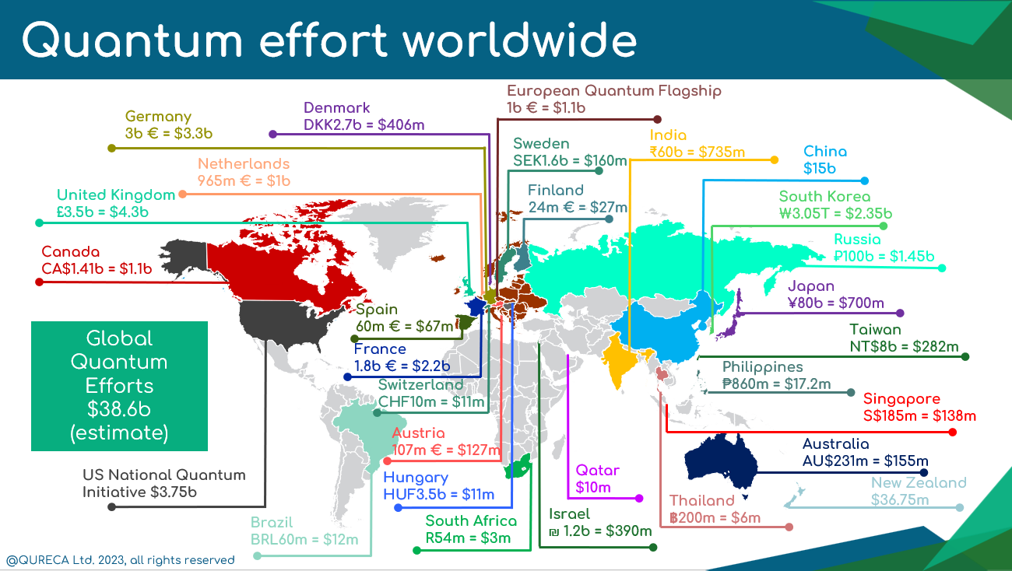
Quantum Computing and Networking is a Worldwide Initiative
Notes:
First of all, let me give some backgrounds on quantum computing and networking. Quantum computing and networking is a worldwide initiative.
Here is a picture I grad from the Internet, which shows the global investment in quantum computing and networking. The major players in this field are US, Europe, and China.
The competition in the fields of quantum computing and networking is intense.

Slide 68



World-wide quantum network efforts - US
The QUANT-NET Testbed (⁴⁰Ca⁺ ions)
ORNL-QLAN Testbed
Amazon-Harvard quantum network testbed (²⁹Si nuclear spins)

Slide 69




World-wide quantum network efforts - US (cont.)
Illinois-Express Quantum Networks
The INQUIRE quantum network testbed
Long Island Quantum Information Distribution Network (LiQuIDNet)
Boston-Area Quantum Network testbed
Notes:
LiQuIDNet: quantum memory, QFC

Slide 70




World-wide quantum network efforts - Europe
The Cambridge quantum network testbed
Innsbruck quantum network testbed
Bristol quantum network testbed
Swiss QKD network

Slide 71

World-wide quantum network efforts - China
The Micius Project

Slide 72


World-wide quantum network efforts - Japan
Moonshot quantum network testbed

Slide 73



Status for quantum network architecture & control
Quantum node control
Centralized quantum network control
Delle Donne, C., Iuliano, M., van der Vecht, B. et al. An operating system for executing applications on quantum network nodes. Nature 639, 321–328 (2025).
Monga, Inder, et al. "QUANT-NET: A testbed for quantum networking research over deployed fiber." Proceedings of the 1st Workshop on Quantum Networks and Distributed Quantum Computing. 2023.

Slide 74


Status for quantum repeaters and networks
Entanglement of trapped-ion qubits separated by 230 meters
Trapped ion quantum repeater node
Realization of a multinode quantum network of remote solid-state qubits
Krutyanskiy, V., et al. "Entanglement of trapped-ion qubits separated by 230 meters." Physical Review Letters 130.5 (2023): 050803.
Krutyanskiy, Victor, et al. "Telecom-wavelength quantum repeater node based on a trapped-ion processor." Physical Review Letters 130.21 (2023): 213601.
Pompili, Matteo, et al. "Realization of a multinode quantum network of remote solid-state qubits." Science 372.6539 (2021): 259-26

Slide 75


System area → Local area → Wide area (Quantum Internet)
Wide area to scale out
Wehner, Stephanie, David Elkouss, and Ronald Hanson. "Quantum internet: A vision for the road ahead." Science 362.6412 (2018): eaam9288.
Local area to scale out
System area to scale up
Pompili, Matteo, et al. "Realization of a multinode quantum network of remote solid-state qubits." Science 372.6539 (2021): 259-26
Monroe, Christopher, and Jungsang Kim. "Scaling the ion trap quantum processor." Science 339.6124 (2013): 1164-1169.

Slide 76
ESnet’s quantum activities at OFC’25
Paper
  Experimental Test of Bell-state Measurement for Narrow-band Ion-photon Interfaces in the Quant-net Testbed
    Session Title: Quantum Entanglement and Computing, M4E
    Session Time: March 31, 2025 from 4:30 PM to 6:45 PM Pacific Time (UTC-07:00)
    Session Location: Room 208 (Level 2)
Demos:
  The QUANT-NET Project Demonstration
    Location: Booth 5137
  Modeling and simulation of quantum networks
    Location: Booth 5137

Slide 77
Questions
What do you see as crucial R&D projects in the quantum technology space today, and how do you see the results impacting production networks in the immediate (3-5 year) future?
Could you unpack for us the extent to which current production network design drives or influences R&D progress in quantum technologies?
What do you think the next step is in quantum R&D, i.e., what will we be talking about or see demonstrated at OFC2026?

Slide 78
Networks of the Future:
Bleeding-edge technologies and how soon will they be here?
Sana Bellamine, CENIC MMBI, United States (Facilitator)
Lidia Galdino, Corning Optical Communications, United Kingdom
Dirk van den Borne, Juniper Networks, Germany

Slide 79
Questions
How are AI advancements impacting inter-datacenter connection development, and which spatial scales are becoming most critical (1km, 10km, 100km, 1000km, 10000km)? Are we seeing new trends in deployed solutions?
How does fiber selection impact the performance and capabilities of next generation networks? What advancements in fiber technology can benefit future production networks?
How do you see advancements in wireless technologies impacting next-generation optical networking development?
What is on the horizon that excites you in terms of hardware and/or protocol or advancements that will transform networking performance for hyperscalers or cloudy applications?

Slide 80
The Role of Parallelism in Driving Innovation in Fiber Optic and Cable Technology
Lidia Galdino
Corning Optical Communications
Notes:
Technology innovation often arises out of need to solve a problem. Today, I am going to discuss events that have happened and are happening in terrestrial backbone LH networks, how they have driving innovation in optical fibers and cables,

Slide 81


World-wide core networks bandwidth continues to grow while fiber capacity is saturating
26% annual growth
Source: Dell’Oro Group
Forecast
Notes:
There are two key events in terrestrial backbone networks. First, there's been exponential bandwidth growth over the last 25 years. To meet current and future bandwidth needs, we can increase data transmission in a single core optical fiber, via innovation in transport equipment, or add more fiber in in a give path (route)
Second, over the past decade, there's been a saturation or slowdown in single core fiber capacity enabled by commercial transport equipment.

Slide 82







Exponentially bandwidth growth and saturation in fiber capacity led to fiber count cable growth, doubles every 4-years
Capacity per path
spatial paths
Noise
Bandwidth
Corning analysis
Higher core density (fibers/mm²) is required to fully utilize precious space in the installed ducts
Notes:
This brings us to the third piece of evidence (event): The growth in fiber count cables over the years.
The combination of exponential bandwidth needs and a slow (sub-linear) growth in fiber capacity has led to an increase in fiber count cables) to meet the capacity per path needs
However, The increase in fiber count cables impacts cable density requirements for brownfield conduit sizes. Most backbone infrastructure builds today are brownfield, and conduits are valuable real estate. High-density cables are critical for duct maximization.

Slide 83








Innovative cable designs and smaller OD fibers enable a tenfold increase in fiber density over the last 20 years
~40% reduction in cross-sectional area (245 um to 190 um OD)
Density [Fiber/mm²]
Capacity per path
Polarization
Bandwidth
Noise
spatial paths (f/mm²)
2004
2008
2012
2016
2020
2024
Innovation in fiber design is required to increase density without compromising optical performance and therefore spectral efficiency
Notes:
What this means is - these events have led to a lot innovation in fiber and cable technology over the last 20 years, with cable density increasing by an order of magnitude
And, the cable density, defined as f/mm², has been achieved by redesigning the cable and reducing the fiber outer diameter, essentially by removing the coating.

Slide 84
Aggressive high-density cables combined with lower OD fibers makes them more susceptible to microbending-induced loss
Mechanisms to mitigate microbend induced attenuation in high density cables
Cable Design
Fiber
Design
Coating Attributes
Microbend stimuli along length
Microband induced attenuation
Core radius (MFD)
Refractive index/Optical
Total fiber diameter (OD)
Softer primary coating with lower modulus
Removing primary coating makes fiber more susceptible to microbending
Notes:
However, the coating is there for a reason. If the coating is removed, the fiber becomes more susceptible to microbending, which could impact attenuation and therefore the received SNR.
So there is a need to go back and redesign the product, the cable, and the fiber and the coating. Does it need a deeper trench? Can the MFD be maintained the same? Does it need a softer primary coating?
What I am trying to say is that we cannot simply remove the coating and pack the fiber in an aggressive cable design. It requires a much more engineered product when higher density is need.

Slide 85


Doubling subsea cable capacity and density with 1x2 MCF
1x2 MCF
1x2 MCF
The 1x2 Multi-Core Fiber (MCF) doubles the capacity of the subsea cable while maintaining the same number of fiber pairs
Notes:
To date, we have met the density needs by better engineering the optical fiber and cable technology while keeping the ecosystem compliant. What about the future? Can innovation continue on this path, reducing the fiber OD, or will it require a step change, such as MCF, to achieve future density needs?
The industry is confident that before the end of the decade, there will be a 2-core MCF trans-Atlantic cable to enable 1 P cable

Slide 86


Ultra-low attenuation and negligible cross-talk levels is paramount to not compromise spectral efficiency
Outer periphery
Inter-core pitch
[1] P. Tandon, at. all. “ Record Low Loss 0.144 dB/km 2-Core Optica Fiber for Submarine Transmission”, Journal of Lightwave Technology, June 2024
In an uncoupled core MCF design, an increase in the inter-core distance improves the inter-core crosstalk, but also places the cores closer to the outer periphery of the fiber cladding, resulting in increased radiation
Notes:
When it comes to the design of new fiber, for example the MCF for subsea amplication, the design rules are the same – no compromise in optical performance.
In other words, this MCF for subsea must maintain the same attenuation as today’s single core fiber, and the target XT level should not impact transmission performance.
Now it is supper clear the value of MCF to enable a step change in density, and we know we can do it without compromising transmission performance (at least for 2-cores MCF)

Slide 87





Can Hollow Core Fiber Solve the Scaling Challenge?
Source: Compilation of publicly available images (via Google image search)
Capacity per cable
Polarization
Bandwidth
Noise
spatial paths (f/mm²)
[1] SE vs. distance without (dashed lines) and with (solid lines) a transponder SNR limit of 30 dB
Upper bond of SE is set by transporter technology
HCF has the potential for a much wider ultra-low-loss spectral range compared to SMF
  Will transponders (amplifiers if needed) deliver similar SNR as today's operating at the telecom window?
Can HCF achieve the same cable density as SMF without compromising attenuation?
[1] Werner Klaus, “The Role of Parallelism in the Evolution of Optical Fiber Communication Systems,” Proceedings of the IEEE, November 2022
Notes:
But what about HCF? Can HCF solve the density scaling challenge? Here is a few things to take into consideration
The theoretically achievable loss and negligible nonlinearity could, in principle, be a game changer. However, it is well documented that the upper bound in SE, is settled by the transceiver subsystem, and marginal SE gain is expected for terrestrial LH.
Second, HCF's potential for wider ultra-low-loss bandwidth is a very positive optical property to scale capacity per path. Yet, the question remains: Will the transceivers (and optical amplifiers) that need to be developed for different wavelength operations deliver similar SNR as today’s C+L band?
The third point is about density. It all comes back to the fiber design. Literature has shown that the optimum HCF core diameter to minimize loss is ~30um (3x bigger than silica fiber). This goes against density, since #1 the fiber itself needs to be bigger than silica fiber and #2 the larger core makes the fiber more susceptible to micro-bending sensitivity. It is a trade-off: a large core minimizes loss but compromises size and microbending performance – both impact density

Slide 88







Pathways to overcome scaling challenges with SDM Fibers
Capacity per path
Polarization
Bandwidth
Noise
spatial paths (core/mm²)
Optical fiber properties that impact SNR include polarization dependency loss, crosstalk, mode dependency loss, intermode interference, microbend sensitivity, and attenuation.
Werner Klaus, “The Role of Parallelism in the Evolution of Optical Fiber Communication Systems,” Proceedings of the IEEE, November 2022
Signal generator
Receiver
Noise
Noise
Noise
Noise
Future optical line systems and transceiver technologies required to support these revolutionary fibers will also impact SNR.
Source: Compilation of publicly available images (via Google image search)
Notes:
What about more exotic SDM fibers? There is a clear benefit for enabling density, but what will be the compromise in performance across the entire ecosystem (MIMO DSP, SDM amplifiers, optical properties of the fiber itself… All to take into consideration when looking into the next generation for transport solutions (active or passive)

Slide 89
Networks of the future bleeding-edge technologies and how soon will they be here?
Dirk van den Borne
30th March 2025, OFCnet workshop, OFC 2025, San Francisco

Slide 90


A QUICK INTRODUCTION
Who am I?
Dirk van den Borne
  Director of Systems Engineering at Juniper Networks. Heading the Technology Solution Architecture organization for WAN/routing
  Originally from the Netherlands, now living in Munich, Germany
  OFC #20 this year 😱

Slide 91


THE BLEEDING EDGE TODAY
Example of a compact router platform
28.8T Packet Forwarding Engine ASIC
36 x 800GE with QSFP-DD800 ports
28.8T full-duplex throughput with 10B PPS
<30 W/Tbps power efficiency
800ZR/ZR+ supported on all 36 ports
<850W
(typical & without optics)
Juniper PTX10002-36QDD
First routing platform for which the optics can consume majority of the power consumption, more than the router itself!

Slide 92

WHAT’S NEXT
The most reliable way to predict the future is to create it
1600ZR+
1.6T/λ for long-haul transport: how to build it in less than 40W?
1600ZR
1.6T/λ for DCI: parity with 800ZR, but scale beyond C+L band?
800G ZR+
800GE anywhere: can we extend into the (ultra)-long-haul?
800ZR/ZR+
optics
400G ZR+
400GE into the metro-access: can we fit it in a QSFP112 or SFP-DD?
The most reliable way to predict the future is to create it
- Abraham Lincoln

Slide 93
Questions
How are AI advancements impacting inter-datacenter connection development, and which spatial scales are becoming most critical (1km, 10km, 100km, 1000km, 10000km)? Are we seeing new trends in deployed solutions?
How does fiber selection impact the performance and capabilities of next generation networks? What advancements in fiber technology can benefit future production networks?
How do you see advancements in wireless technologies impacting next-generation optical networking development?
What is on the horizon that excites you in terms of hardware and/or protocol or advancements that will transform networking performance for hyperscalers or cloudy applications?

Slide 94

Concluding Remarks
Thank you to our speakers & audience for your participation and engagement!
Comments & Feedback? sstrachan@nshe.nevada.edu, sana.bellamine@goldenstatenet.org
Check out the OFCnet NOC and Demos - Booth 5137
https://www.ofcconference.org/en-us/home/exhibition-and-show-floor-programs/ofcnet/

