Slide 1
OFCnet 2024 Introduction
Cees de Laat, University of Amsterdam, Netherlands
Reza Nejabati, University of Bristol, United Kingdom
Gwen Amice, EXFO, Canada
Andrew Lord, British Telecom, United Kingdom

Slide 2
Workshop
Started in 2023, OFCnet brings a new opportunity to the exhibition and demonstrates products, concepts, solutions, research, and architectures in live high-speed optical networks connected to the leading research and education networks worldwide.
This increased focus on designing and building next-generation Optical Networks will expand exposure to connectivity, emerging and next-generation network technologies such as Quantum Networks, programmable and software-defined optical networks, and their applications such as big data, security, and distributed classical and quantum computing.
This workshop brings together the innovators and researchers who work on the mentioned topics to enrich the OFCnet community further and expand the contributing parties. We discuss how this initiative should be developed to ensure OFCnet enriches future community participation.

Slide 3
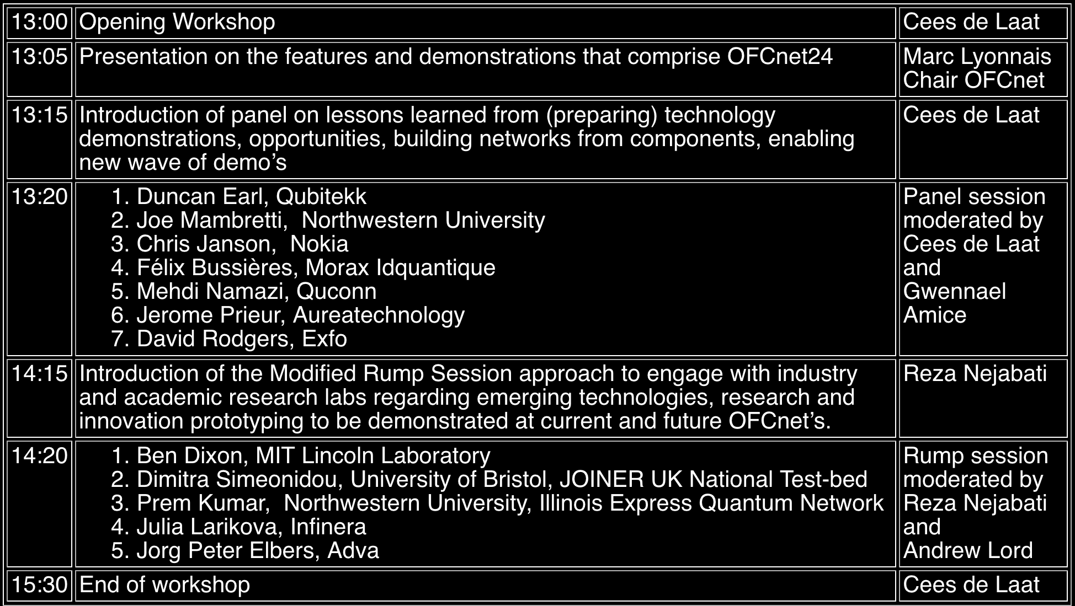
Program

Slide 4
OFCnet 2024
Marc Lyonnais, OFCnet Chair

Slide 5
Highlights
We are bringing a live Network on the Exhibit floor;
With 20 live demonstrations of these 9 are about Quantum Networking
We are 35 volunteers with international presence.
We are hosting hands-on live course as well as this workshop.
We are an Open Network with multiple Industry and Academic researchers.
Optica gave us great support to Reduce the barrier of live demonstrations and collaboration; OFCNet 2024 represents the culmination of 5 years of effort!

Slide 6
The 2024 Team Edition (35 people)
Network Build and Vendor Reachout
Management team +
Tunde Sanda CENIC
2 CENIC Engineers
Mike Blodgett Esnet
Jo-Ann Bender (Internet2)
Scotty Stracken (NSHE)
Chris Skaar (University of Illinois)
Demonstrations organization
Carl Williams (co-Team lead) CJW Quantum Consulting
Chris Tracy (co-team Lead) Esnet
Sergey Ten or Peter Wigley (Corning)
Security, Analytics and Measurements:
JP Velders (UVA) (co-Team lead)
Gwenn Amice EXFO
Gauravdeep Shami Ciena (Data Lake project) (co-Team lead)
Danial Ebling (UETN)
Tom Hutton (SDSC)
Mariam Kiran (ORNL)
Communications and Signage
Jennifer Inglisa (Optica) (Team lead)
Beth Harrington (Optica)
Ashley Collier (Optica)
Colleen Morrison (Optica)
Eve Griliches (Cisco)
Dave Brown (Nokia)
Rodney Wilson (Ciena)
OFCnet
Marc Lyonnais (Chair) Ciena
Jim Stewart (Vice Chair) UETN
Sana Bellamine (Deputy Chair) Will be OFCnet 2025 Chair
Casey Foulds (Program Manager) uTD
Jessica Pagonis Optica Liaison & Biz manager
Randy Giles Optica Scientific Advisor Liaison
Network Architecture
Scott Kohlert (Co-Team Lead) Ciena
Mike Blodgett (Co-Team Lead) ESnet
Logistics
Akbar Kara (Ciena)
Casey Foulds (uTD)
OFCnet Workshop, BoF
Cees de Laat (Team Lead) UVA
Reza Nejabati
Andrew Lord
Gwen Amice (Co-Team Lead), EXFO
Short Course
Gwen Amice (EXFO)
Christine Tremblay (ETS)
Panel Preparation
Casey Foulds (uTD)

Slide 7
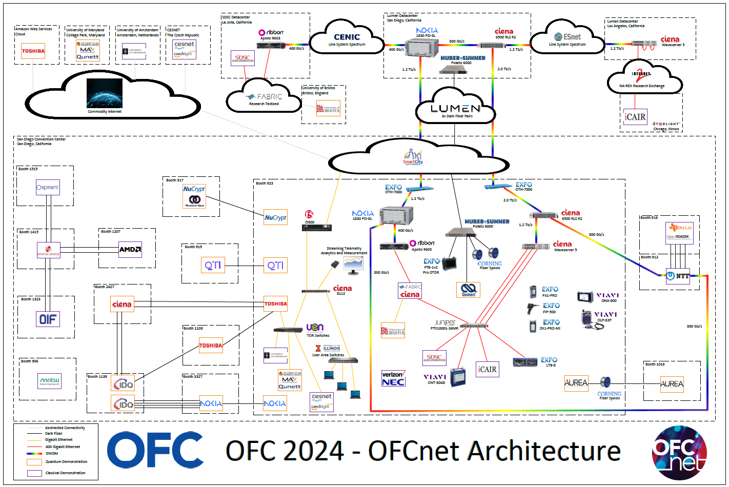
Architecture Diagram

Slide 8
OFCnet Exhibiting Companies
Kiosks (we have 11)
CESNET, z.s.p.o.
Ciena/FABRIC/SDSC
F5, Inc.
ID Quantique (share)
NEC Laboratories America
NOKIA (share)
OFS (share)
Qunnect Inc.
StarLight/International Center for Advanced Internet Research Northwestern University
University of Amsterdam
University of Bristol (they have 2 kiosks)
University of Maryland
Verizon
Booths (we have 6)
AUREA Technology
ID Quantique
IOWN Networking Hub (they have 2 booths)
NuCrypt, LLC
QTI SRL
The University of Texas at Dallas (they have 2 booths)

Slide 9
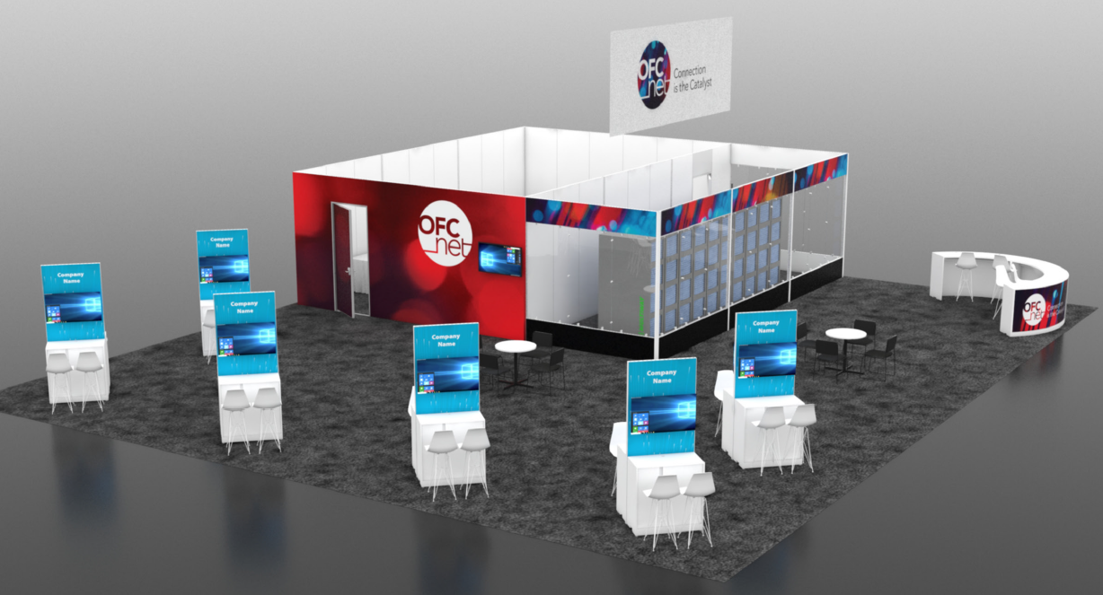
OFCnet Booth
Notes:
Specific Elements of Monetization:
Fiber connectivity (to offset SmartCity expenses)
$800 x 10 = $8,000 for “Founding” exhibitor connectivity
$1600 x 10 = $16,000 for new OFCnet connectivity
New Revenue:
Four 10 x 10 exhibit spaces - $3,500 x 4 = $14,000
Fifteen OFCnet kiosks
10 from academia @ $800 = $8,000
5 from corporate @ $3,000 = $15,000
Sponsorship
i. $10-20,000 in sponsorship of collateral (shirts, hats, jackets) and promotional sponsorships
Kiosk (in OFCnet Booth)
Kiosk Package USD 3000
Includes backwall for graphics/branding, lockable counter-height cabinet, two bar stools, carpet, Company ID, monitor, one RJ45 and one 15 amp electrical drop.
Kiosk Package (Academic and Research Institution Only) - USD 800
Includes backwall for graphics/branding, lockable counter-height cabinet, two bar stools, carpet, Company ID, monitor, one RJ45 and one 15 amp electrical drop.
Note: no additional equipment will be permited in the kiosks (i.e. servers). Direct fiber access is available upon approval.
OFCnet 10x10 Booth
2023 OFCnet Participants - USD 3800
New OFCnet Participant - USD 5400
Booths come with one (1) fiber pair
Fiber Connectivity to OFCnet
Current 2024 exhibitors may participate and connect to OFCnet from their existing booths. The following rates apply:
2023 OFCnet Participants - USD 800
New OFCnet Participant - USD 1600

Slide 10
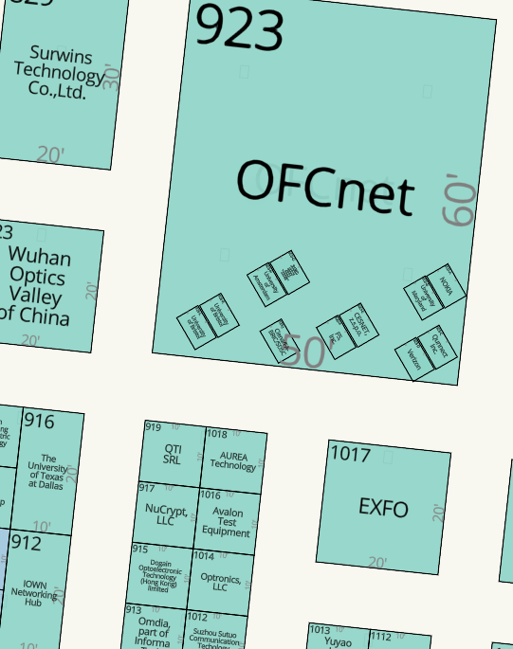
OFCnet

Slide 11
Program

Slide 12
OFCNet Workshop Panel
Dr. Duncan Earl
President & Chief Technology Officer
Qubitekk, Inc.
March 2024

Slide 13
Quantum Networks Today
EPB Quantum Network (deployed/commercial)
Center for Quantum Networks (CQN) - Tucson
Boston-Area Quantum Network(BARQNET) - Boston
MIT Quantum Network Testbed - Boston
Chicago Quantum Exchange (CQE) - Chicago
Quantum Application Network Testbed for Novel Entanglement Technology (QUANT-NET) - Berkeley
MSU Quantum Network – Bozeman
AFRL Quantum Network – Rome
DC-QNet – Washington, DC
Hybrid Quantum Architectures and Networks (HQAN) – Urbana-Champaign
Tri-City Quantum Network – Sherbrooke
Los Alamos National Lab Quantum Network
7
11
8
4
3
5
9
6
10
12
1
2

Slide 14
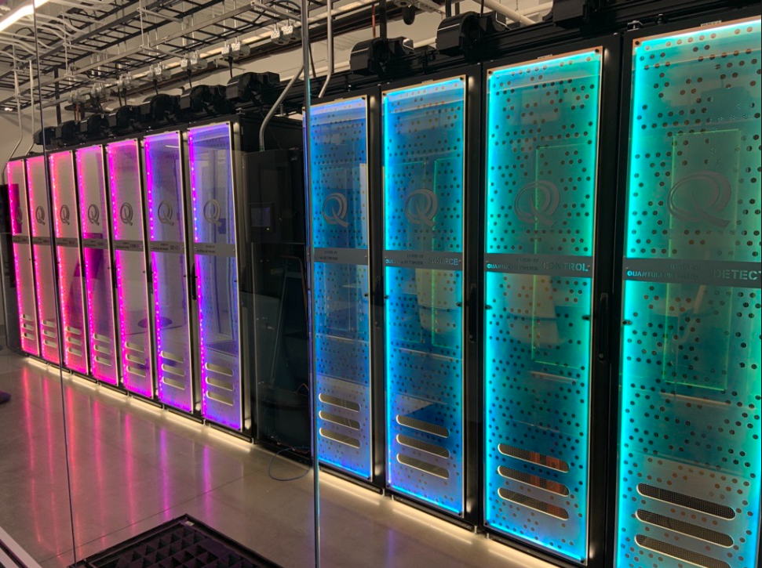
over the next 5 years…
Early network “frameworks” are currently being adopted – winners and losers to follow
Quantum network components will expand rapidly:
  Memories
  Efficient frequency converters
  Active channel correction
  Timing and synchronization
  Network simulators
  Control and monitoring software
Lots of industry education coming
  Fiber optic asset owners are still currently trying to figure out what quantum is and means for their business
  OFCNet could provides hands-on education and training to industry
  OFCNet could coordinate network operators and identify best-practices for rest of industry
“Common-use” quantum hardware in the EPB Commercial Quantum Network

Slide 15
Thank You
Contact:
Dr. Duncan Earl
e-mail: dearl@qubitekk.com

Slide 16
Program

Slide 17
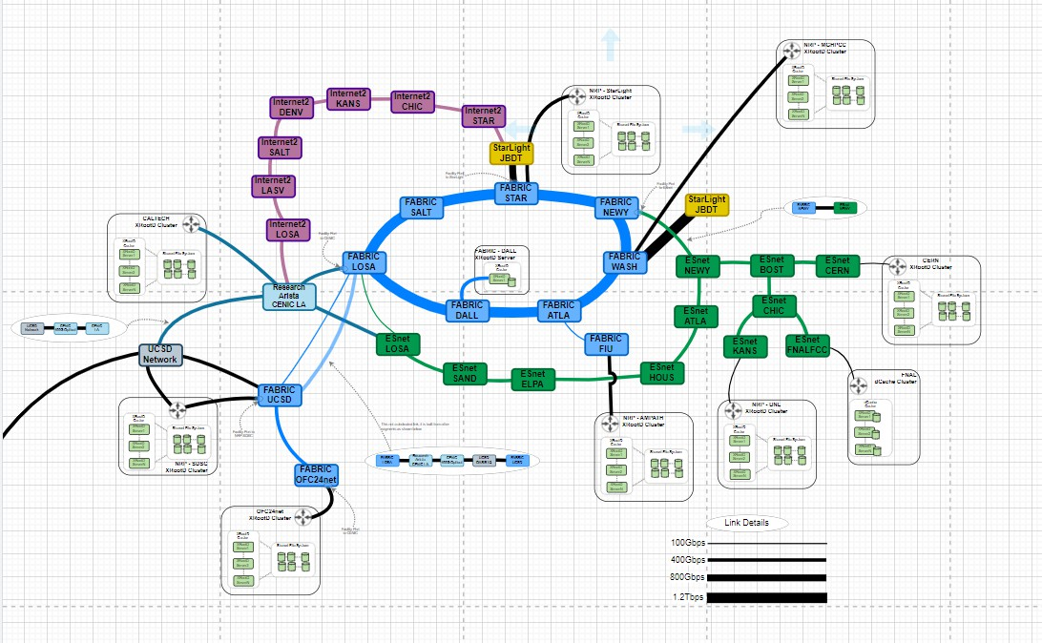

Slide 18
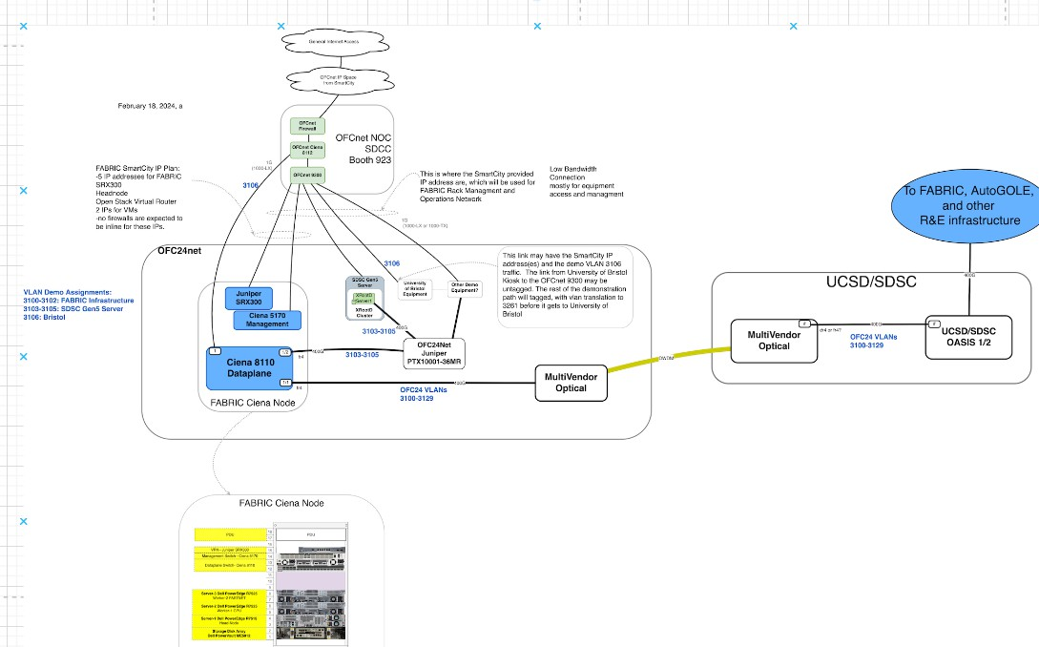

Slide 19
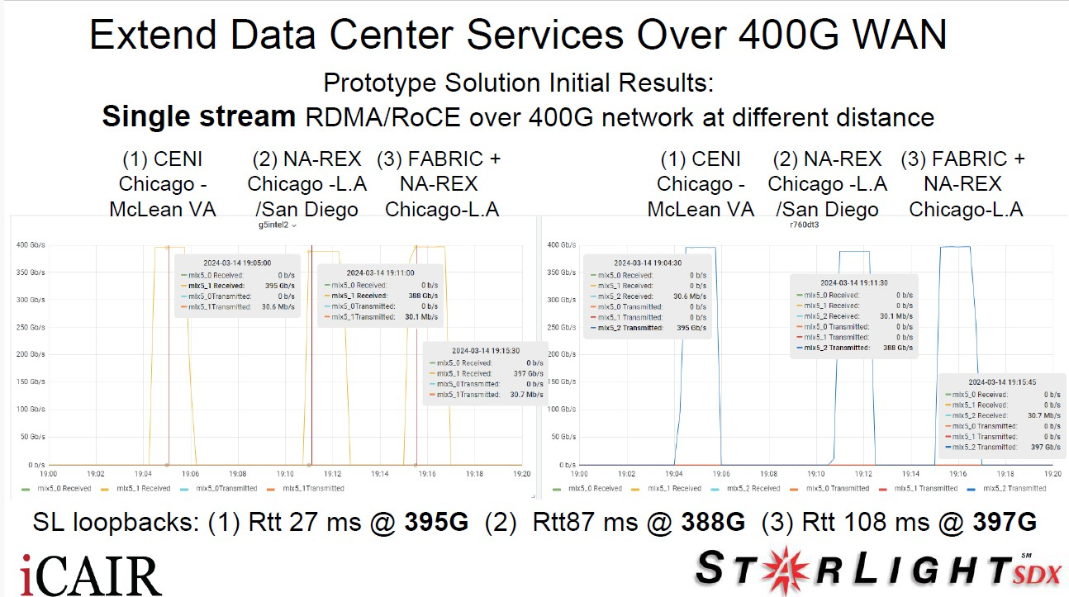

Slide 20
Program

Slide 21
QKD demonstration
OFCnet
Amplify your network
OFC 2024

Slide 22
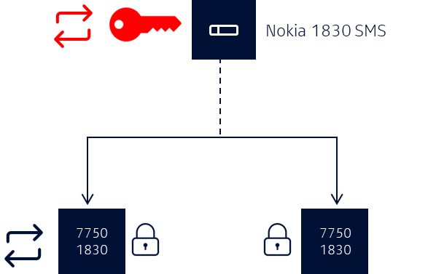
Nokia Quantum-Safe Networks
Automated, pre-shared, symmetric key distribution
Classical physics-based key generation
MACsec
OTNsec

Slide 23

Nokia Quantum-Safe Networks
QKD with automated, pre-shared, symmetric key distribution
QKD appliance
QKD appliance
Quantum key generation/
distribution
Quantum key orchestration
Classical physics-based
key generation
OTNsec
MACsec

Slide 24





OFCnet
QKD hybrid key management demonstration
Alice
(Nokia booth)
Bob
(IDQ booth)
Quantum Layer
IDQ
Cerberis XGR
KMS Layer
SOC
(OFCnet booth)
IDQ
KMS
Physical/Network/Data layer
Nokia
1830 PSI
DFC12E; 400G
Nokia 1830 SMS

Slide 25
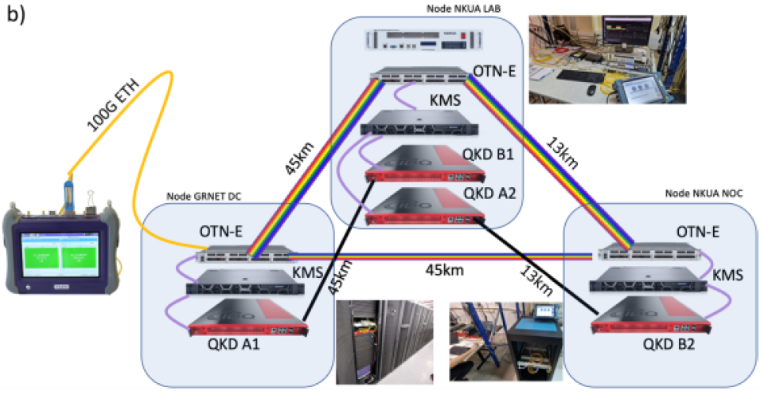
OFCnet
GRNET QKD-hybrid demonstration facts
Nokia 1830SMS acts as key orchestrator; both for quantum (thru KMS) and classic keys
KMS attack simulated by disabling KMS, QKD attack by blocking Q-channel
Reverts to classic key usage when QK not available
Key rotations tested at 1, 5, 15, 60 mins
Quantum key buffers with up to 1K keys, exp in 4 hours

Slide 27
Program

Slide 28

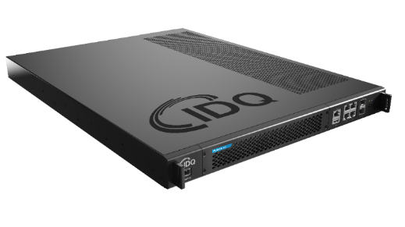

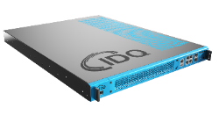


IDQ’s comprehensive range of Quantum Key Distribution solutions
Proven and highly reliable technology
Designed for complex topologies and large-scale deployments
Clavis XG
Last mile
Backbone
Last mile

Slide 29





Korean National Convergence Network Project
[ QKD & KMS Network ]
2000
kilometers
IDQ and SK Broadband selected for the construction of the first nation-wide QKD network in Korea
48 government organizations
Security, stability & efficiency
Gov. regional office
Customer ring
SKB regional office
SKB backbone
Customer KMS link
Ext. key
SKB KMS link

Slide 30
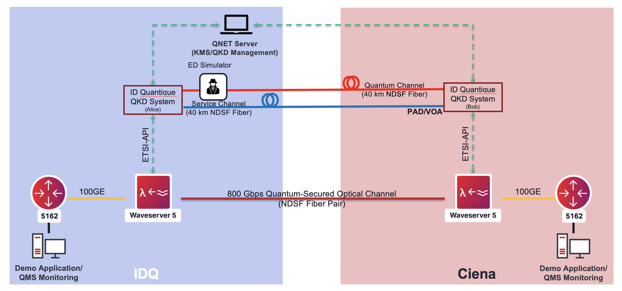

OFCnet 2023 – Joint Ciena/IDQ demo

Slide 31
OFCnet 202x – Arising topics on which the OFCnet community can play a role
Confronting the physical challenges of integrating QKD into classical networks (classical/quantum mix, network topology limits)
Key management systems (KMS) : scalability, interoperability between vendors
Utra-high-rate QKD/Ultra-long-distance QKD : how to integrate the supporting (still maturing) technologies in classical networks?
The rise of quantum networks that exchange entanglement : totally different that what we have today

Slide 32
Program

Slide 33


Pioneering Solutions for
The Quantum Internet
Mehdi Namazi
Chief Science Officer
Qunnect Brooklyn

Slide 34
What is our end goal?
Practical distribution
of
useful entanglement
over
longer (and longer) distances

Slide 35
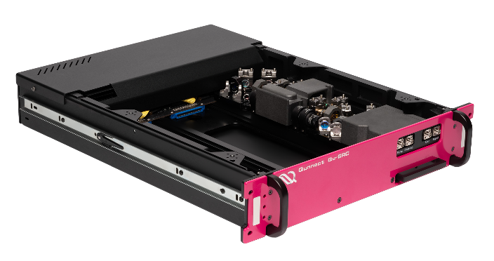
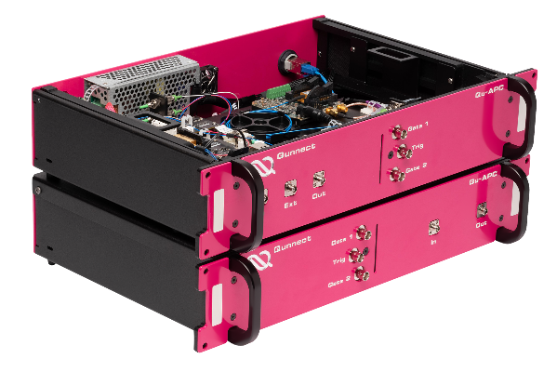
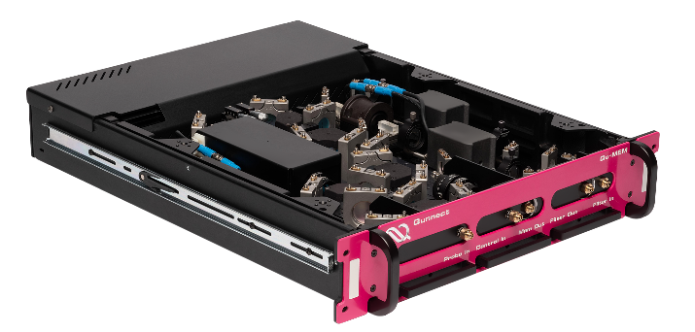

Our core capabilities
Generating Entanglement
Preserving Entanglement
Storing Entanglement
QU-SOURCE
Only source on the market that can be used for applications beyond secure communication
QU-LOCK
High precision reference for stabilizing lasers driving QU-SOURCE
QU-LAS (available mid 2024)
Turnkey laser solution to drive
QU-SOURCE
QU-APC
Auto Polarization Compensator
Maintains high channel fidelity and network uptime resulting in low QBER (quantum bit error rate)
QU-MEM Quantum Memory
Providing temporal control to quantum networks
QU-MEM Broadband (2025)
Improved performance specs for optimal interfacing
QU-VAL (available mid 2024)
Validating entanglement for networking protocols

Slide 36

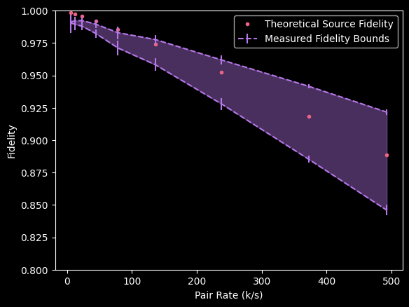
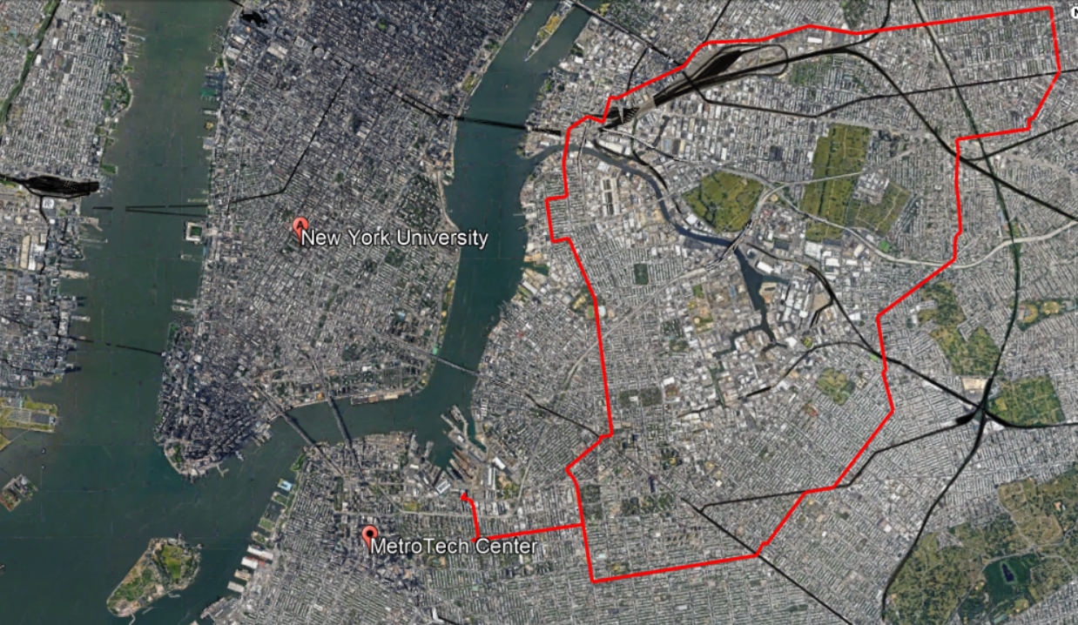

Ent. Distribution over 34km of NYC’s fibers

Slide 37
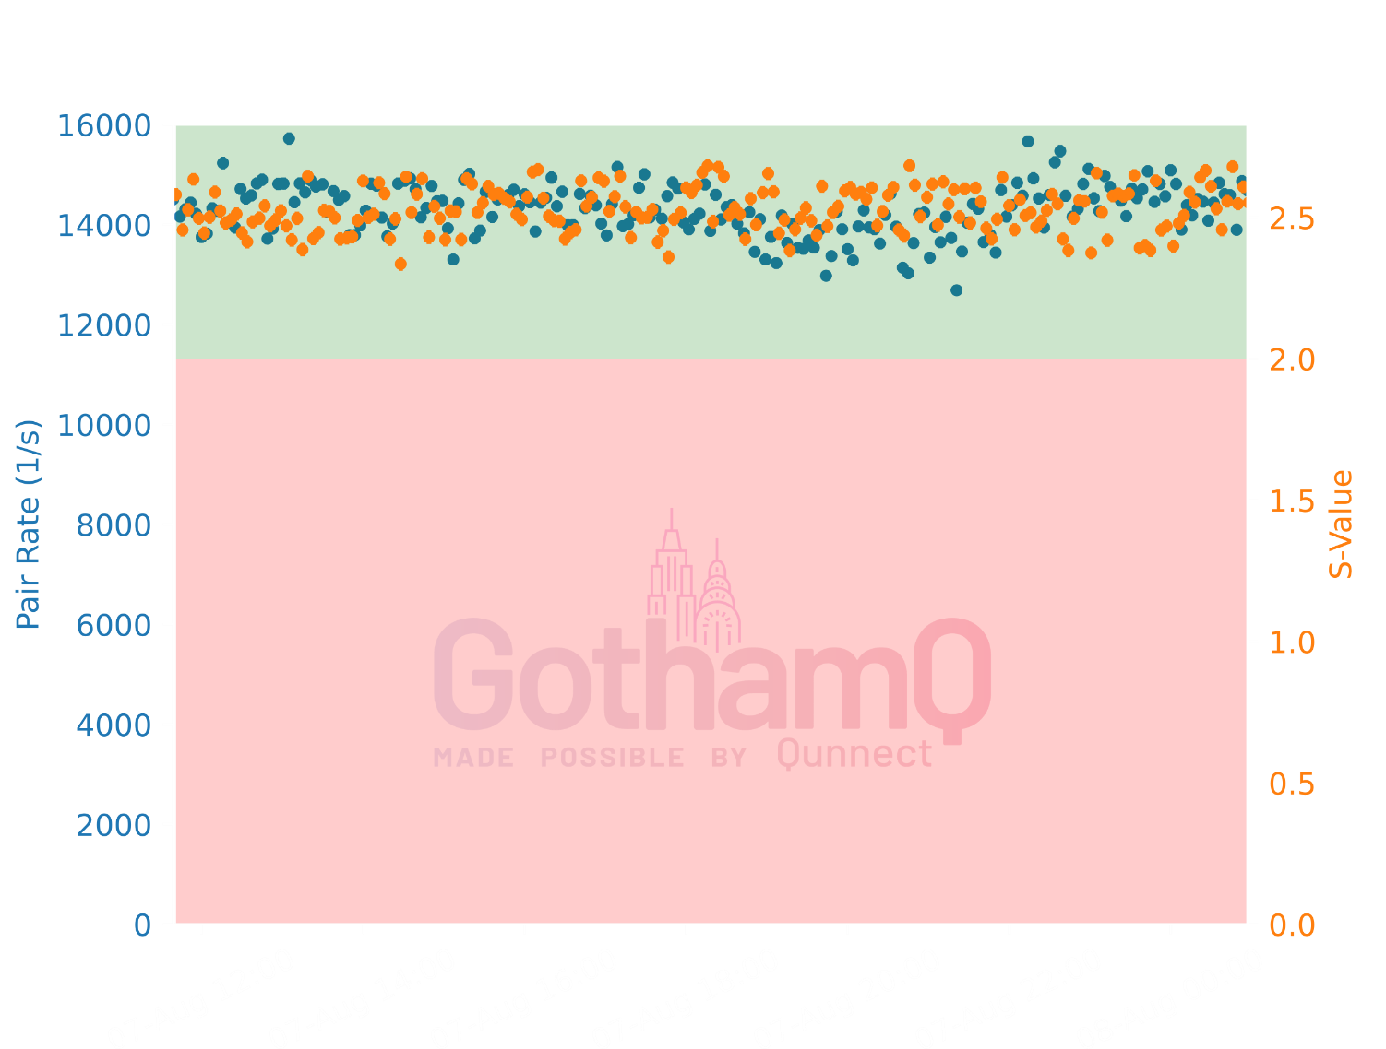

Qunnect(BrooklynQ)←→NYU (BroadwayQ)
In collaboration with: NYU’s CQIP

Slide 38
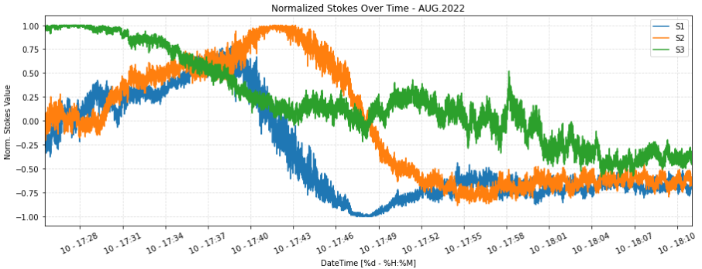
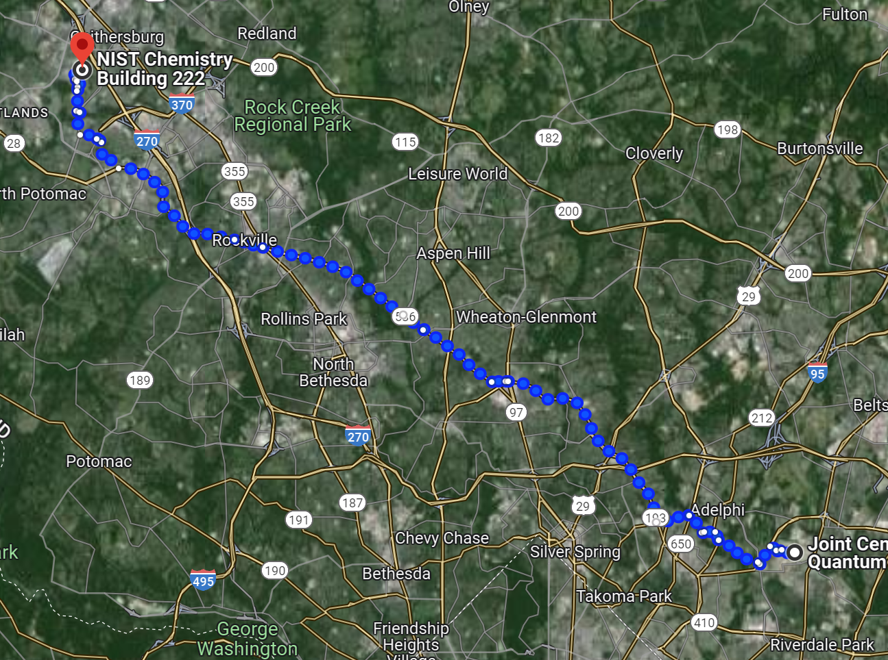
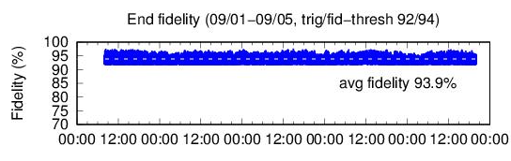
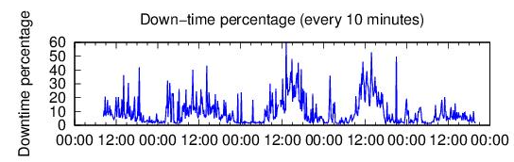

NIST←→JQI (U Maryland)
~ 60km aerial fiber (22dB loss @ 1550)
Recent compensation results over 5 days, 94% avg Fidelity @ 90% uptime.
In collaboration with:
Yicheng Shi, Mheni Merzouki, Abdella Battou, Oliver Slattery, Thomas Gerrits

Slide 39
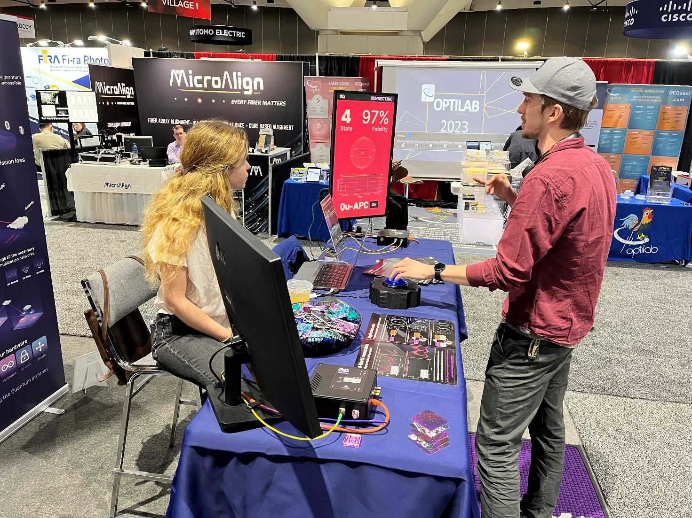
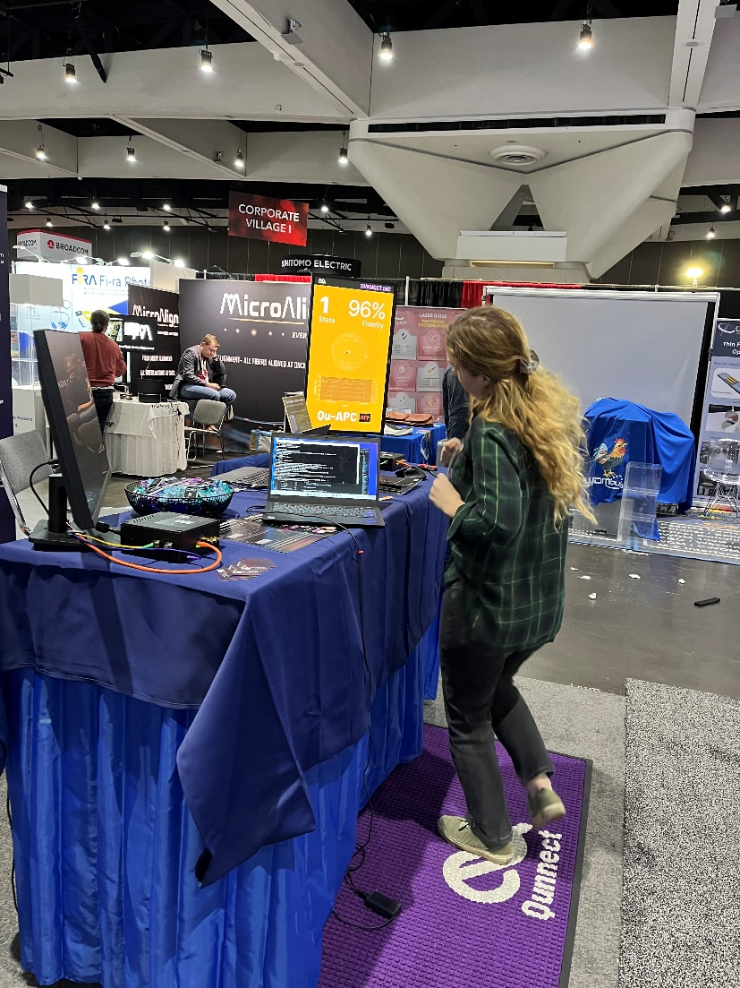
OFC 2023
Demo of the real-time performance of our Qu-APC by stomping the fiber!

Slide 40
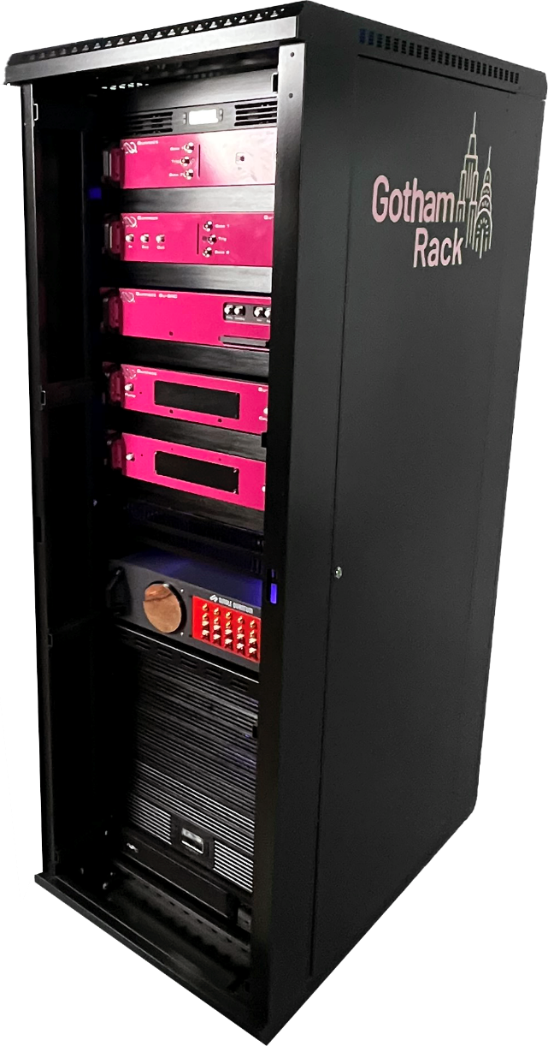
From Devices to solutions
World’s first plug and play, automated rack solution for distributing useful entanglement
World’s first atomic-based entanglement source
10 M pairs/s | 95% fidelity | sub-GHz linewidth
World’s fastest polarization compensating device
99% fidelity | <2dB loss | fully automated
Automated inter-node entanglement validation
configurable to user’s requirements
Integrated lasers and telecom wavelength reference
Integrated multichannel TDCs with inter-link ns
Synchronization and multiplexed single photon detectors
Classical network routing and servers for control
and automation

Slide 41


HARDWARE, NOT HYPE

Slide 42
Program

Slide 43
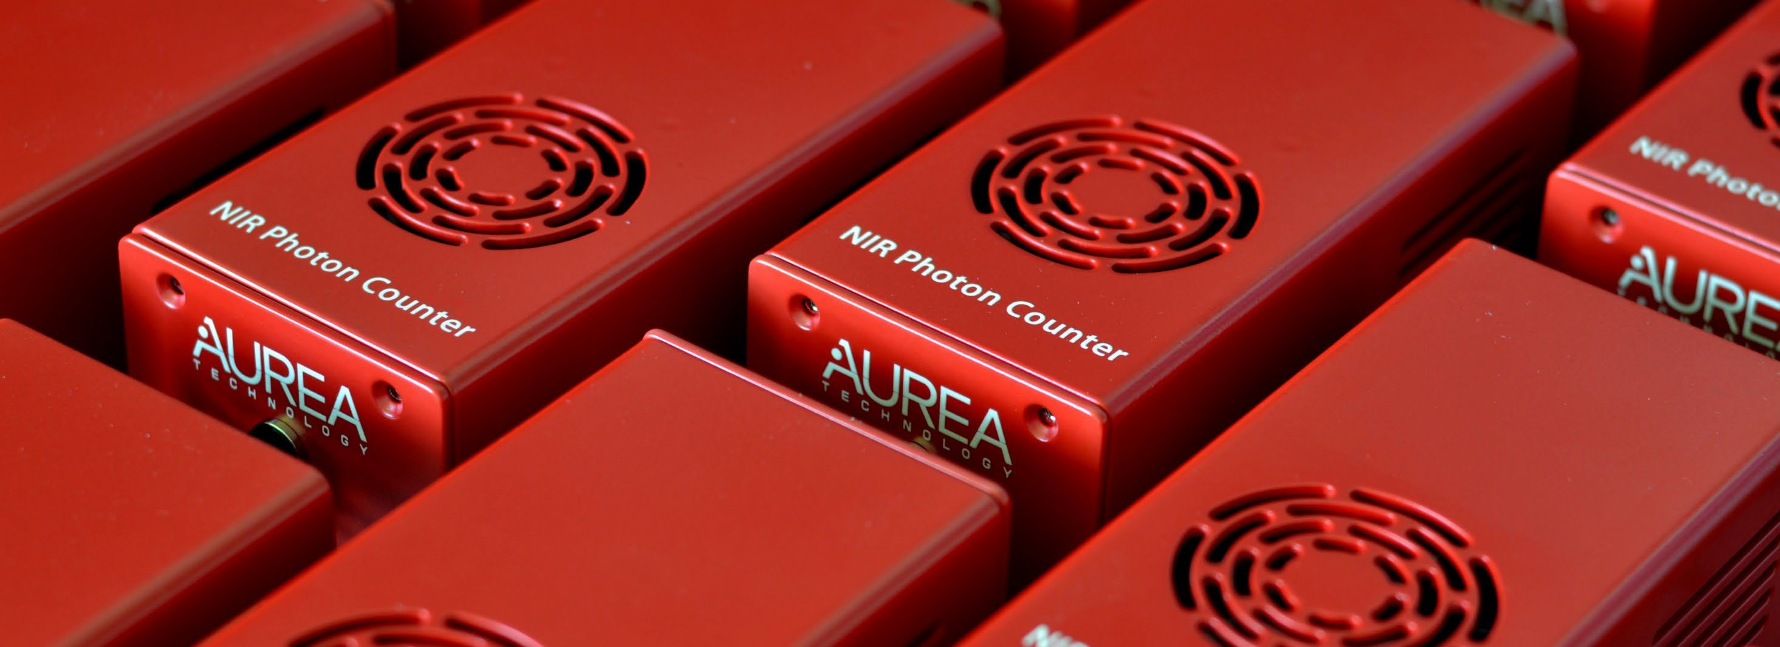


WDM Entangled Quantum Communications at OFCnet
Jerome Prieur, March 2024, OFCnet San Diego
Copyright 2024 AUREA Technology
2024 | 1

Slide 44



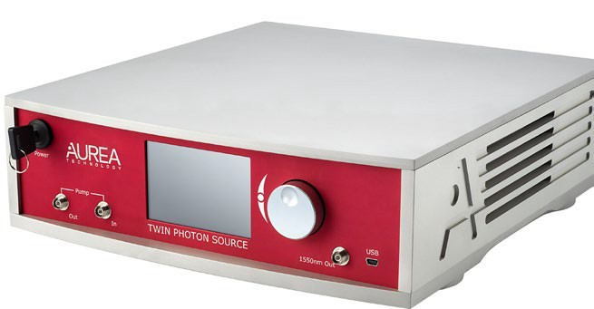
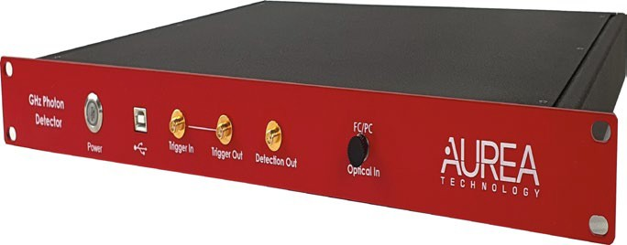
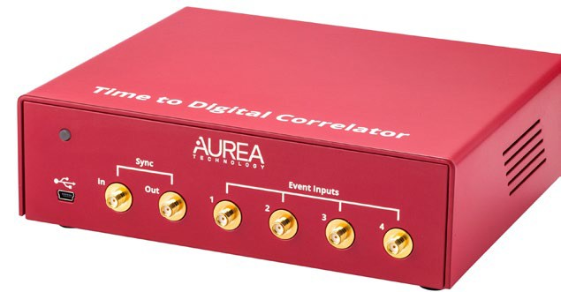
World-class
Quantum-safe Communications
Entangled Photon Sources Single Photon Detectors Time taggers
Visit us booth 1018 at OFC on 24-26 March 2024 in San Diego

Slide 45
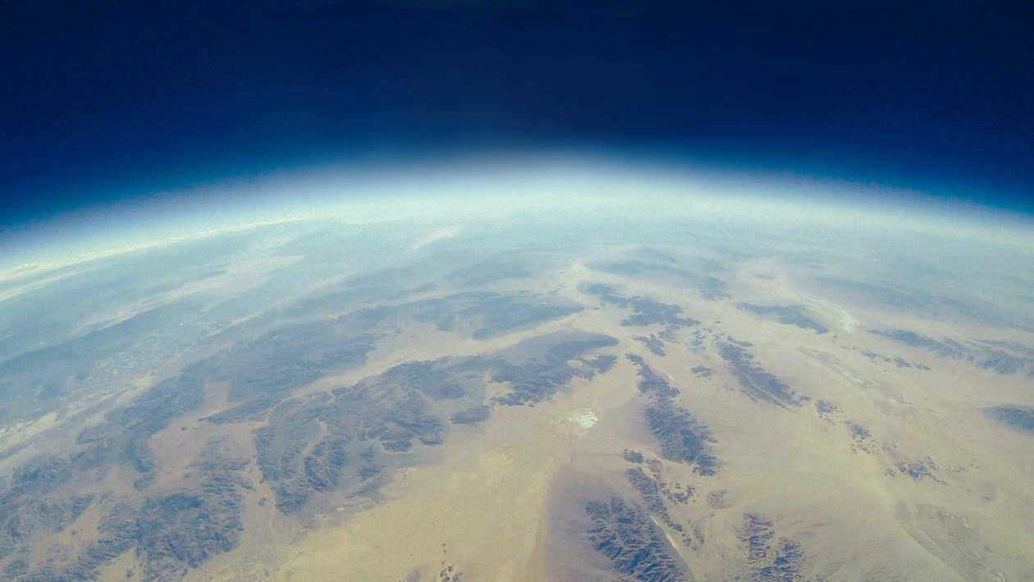




WDM Entangled Quantum Communications
WDM Entangled Quantum Emitters
Ground Station 1
Ground Station 2
WDM Quantum receivers
Secure Key Exchange
Single Photon Detection
Single Photon Detection
Copyright 2024 AUREA Technology
2024 | 3

Slide 46
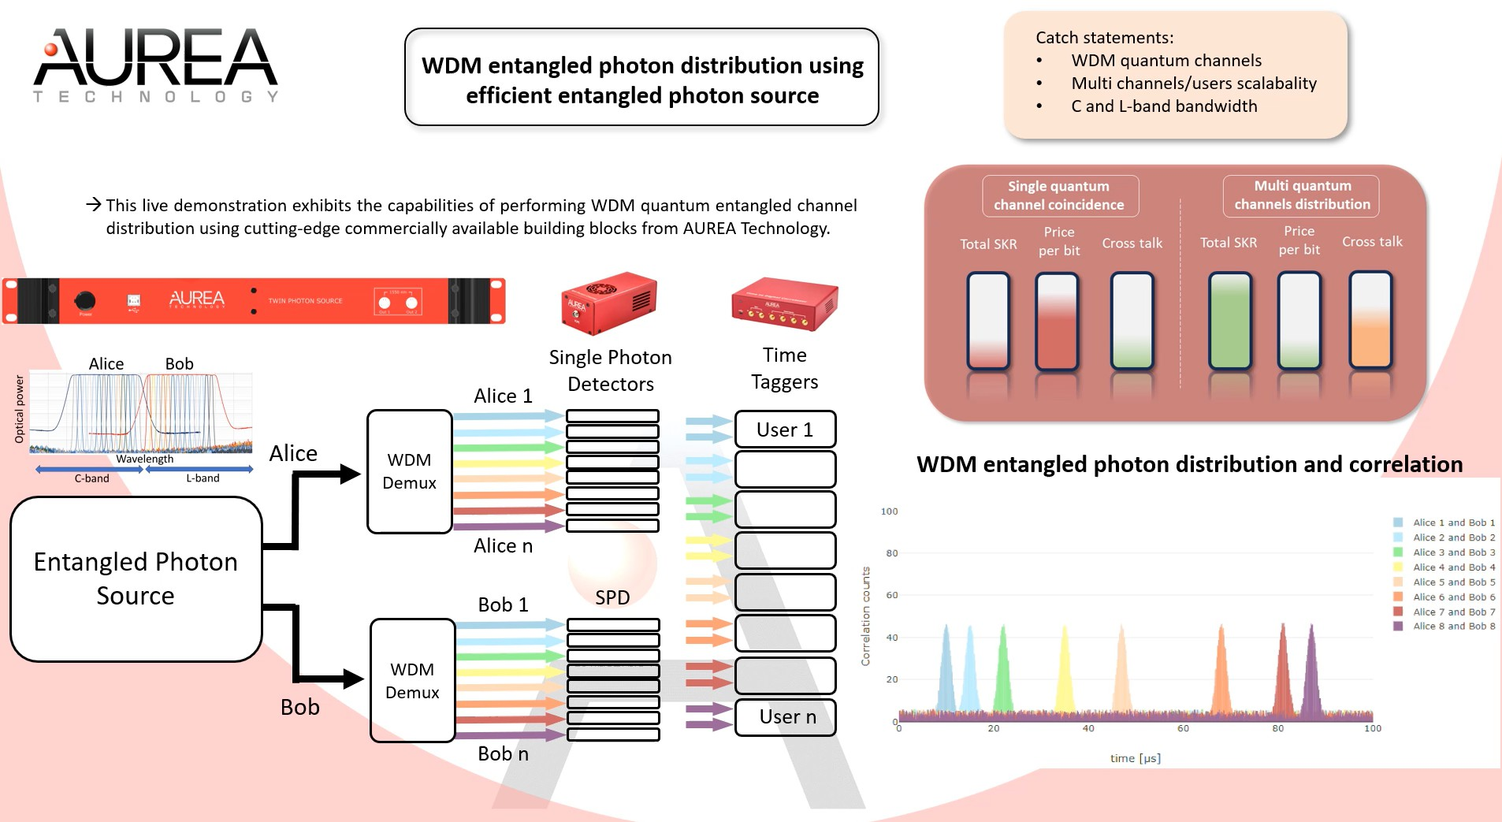
Copyright 2024 AUREA Technology
2024 | 4

Slide 47
Thank you!
Jerome Prieur, CEO and co-founder
Copyright 2024 AUREA Technology
2024 | 5

Slide 48
Program

Slide 49
OFC 2024 Ethernet Alliance Panel
“Lessons Learned from Preparing interoperbility demonstrations…”
David J. Rodgers
24 March 2024

Slide 50

The Ethernet Alliance
A Global Community of End Users, System Vendors, and Component Suppliers
Our Mission
  To promote industry awareness, acceptance and advancement of technology and products based on, or dependent upon, both existing and emerging IEEE 802 Ethernet standards and their management.
  To accelerate industry adoption and remove barriers to market entry by providing a cohesive, market-responsive, industry voice.
  Provide resources to establish and demonstrate multi-vendor interoperability.

Slide 51
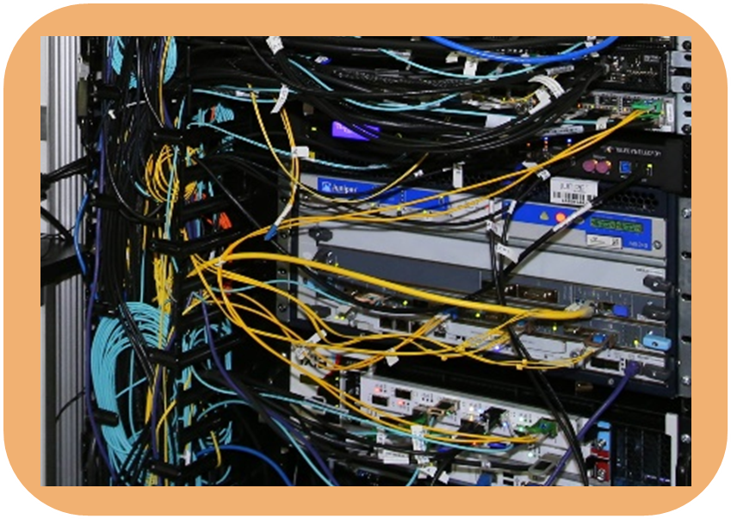
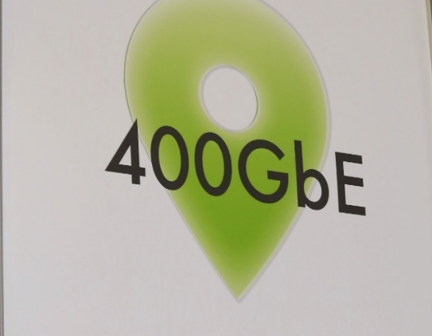

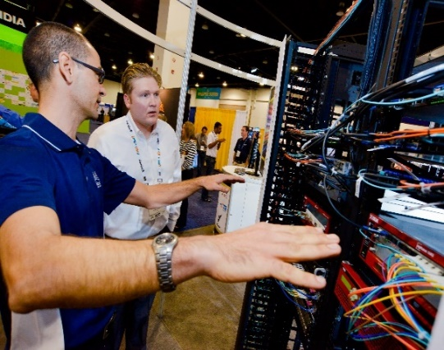
The Ethernet Alliance – (if there was only 1 thing)
Investment in Multi-vendor Interoperability
Plugfests
  High Speed Networking
  NBASE-T
  SPE
Public Demonstrations
Trade Shows
  OFC
  SC
  ECOC
  BICSI

Slide 52
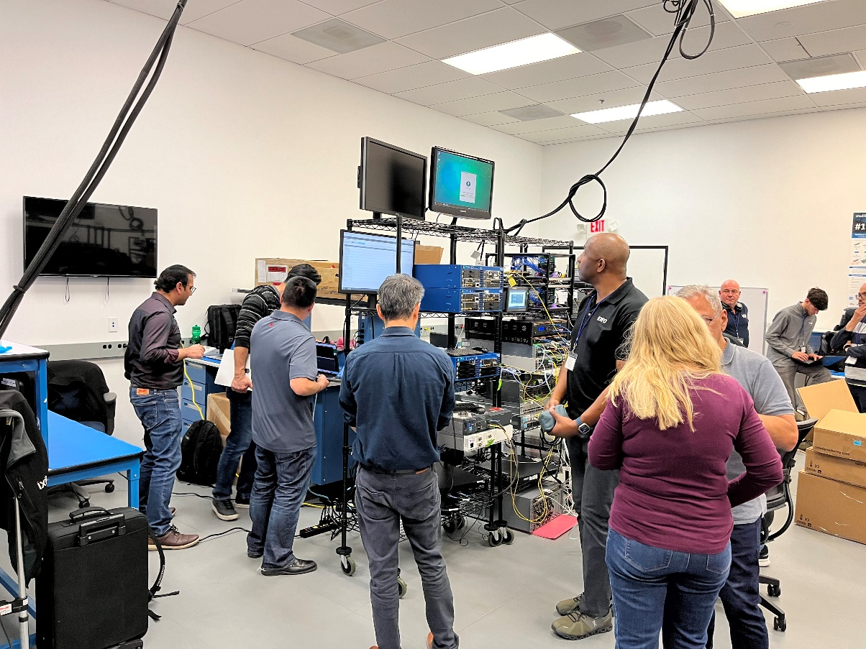
Building the Demo requires a TEAM!
Coordinator/Coach
On-Field Captains - Tech Leads
Position Players
Practice, practice, practice
Provide resources to enable the success of the demonstration and multi-vendor interoperability.

Slide 53
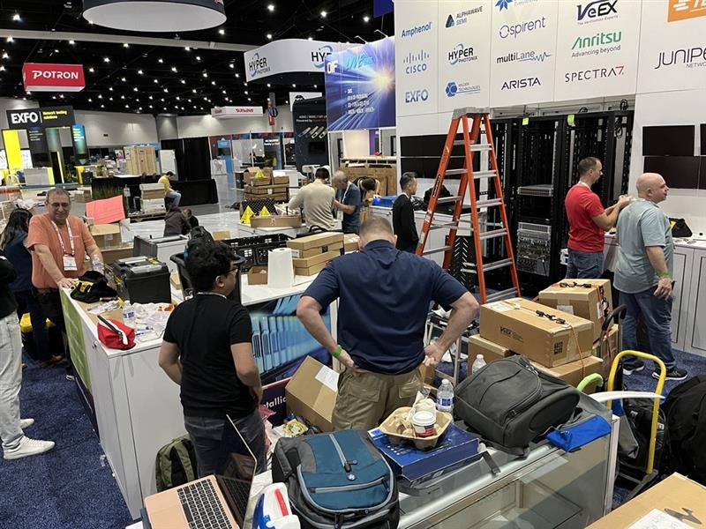
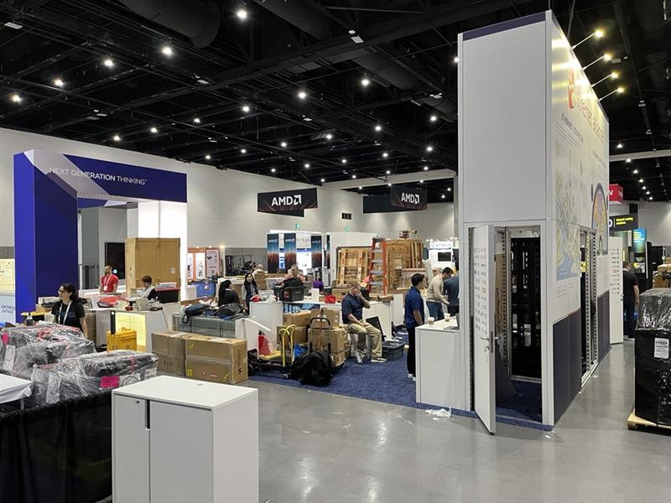
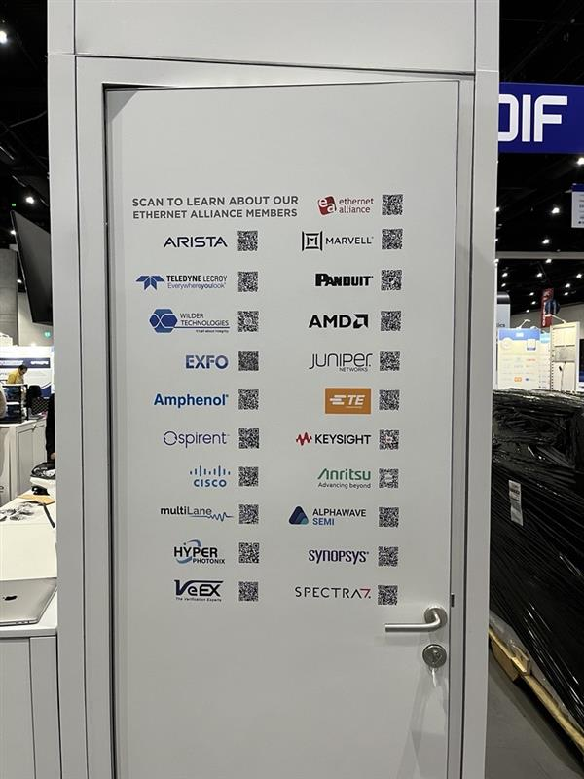
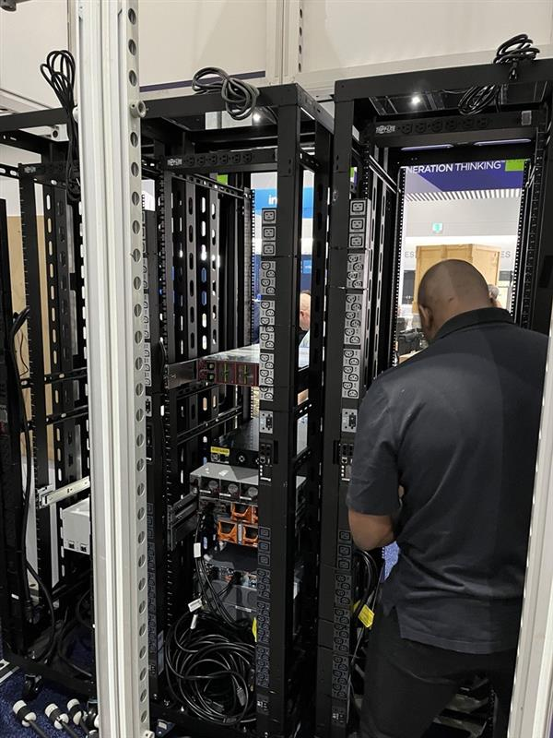
Chaos becomes Cohesion

Slide 54
Learn More About Ethernet Alliance
Ethernet Alliance:
visit www.ethernetalliance.org;
Follow @EthernetAllianc on Twitter
Join the Ethernet Alliance LinkedIn group
Visit the Ethernet Alliance Facebook page
PoE Certification Program:
visit www.ethernetalliance.org/poecert/

Slide 55
Program

Slide 56


Rump Session
Reza Nejabati , Andrew Lord

Slide 57
Objective
Do we need OFC pop-up style optical network test-bed ?
If so, how it should look like ?

Slide 58

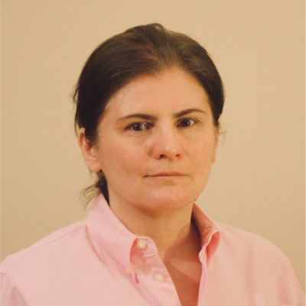
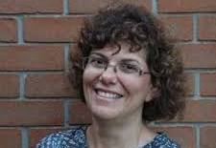

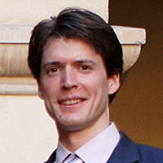
Rump Session Speakers
Jorg-Peter Elbers, Adtran, Germany
Julia Larikova, Infinera, United States
Dimitra Simeonidou, University of Bristol, United Kingdom
Prem Kumar, Northwestern University, United States
Ben Dixon, MIT Lincoln Laboratory, United States

Slide 59
Questions
Do we require field trial testbeds for scientific and engineering breakthroughs in telecom networks?
Why can't we rely solely on lab-based test-beds, virtual test-beds, and test-bed emulation?
Is there a role for a short-term interop / multi-partner PoC, compared to longer-term standards-based trials ( e.g. OIF)?
Is there any role/place for a pop-up short term test-bed?
What are the essential features of a field trial testbed for future telecom?
What role do fiber/optical networks play in a holistic telecom network testbed?
Is OFC a right venue for such a test-bed ? Why not MWC…, Where that would be?
Who are target users?

Slide 60
Program

Slide 61
Boston Area Quantum Network Testbed Development
P. Ben Dixon – MIT Lincoln Laboratory
Presented at OFC Conference 2024
24 March 2024
DISTRIBUTION STATEMENT A. Approved for public release. Distribution is unlimited.
This material is based upon work supported by the National Reconnaissance Office under Air Force Contract No. FA8702-15-D-0001. Any opinions, findings, conclusions or recommendations expressed in this material are those of the author(s) and do not necessarily reflect the views of the National Reconnaissance Office.
© 2024 Massachusetts Institute of Technology.
Delivered to the U.S. Government with Unlimited Rights, as defined in DFARS Part 252.227-7013 or 7014 (Feb 2014). Notwithstanding any copyright notice, U.S. Government rights in this work are defined by DFARS 252.227-7013 or DFARS 252.227-7014 as detailed above. Use of this work other than as specifically authorized by the U.S. Government may violate any copyrights that exist in this work.

Slide 62
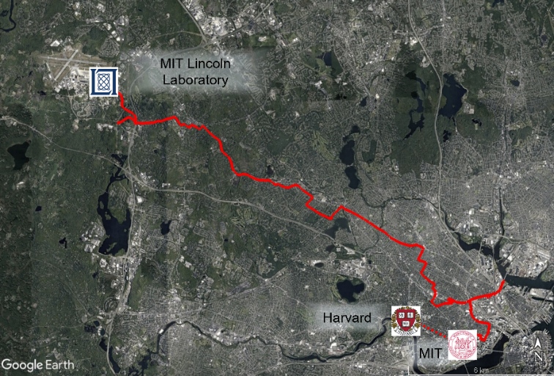
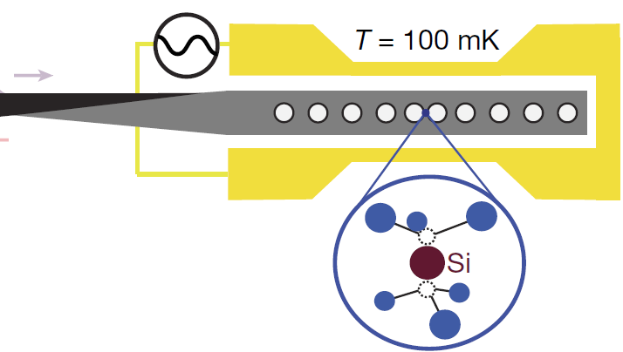
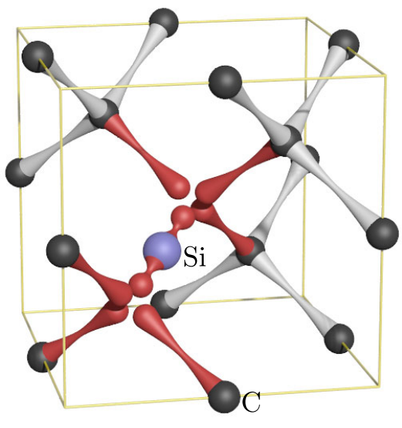
Boston-Area Quantum Networking Testbed
Quantum Network Testbed Goal
Develop capabilities to incorporate emerging quantum memory technologies into Boston-area fiber testbed
Silicon Vacancy Quantum Memory System
Boston-area Quantum Network Testbed
Two optical fibers from LL to MIT and Harvard
Dark telecom fiber links
50 km optical path length
Color-center in Resonant Cavity
Input Photonic Qubit
Interferometric Qubit Capture Heralding System
Quantum Memory Input Requirements for Photonic Qubits
Timing jitter: <10 ns for low inter-symbol-interference
Polarization jitter: <0.5 radian for high efficiency
Optical frequency noise: <1 MHz for low error heralding
Flux: <10 M photons per sec (-90 dBm) to avoid saturation
Testbed Development Effort
Characterize fiber-induced degradations
Design fiber compensation system that maintains photonic qubits an operates with -90 dBm noise floor
Test system by transmitting quantum states across compensated fiber and capturing them in quantum memory
Notes:
Plant = means that we just rented it
DSF = dispersion shifted fiber

Slide 63
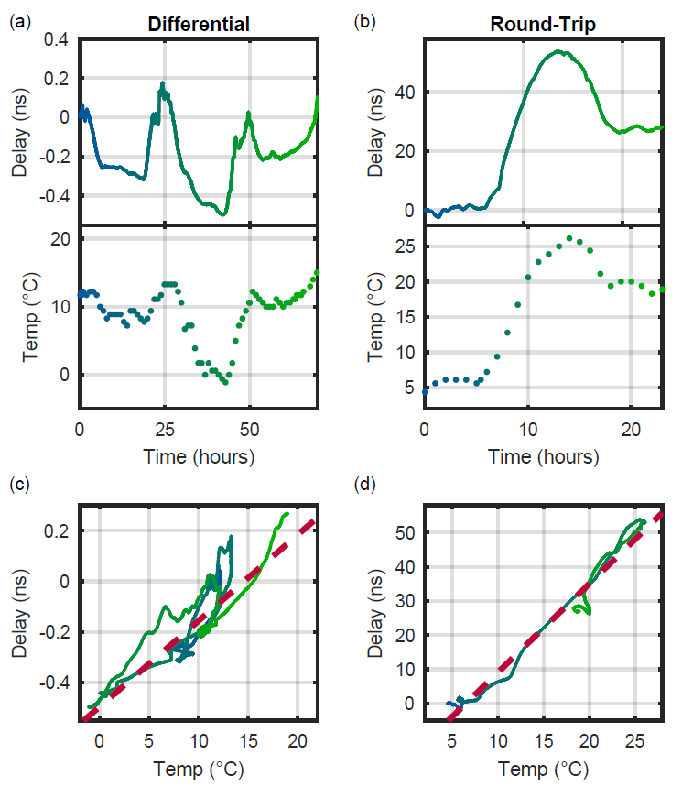
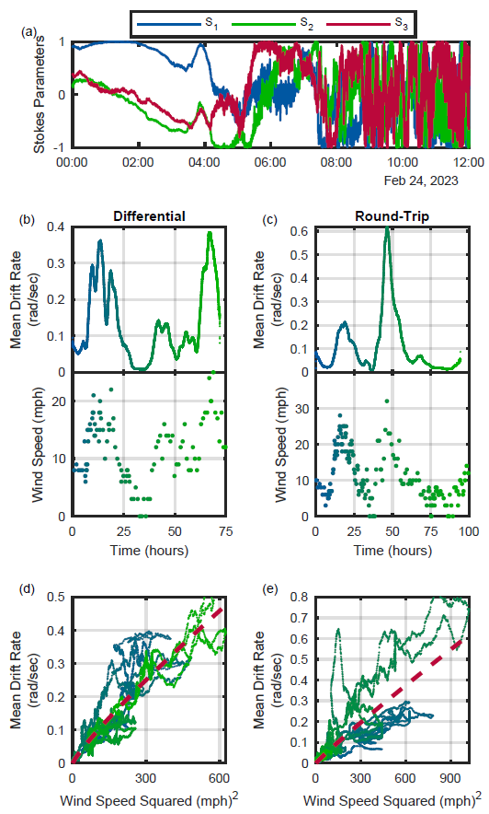
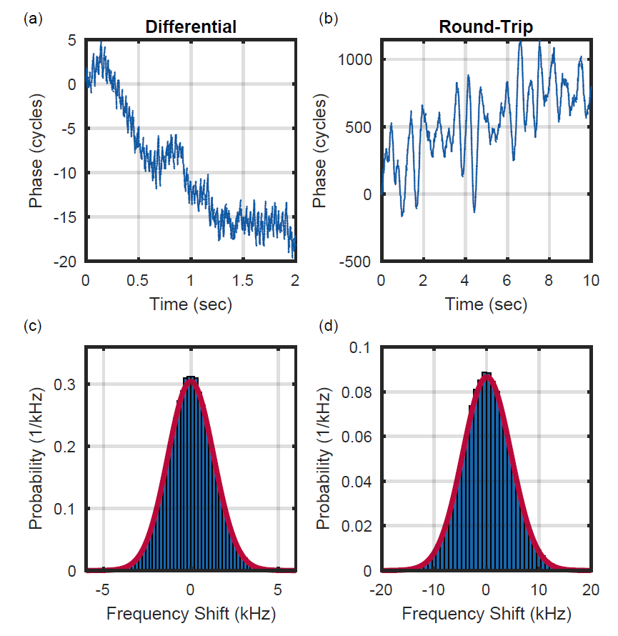
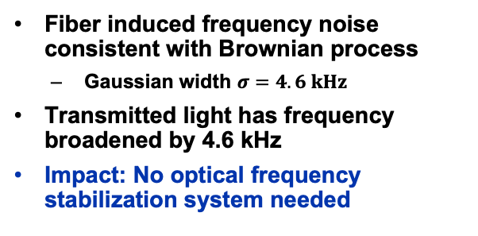


Fiber Channel Characterization
Timing Drift
Requirement: <10 ns timing precision
Polarization Drift
Requirement: <0.5 radian polarization stability
Optical Frequency Noise
Requirement: <1 MHz frequency transfer
Optical Path Length
Ambient Temperature
Polarization Drift Rate
Ambient Wind Speed
Phase Drift
Optical Frequency Spread
Maximum optical fiber path length timing drift of 40 ns
Timing drift highly correlated to ambient temperature
  $2.6 ns/˚C$, $R2=0.96$
Maximum drift rate of 10 ns per hour
Impact: Minute-class time synchronization needed
Polarization drift rate drift correlated to environmental wind speed
  $1.7 {mrad}/{sec⋅mph^{2}}$, $R2=0.42$
Maximum drift rate of 0.5 radians per second
Impact: Second-class polarization stabilization needed
Fiber induced frequency noise consistent with Brownian process
  Gaussian width $σ=4.6 kHz$
Transmitted light has frequency broadened by 4.6 kHz
Impact: No optical frequency stabilization system needed
Fiber-induced degradations characterized, second-class timing synch ad polarization stabilization needed, optical frequency can be transferred without active fiber stabilization

Slide 64



Integrating Quantum Memories into Quantum Network
Integrated Fiber Compensation System and Qubit Transmitter
Cross-Fiber Qubit-Memory Interaction
First Light Data
Qubit Characterization
Transmitter at LL
Timing Reference
30
20
10
0
Qubit type 2 stored and measured
Pol and Freq Reference
Qubit Measurement Signal
(thousands of photons)
Qubit type 1 stored and measured
Photonic Qubit Generation
0 | 500 | 1000
Polarization and Frequency Reference (1350 nm)
1 second repetition rate
AOM and Mems-based VOA gives 120 dB of extinction for low noise floor
Timing Reference (1550 nm)
1 sec repetition rate
200 nm spectral separation gives high extinction (>100 dB) for low noise floor
Time (msec)
Testbed Development Effort
Fiber compensation built and integrated with fiber testbed and quantum memory
Preliminary data confirmed noise floor operation of system
Full characterization demonstrates 87% fidelity transfer of transmitted qubit into quantum memory
Transmitter at Harvard
High contrast indicates ultra-low noise floor
Photonic Qubit (1350 nm)
Time bin weak coherent state qubits

Slide 65
Program

Slide 66
The UK’s Joint Open Infrastructure for Networks Research (JOINER)
Dimitra Simeonidou, University of Bristol, UK

Slide 67
JOINER
A UK national testbed with representative heterogeneity, complexity and scale
Provides key scientific instrumentation for future networks research
Enabling experimental collaboration, introducing new technologies, services and applications resulting from academic and industrial R&D programmes
A platform to accelerate TRL advancement of early-stage research and provide credible experimental evidence towards the introduction of new IP and standards
A place for hands-on training on telecoms systems and therefore a key contributor to a national (multidisciplinary) skills development pipeline.
It will allow to explore new research questions challenging end-to-end assumptions and developing system thinking to Future Networks research:
  Evaluation of Machine Learning algorithms for large scale networks
  System-wide energy consumption optimisation in 6G networks
  Evaluation of end-to-end and multi-layer network security solutions
  Global automated spectrum management and assignment techniques

Slide 68



























Glasgow: RF research and Wireless Networks (UoGlasgow), Scotland 5G Centre
UoLeeds:
Edge, Cloud, THz, mmWave, immersive and agritech
applications
Terminal
QUBelfast: Signal Processing, Communications Theory, wireless systems simulation and emulation platforms
Terminal
Terminal
UoCambridge: Quantum Comms, III-V Photonics, Optical Wireless, NDFF
Cranfield Uni: Satellite and Autonomous Systems
Fabric
Terminal
Terminal
NDFF
London: Imperial (Cloud, Information Theory, AI/ML), UCL (THz, NDFF), Digital Catapult (SONIC)
UoBristol: E2E Networks, Convergence, Control, Management, 5G O-RAN testbeds, Digital Twin facilities, Quantum Nets, AI Isambard Supercomputer, International connectivity, FABRIC
Terminal
Terminal
UoSouthampton:
New fibre, Optical comms, Wireless & Satellite comms, Silicon Photonics,
NDFF
Terminal
Terminal
UoOxford: Quantum Computing, free space optical comms

Slide 69


















JOINER Brain: Measurements, Orchestration, Management, AI computation and Digital twin platforms
Labs and/or testbeds in the JOINER NODES
Local Experimenters
User Portal
JOINER Terminal
Hybrid Private-Public Cloud: Virtual Infra Hosting
User Equipment
mmWave
/THz
WIFI
B5G/6G
LiFi
Fibre Broadband
Sensing Spectrum
Multi-access control
Edge Cloud
JOINER Fabric
MEC
Physical Infrastructure: L0, L1, L2, L3 and satellite connectivity
Programmable Switching and Routing
Access Network

Slide 70
Program

Slide 71

Workshop S1A, OFC’24
24 March 24
How Can OFC, with a Real-Life Test-Bed, Accelerate Innovation in the Optical Photonic Networks?
Prem Kumar
Professor, ECE & Physics
Center for Photonic Communication and Computing
Northwestern University
E-mail: kumarp@northwestern.edu

Slide 72

Illinois Express Quantum Network (IEQNET)

Slide 73

IEQNET Topology
J. Chung, G. Kanter, N. Lauk, R. Valivarthi, W. Wu, R. R. Ceballos, C. Peña, N. Sinclair, J. Thomas, S. Xie, R. Kettimuthu, P. Kumar, P. Spentzouris, and M. Spiropulu, “Illinois Express Quantum Network (IEQNET): metropolitan-scale experimental quantum networking over deployed optical fiber,” Proc. SPIE 11726, 1172602 (12 April 2021); https://doi.org/10.1117/12.2588007.

Slide 74


IEQNET Physical (proposed)

Slide 75

IEQNET’s Quantum Networking Architecture (three planes)
Vol. 3, 4100920 (2022) |

Slide 76


OFC’24 Demo Zone (#M3Z.4, Room 6B)
Monday, 25 March 2024

Slide 77




Quantum Classical Coexistence in the IEQNET
Time Synchronization
1310 nm classical clock light coexisting with 1536 nm photon pairs for picosecond synchronization over 59 km
2. O-band Quantum Networking Beyond Dark Fiber
Coexistence with milliwatt power C-band classical light over >45 km fiber using O-band quantum entangled photons

Slide 78


O-band Pol. Ent. Visibility vs.
Pair Rate w/ C-band Coexistance
Using the optimal quantum channel and narrow spectral-temporal filtering, >95% fidelity to the nearest Bell state is achieved with >18 dBm C-band power.
[2304.09076] Designing Noise-Robust Quantum Networks Coexisting in the Classical Fiber Infrastructure (arxiv.org)

Slide 79





Quantum Teleportation Coexisting with 11 dBm 400 Gbps C-band Signal

Slide 80









OFC’23 Show Floor Demo
Gregory Kanter
kanterg@nucrypt.net

Slide 81



Demonstration Objectives
Distribution of Quantum Entanglement through Fiber with Co-Propagating Classical Data | IEEE Conference Publication | IEEE Xplore

Slide 82

Reilly, Kanter, & Moraw at
OFC’23 Show Floor

Slide 83


OFC’24 Show Floor Demo

Slide 84
Reflections on the Assigned Questions
Do we require field trial testbeds for scientific and engineering breakthroughs in telecom networks? Why can't we rely solely on lab-based test-beds, virtual test-beds, and test-bed emulation?
What are the essential features of a field trial testbed for future telecom?
What role do fiber/optical networks play in a holistic telecom network testbed?

Slide 85
Program

Slide 86
Large scale field testing
Julia Larikova
March 2024, OFC 2024
S1A

Slide 87
Large scale FOAs
Three known use cases:
  SOP sensing and coherent OTDR
    Requires access to real life transmission fiber and a LOT of it
    Long term data collection on different fibers from same cable, same direction
    Metro behavior vs. ULH
    Location matters – strong weather (electric storms vs. earthquakes)
  openROADM type of environment
    openROADM API and MSA is well defined but link control and timing of power control isn’t
    Lab environment isn’t sufficient to truly test 2-3 vendors of optical line systems when it comes to any kind of interop
    Need 40+ to 100+ NEs to validate power stability under outrage and power failure conditions
    Openconfig, IOWN etc – more interop standards to come
  Interoperable OFEC, CFEC and OFEC-PCS formats
    OIF studies show a huge 4-9dB interop penalties which are poorly understood
    No studies over real-life CD or PDL
    No studies over large sample of parts

Slide 88
Program

Slide 89



What is the role of field trial testbeds in comms R&I?
OFC 2024 – Workshop S1A – Real-life Testbed Innovation
24 March 2024, Jörg-Peter Elbers

Slide 90

Field trial testbeds – why?
Technology Readiness Levels (NASA)
Demonstration, test and validation in
operational environment
Use of real channel characteristics and their temporal/statistical variations
Capability to scale up and out
(# of nodes & domains, geography)
Opportunity for ML data generation & test of ML applications
Replacing a lab fiber with a short strand of field fiber is not a field trial!
2024 © ADTRAN

Slide 91
Some good use cases
Optical transmission
Margin assessment in fiber transmission (esp. under challenging conditions)
Study of atmospheric turbulences & their compensation (e.g. ground-space links)
Exploration of joint communication & sensing (fiber network as sensor)
Stability investigations of quantum key distribution & entanglement schemes
Network control & protocols
Verification of protocol performance and scalability in operational environment
Investigation of new network protocols and their interoperability
ML data generation & model tests
Collection of network performance and fault data sets
Benchmark of models for performance optimization & trouble shooting
2024 © ADTRAN

Slide 92


Thank you
joerg-peter.elbers@adtran.com

Slide 93
Program

